Slide 1
Joints- Elbow Joint, Wrist Joint, Radio-ulnar joint, First carpo-metacarpal Joint
Dr MUKESH SINGLA
Additional Professor
Anatomy
AIIMS Rishikesh

Slide 2
Learning Objectives
Type of joint.
Bones participating in formation of joint and the articular surfaces.
Attachment of capsule of joint.
Ligaments supporting the joint.
Muscles responsible for producing various movements.
Applied aspect of joint.

Slide 3
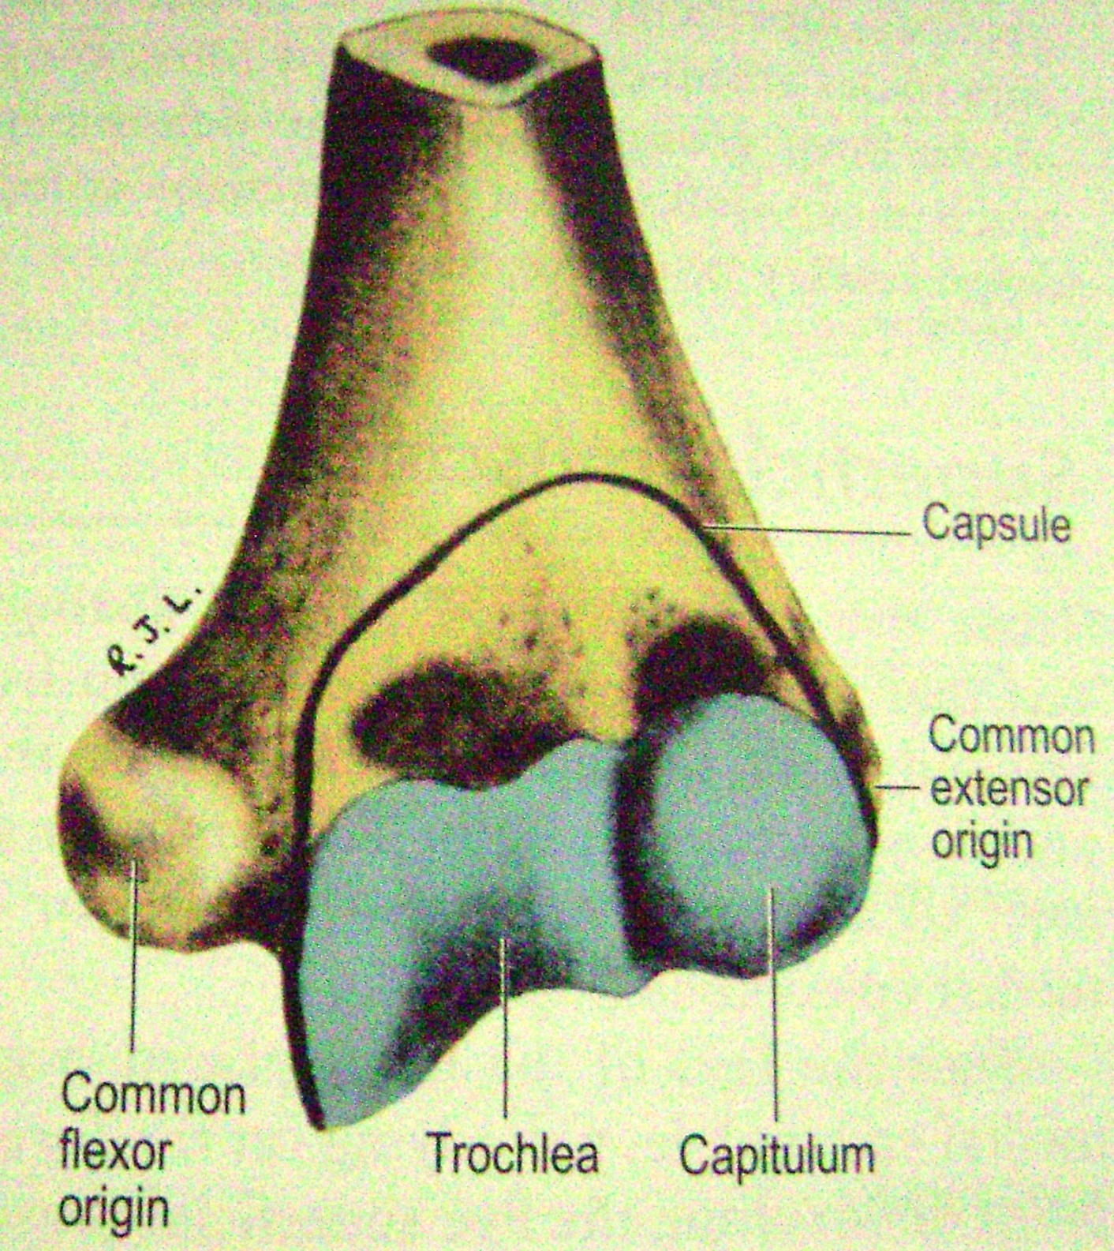

Slide 4
MCQ
Q The characteristics of synovial joints are all of the following except
A Articular surfaces of bones are covered by articular cartilage
B Permit either very limited movements or no movement at all.
C The synovial fluid lubricates the articular surfaces and nourishes articular cartilage
D A fibrous capsule reinforce and supports the joint

Slide 5
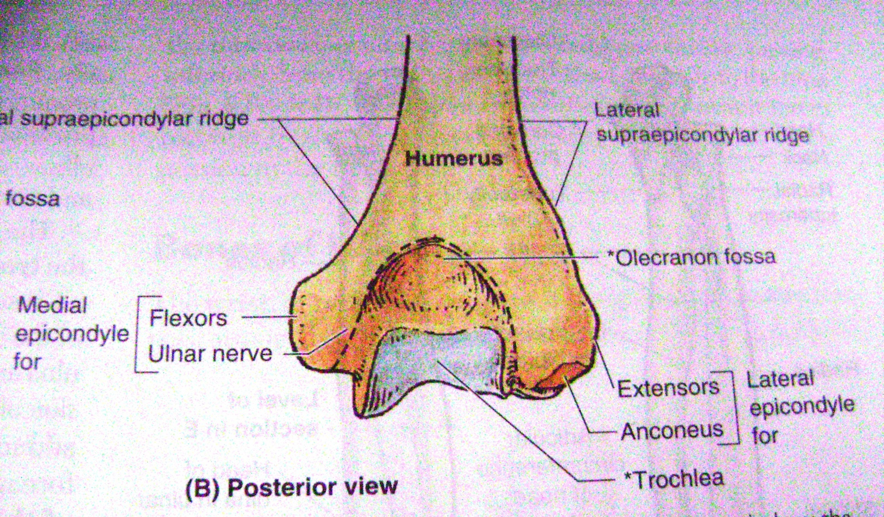

Slide 6
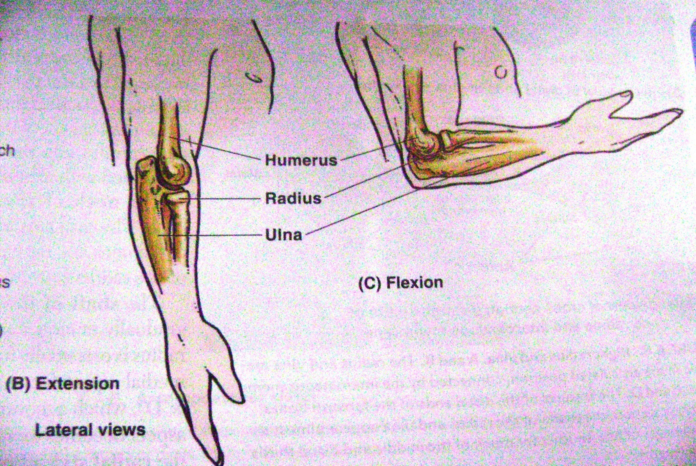

Slide 7
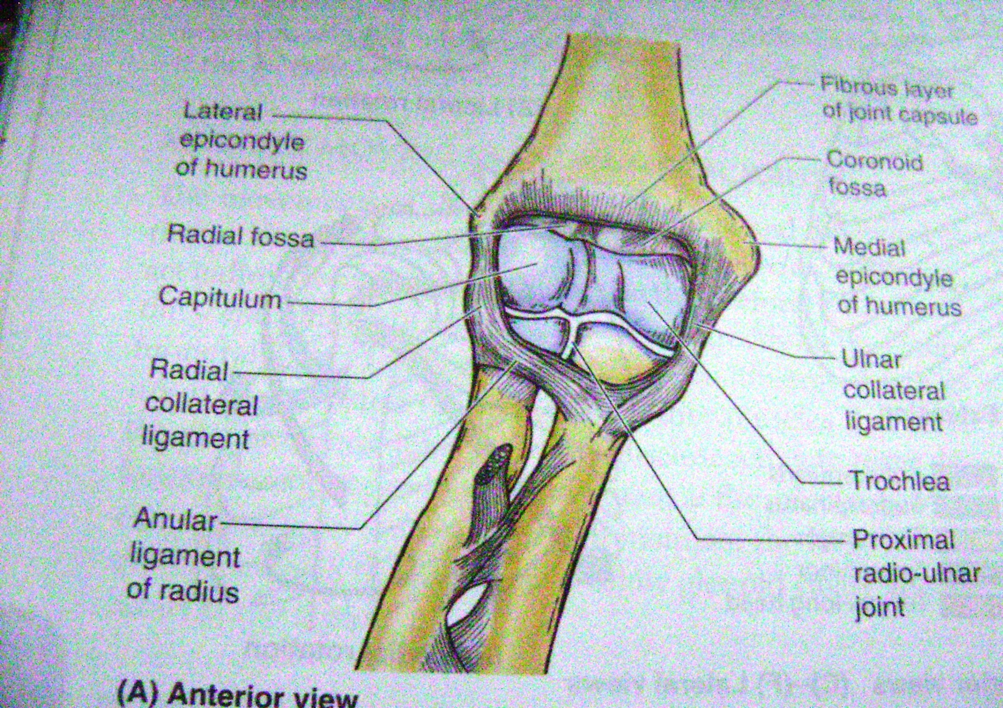

Slide 8
MCQ
Q.All of the following are examples of fibrous type of joints except
A Symphysis
B Sutures
C Syndesmosis
D gomphosis

Slide 9
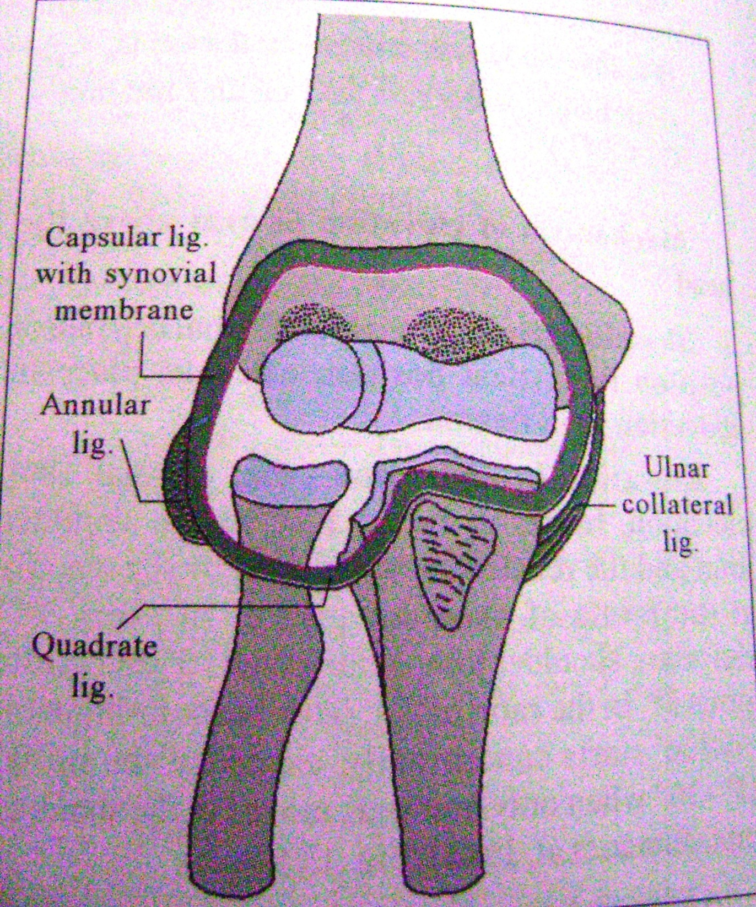

Slide 10
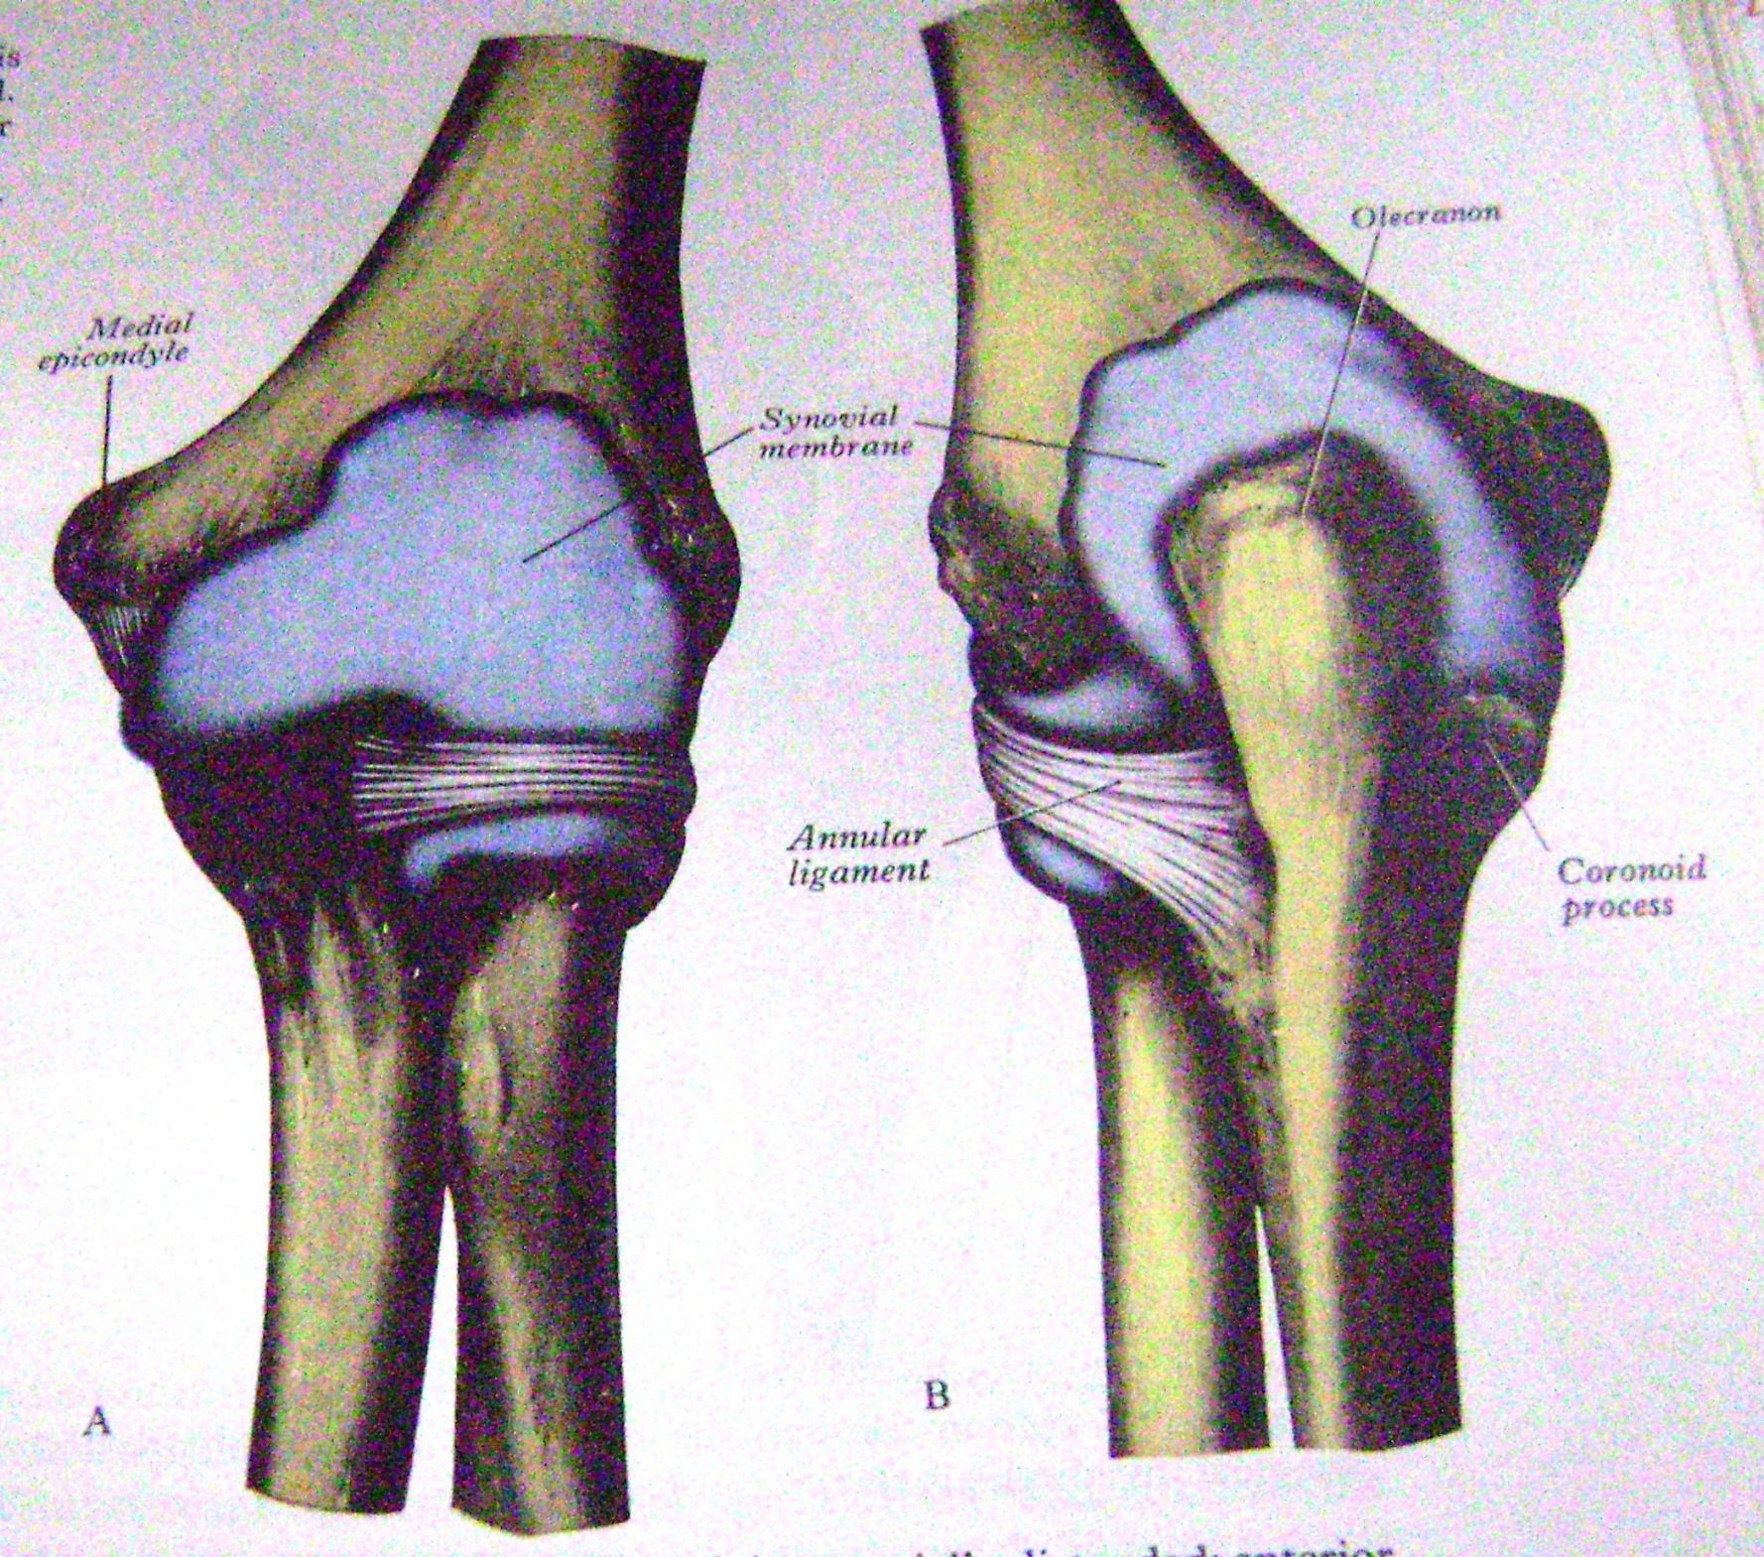

Slide 11
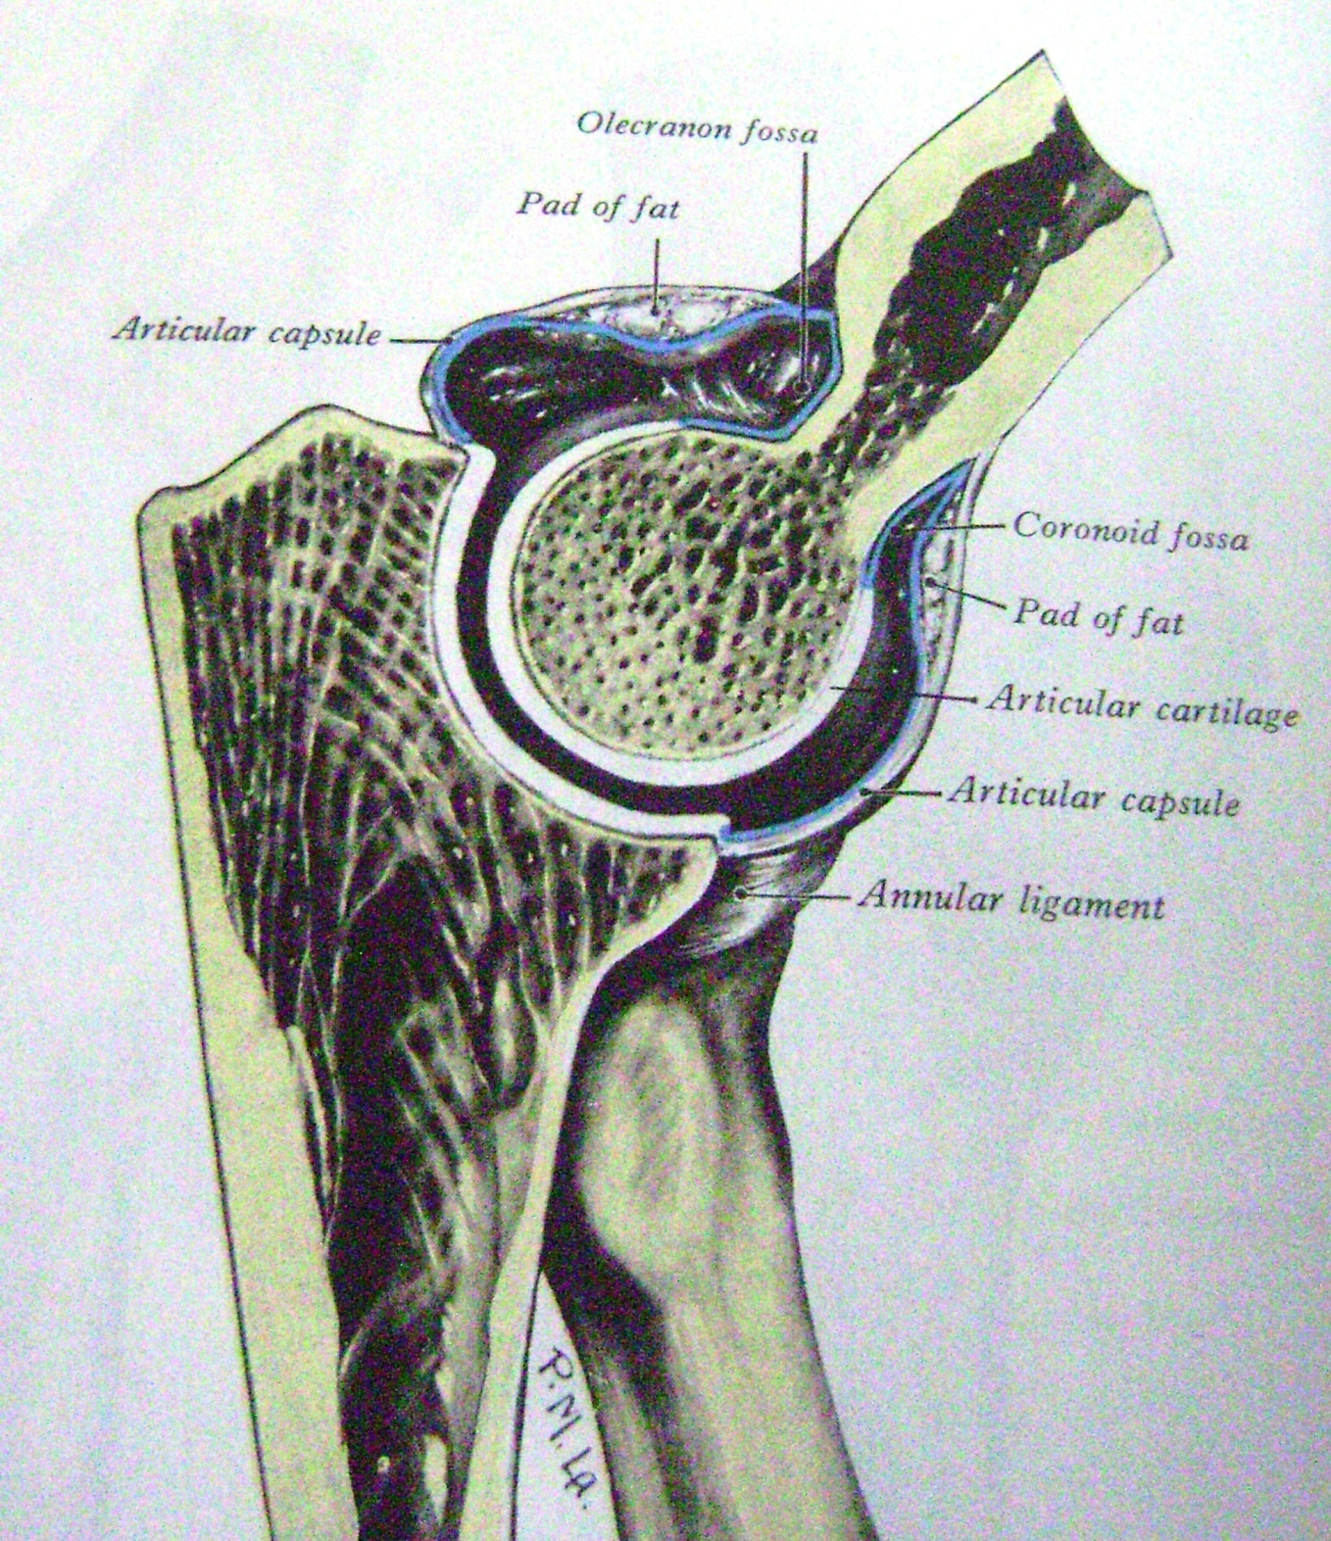

Slide 12
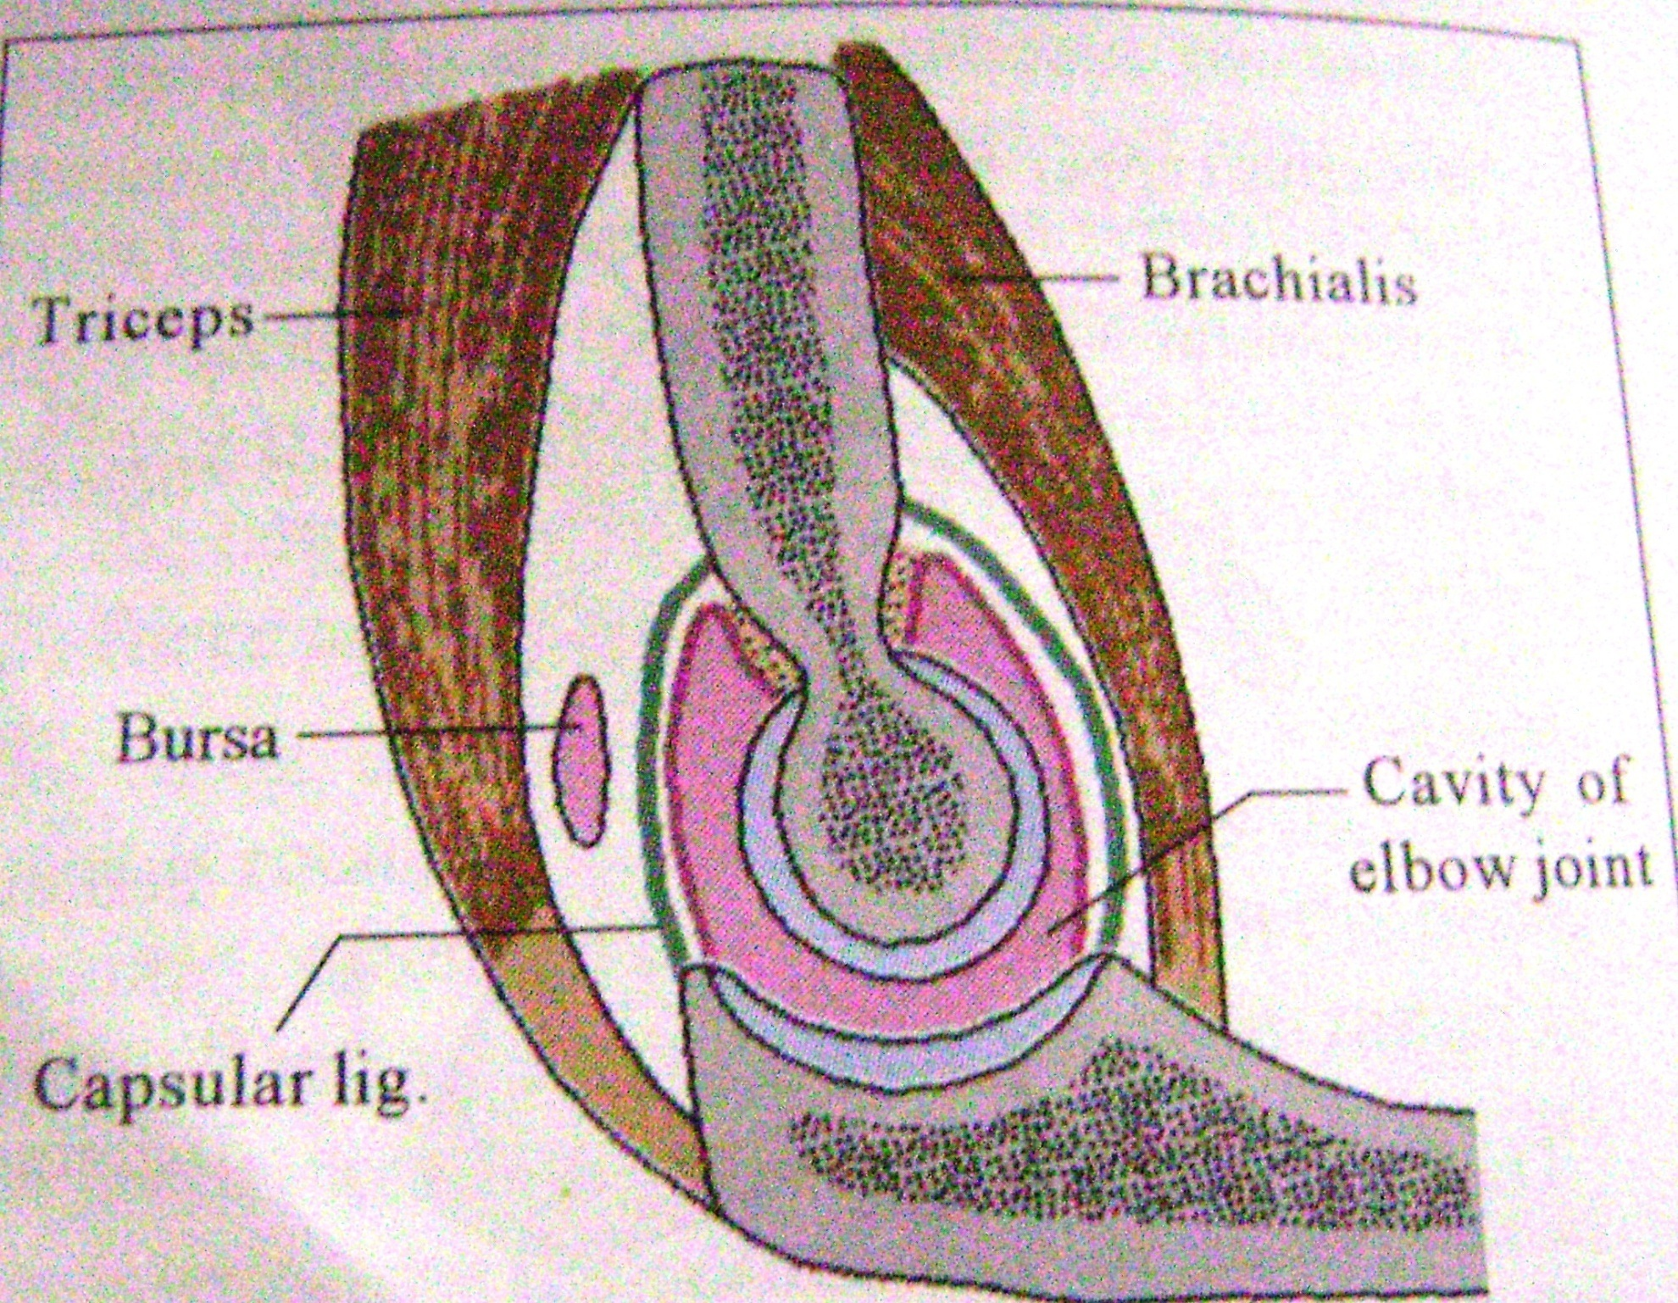

Slide 13
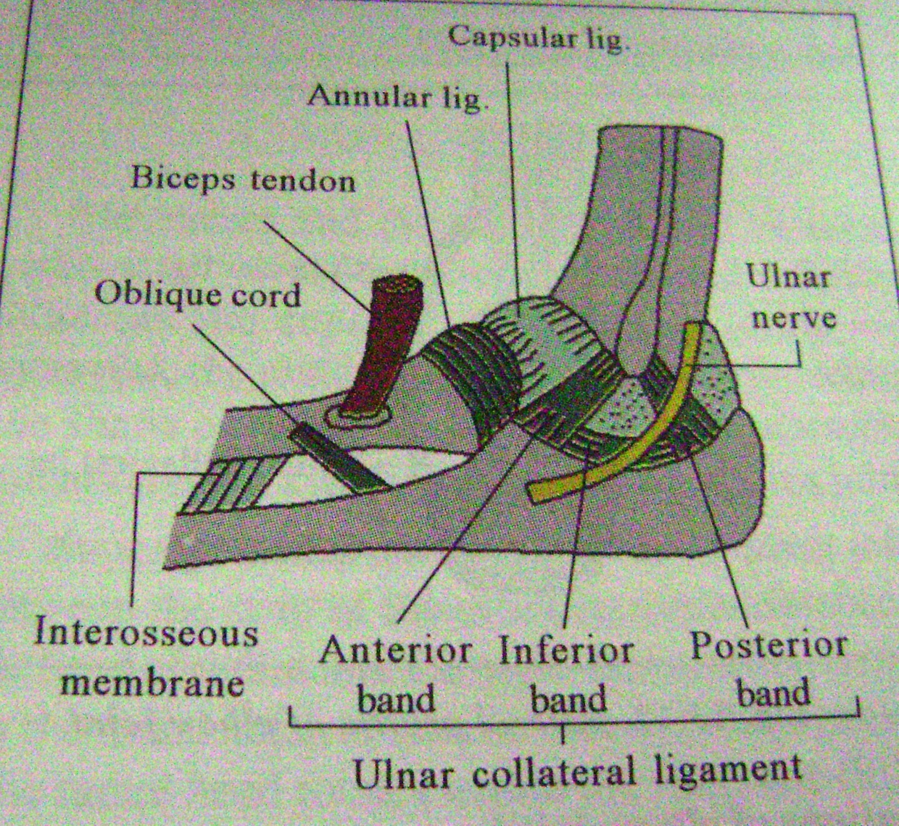

Slide 14
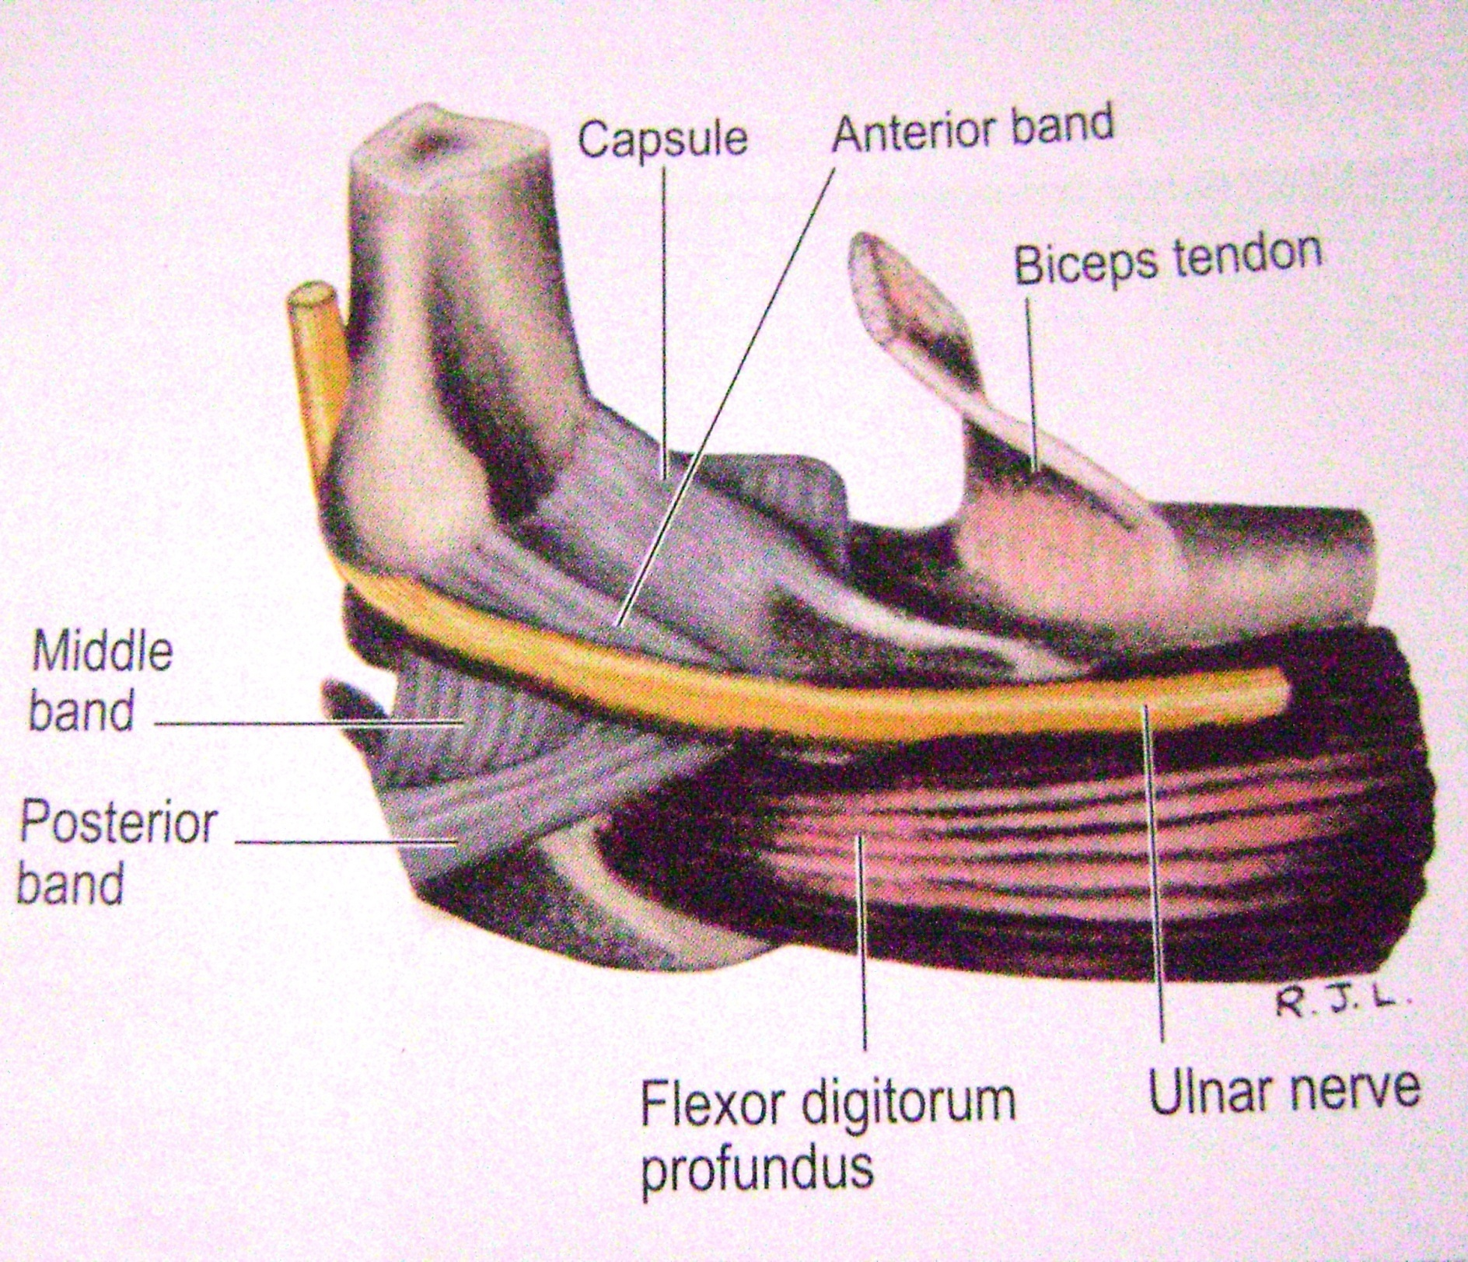

Slide 15
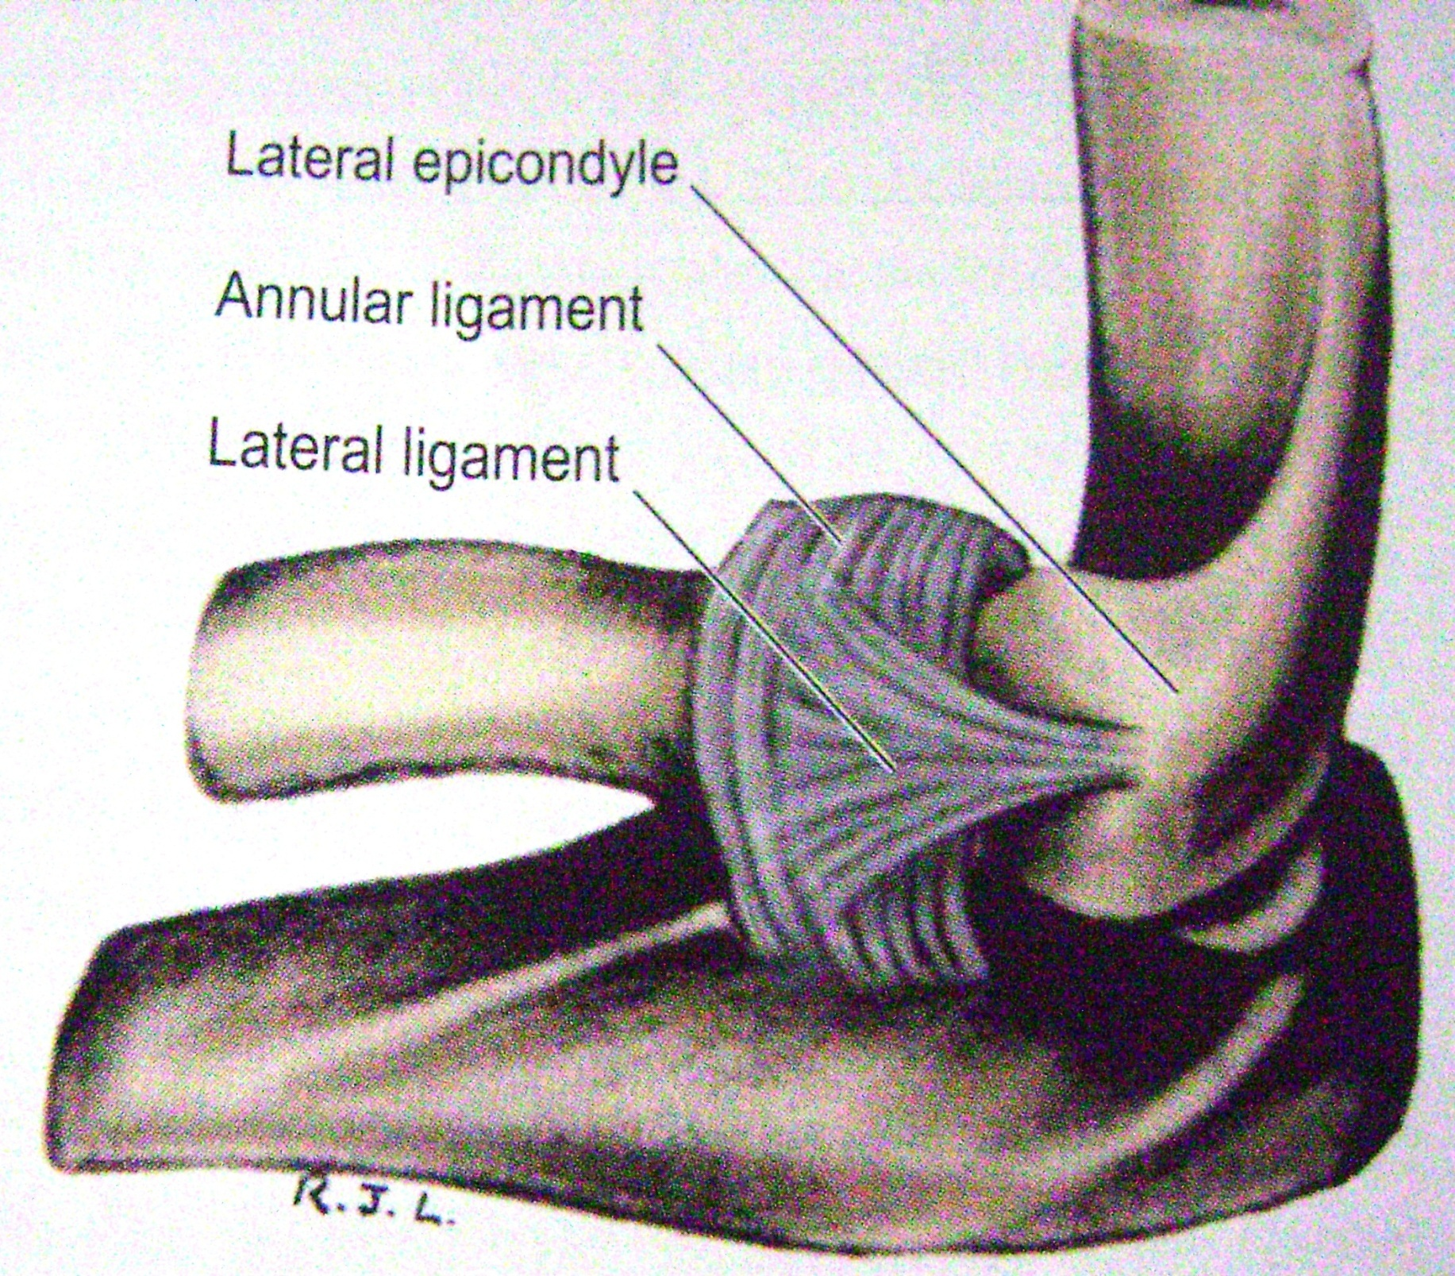

Slide 16
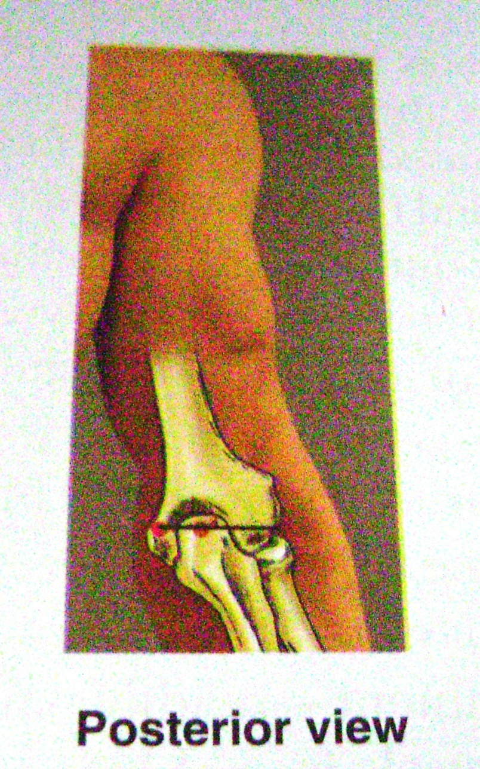
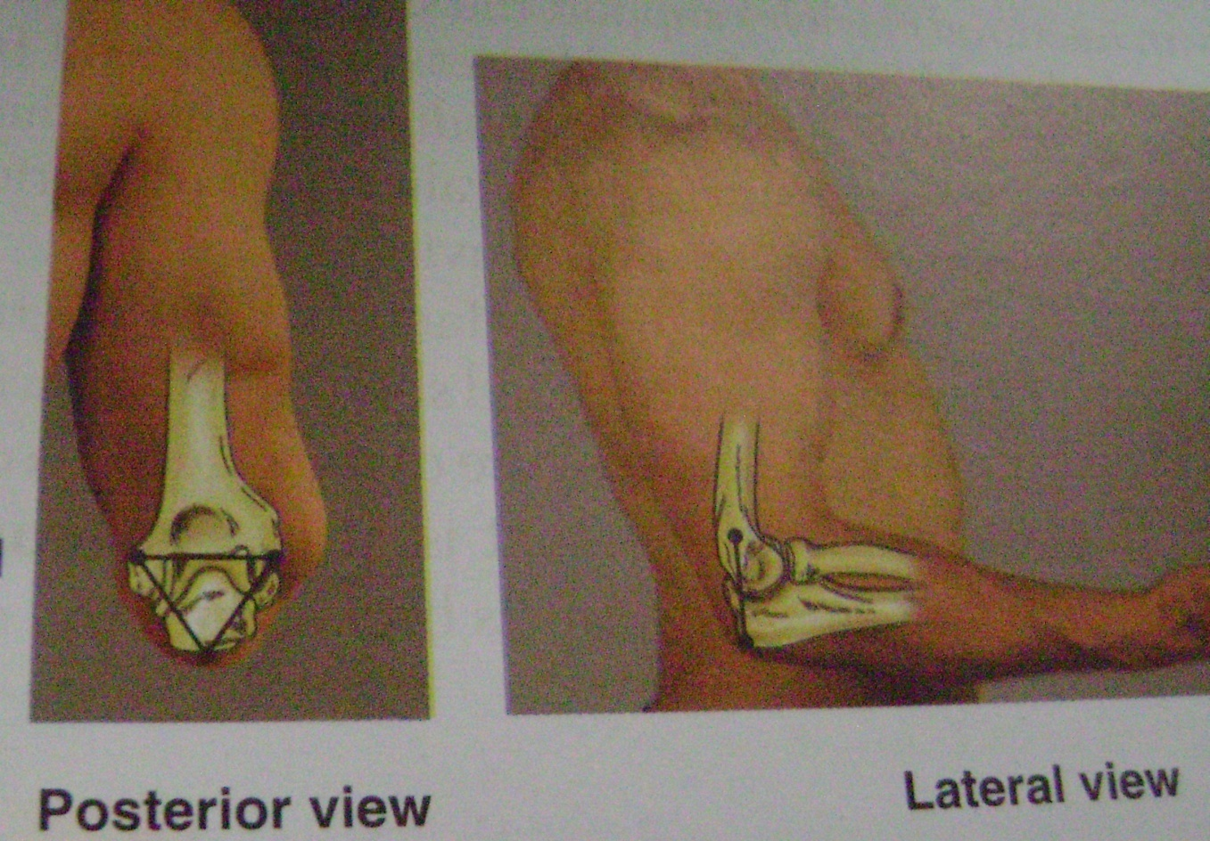

Slide 17
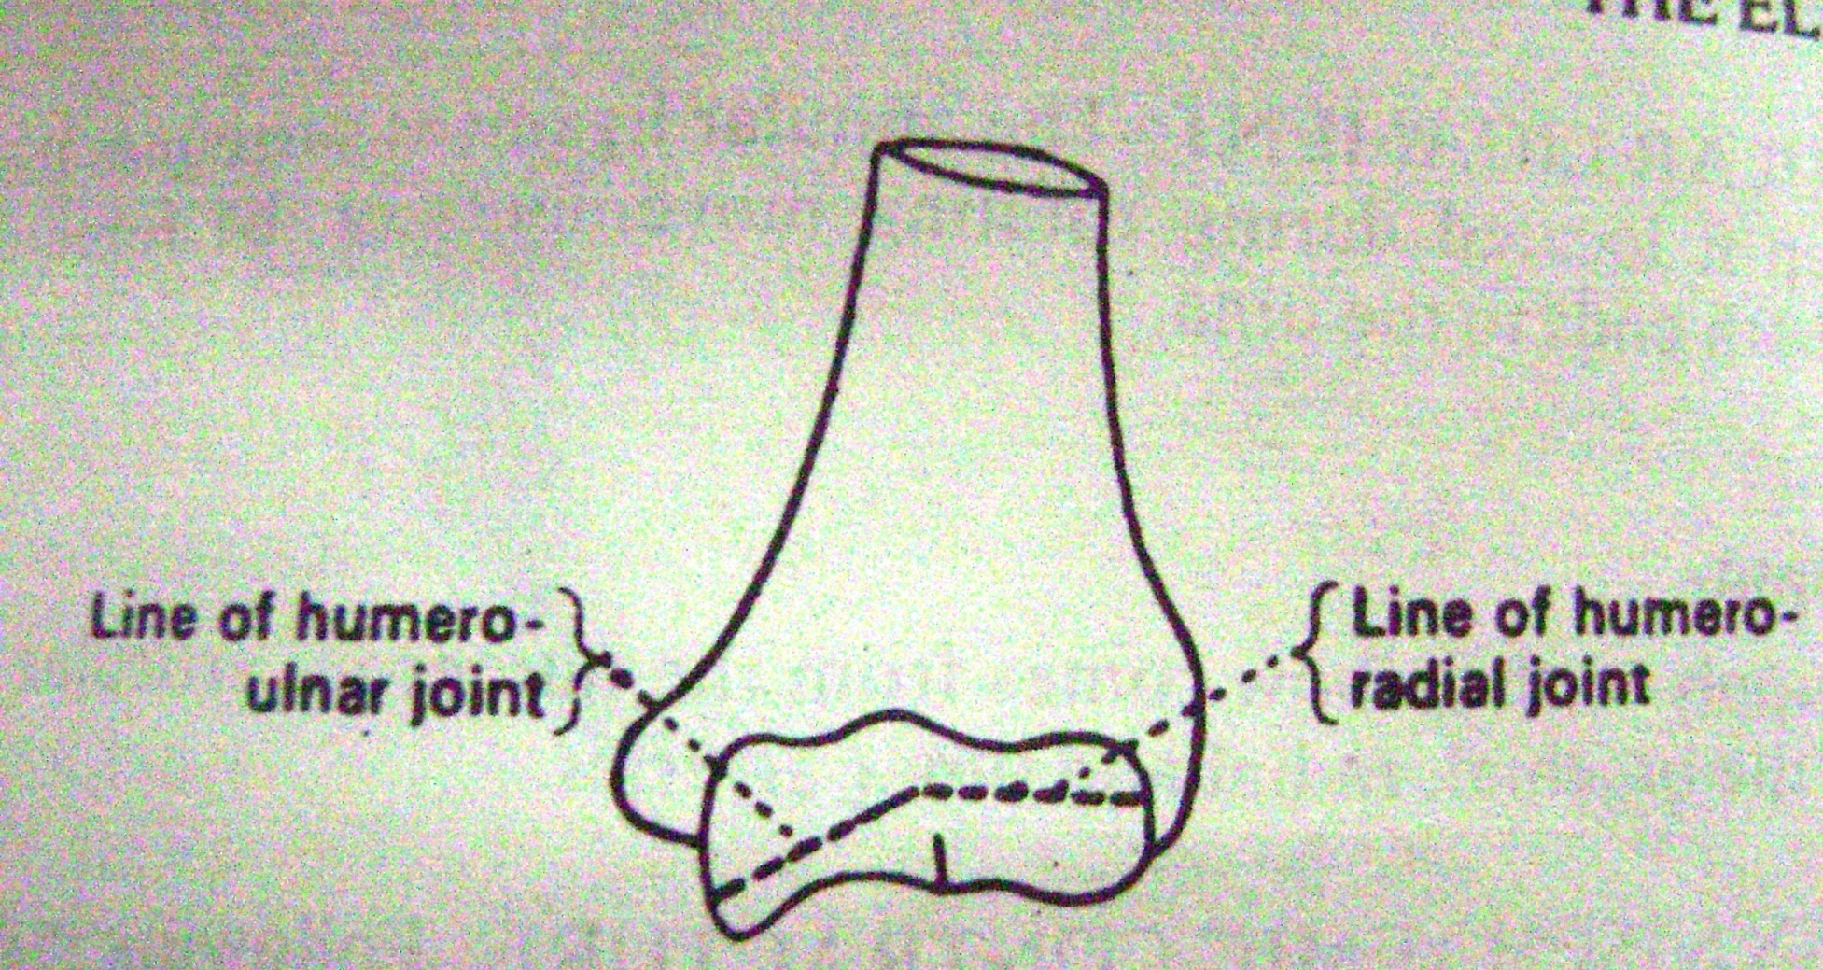

Slide 18
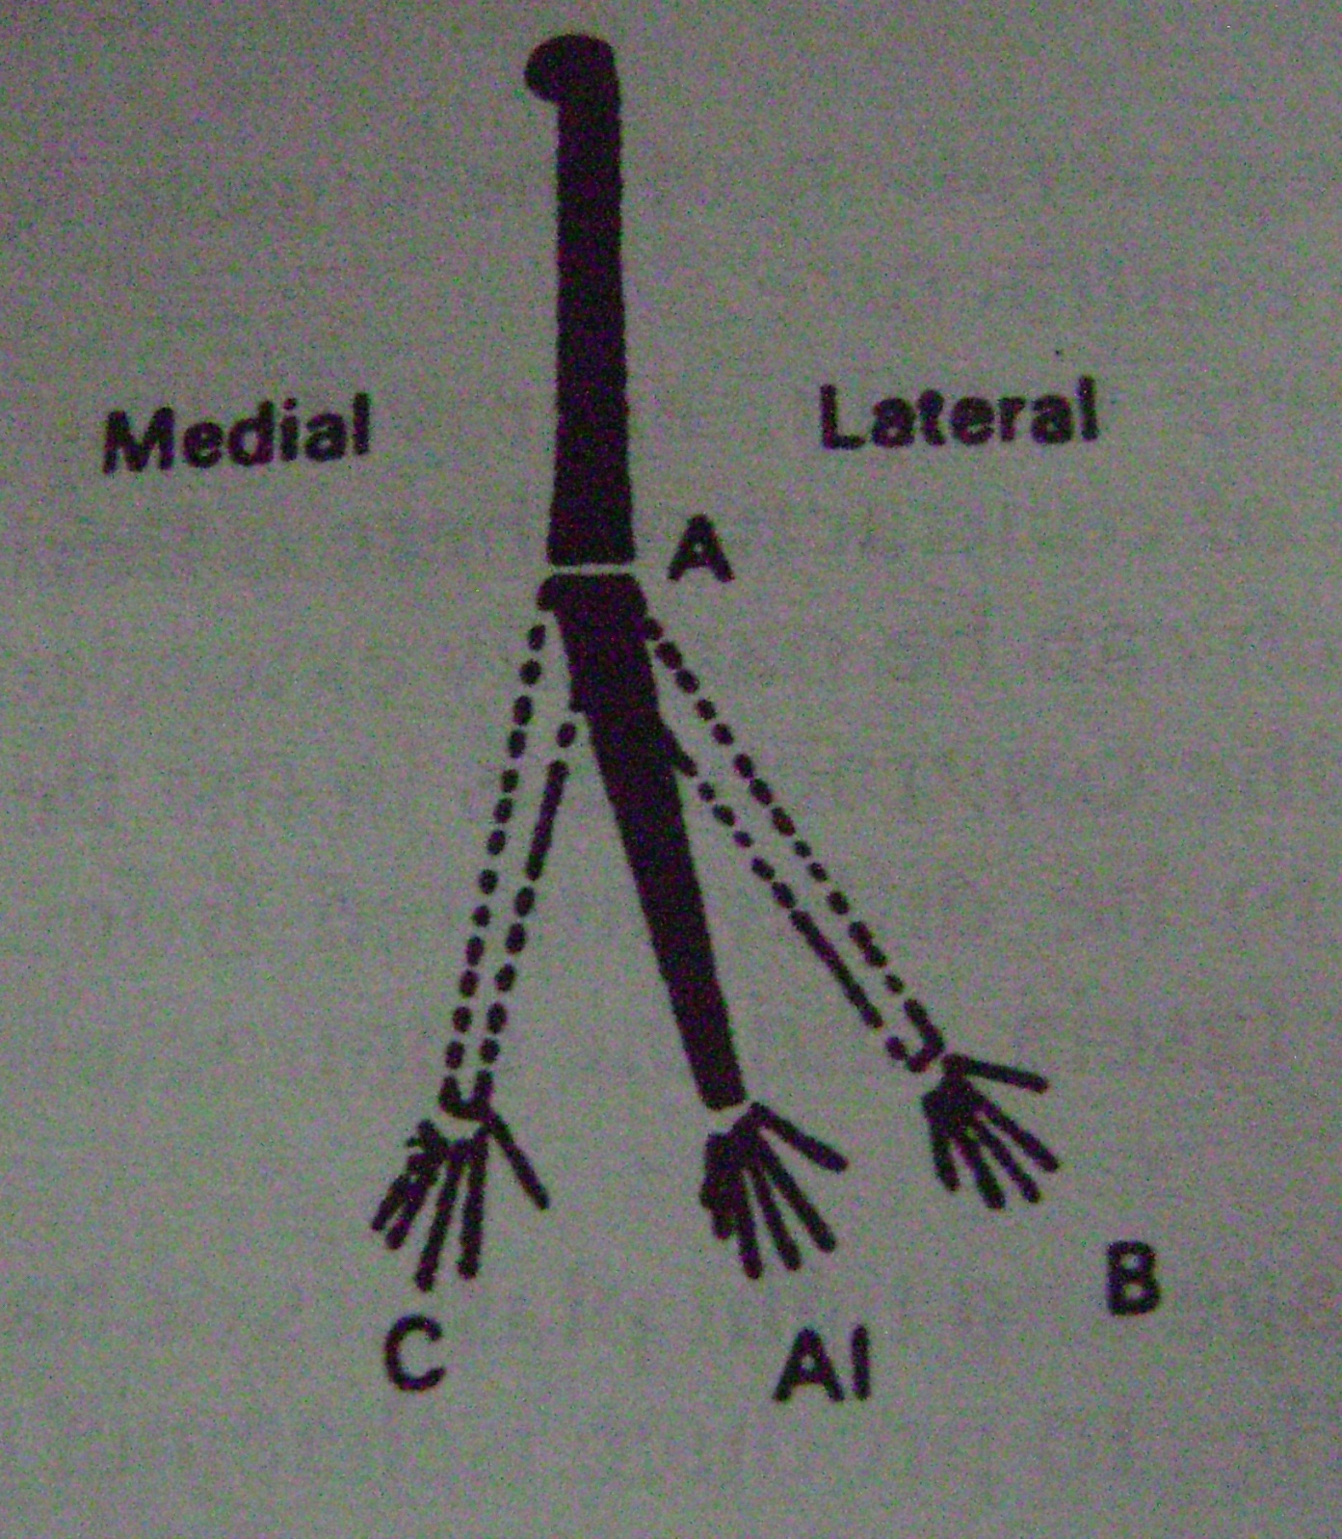

Slide 19
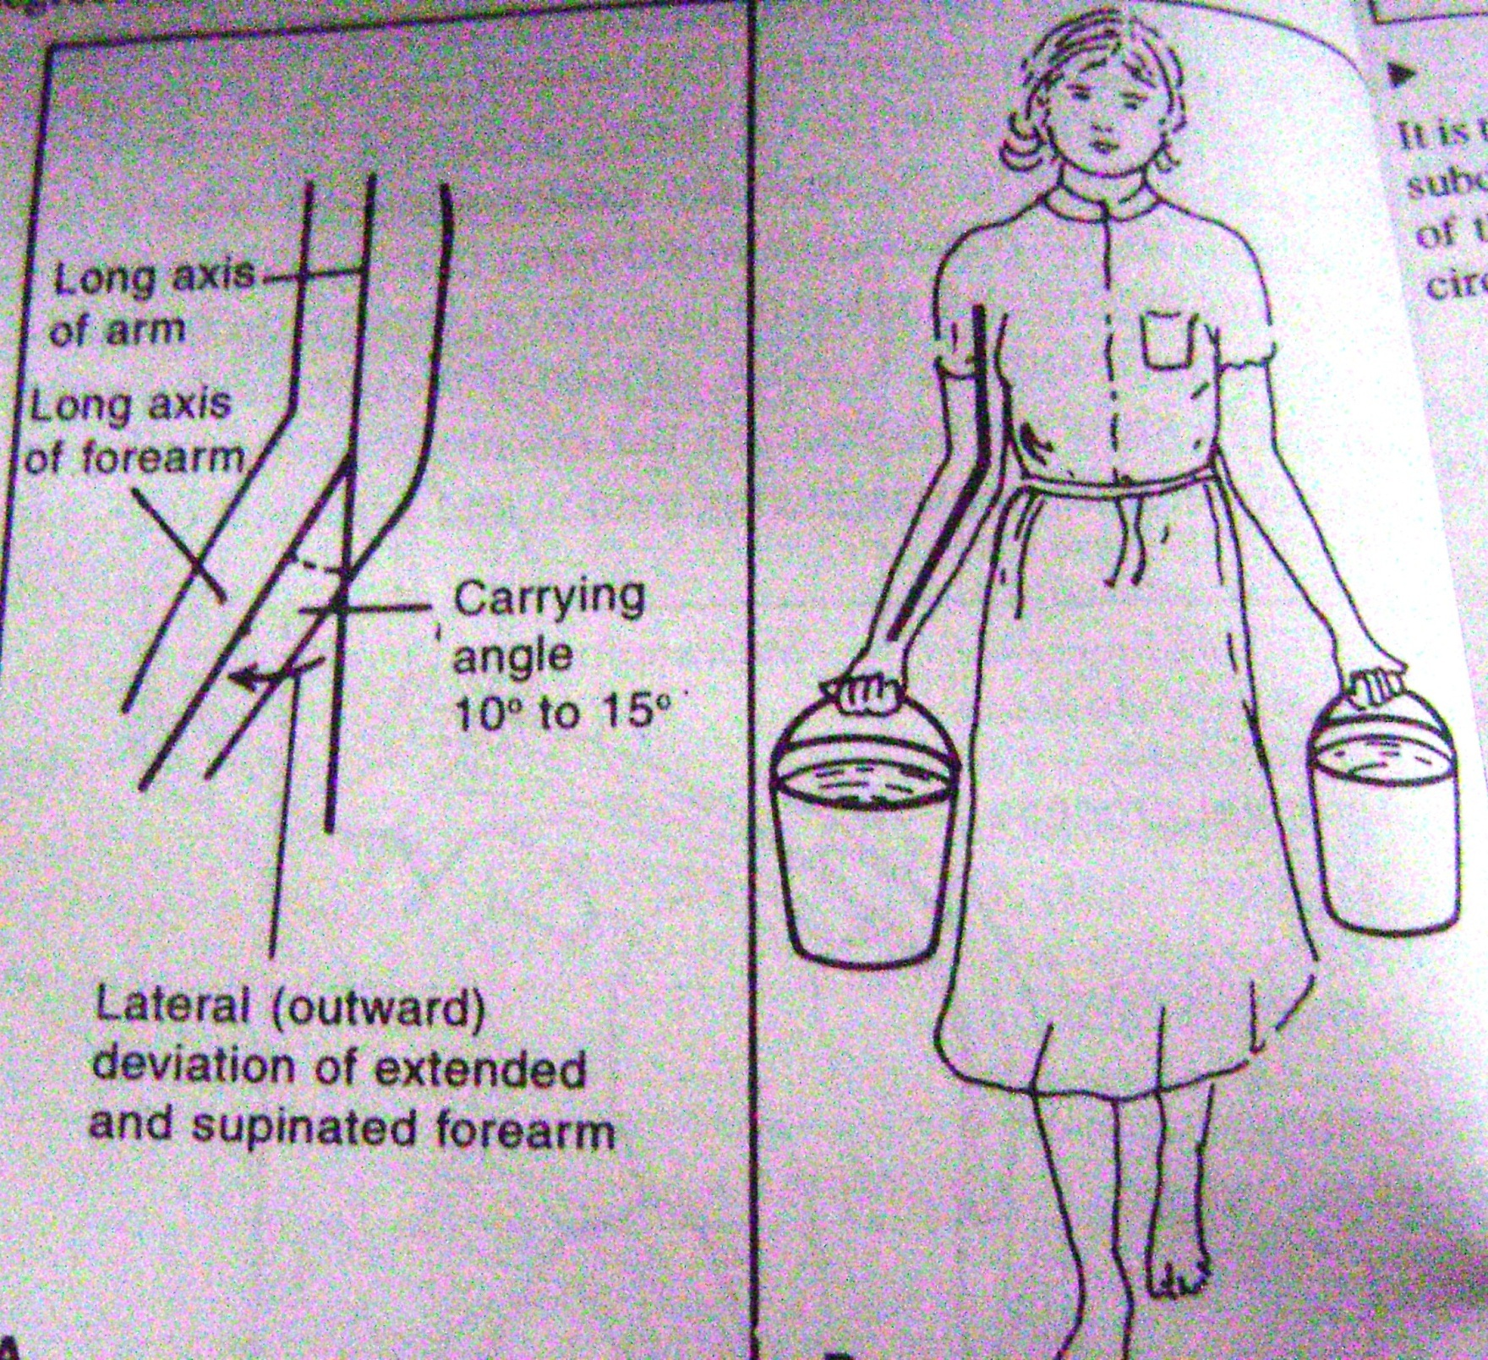

Slide 20
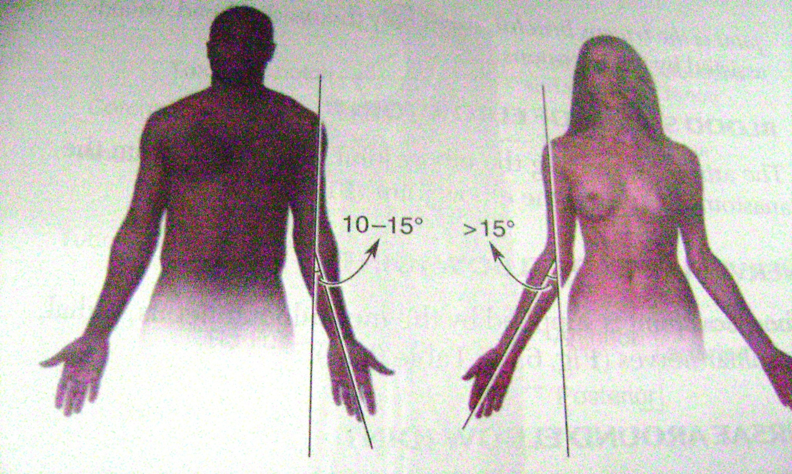

Slide 21
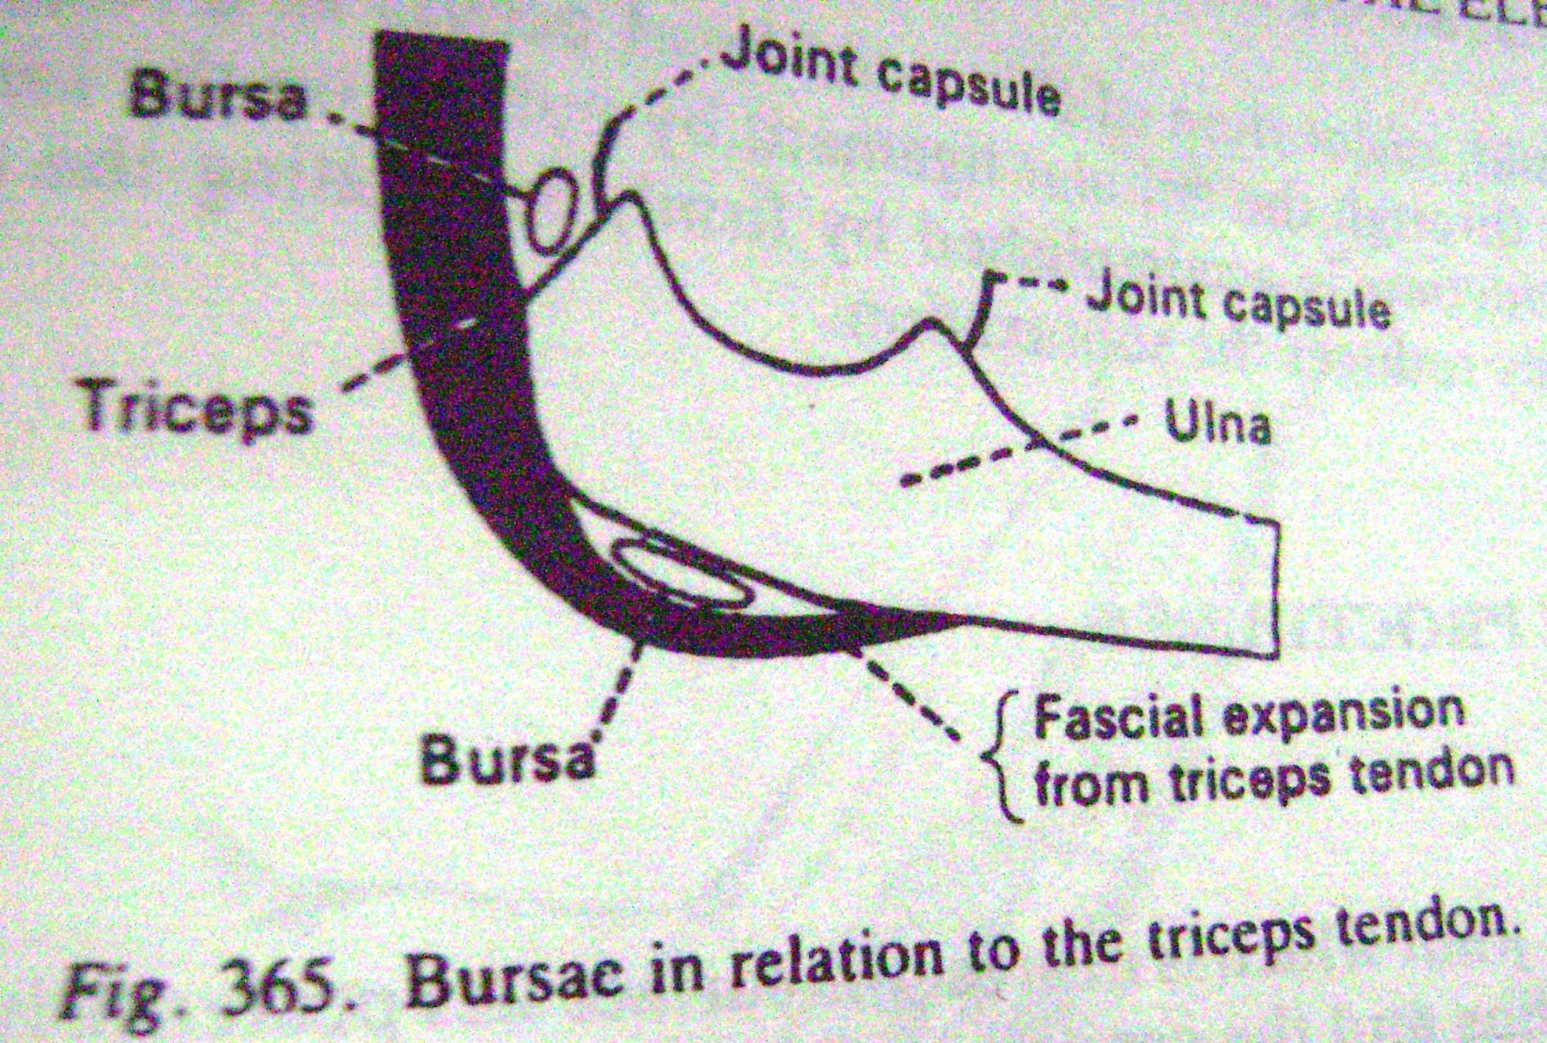

Slide 22
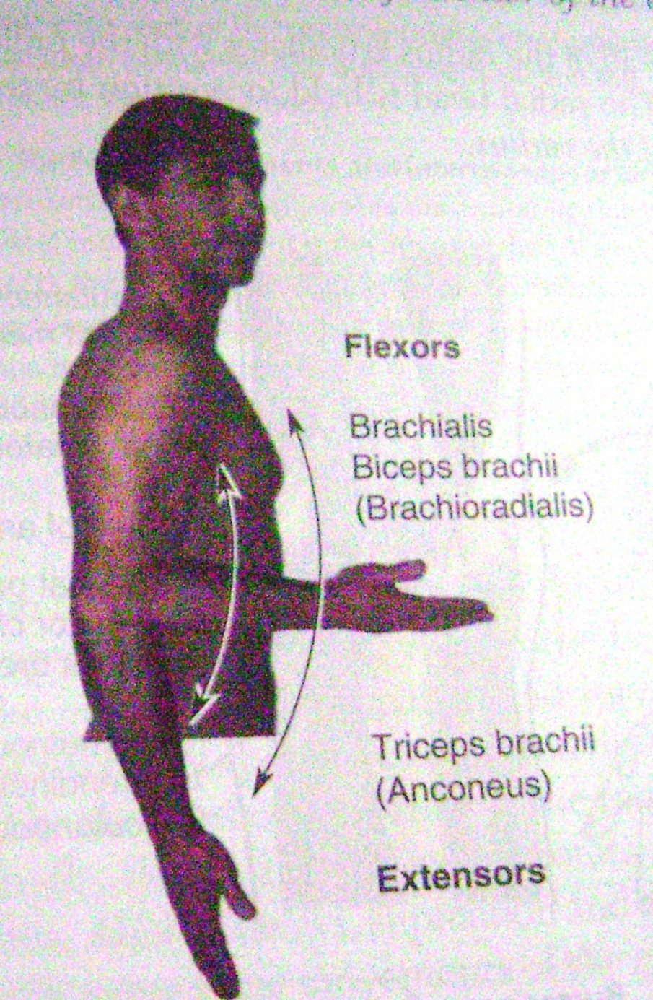

Slide 23
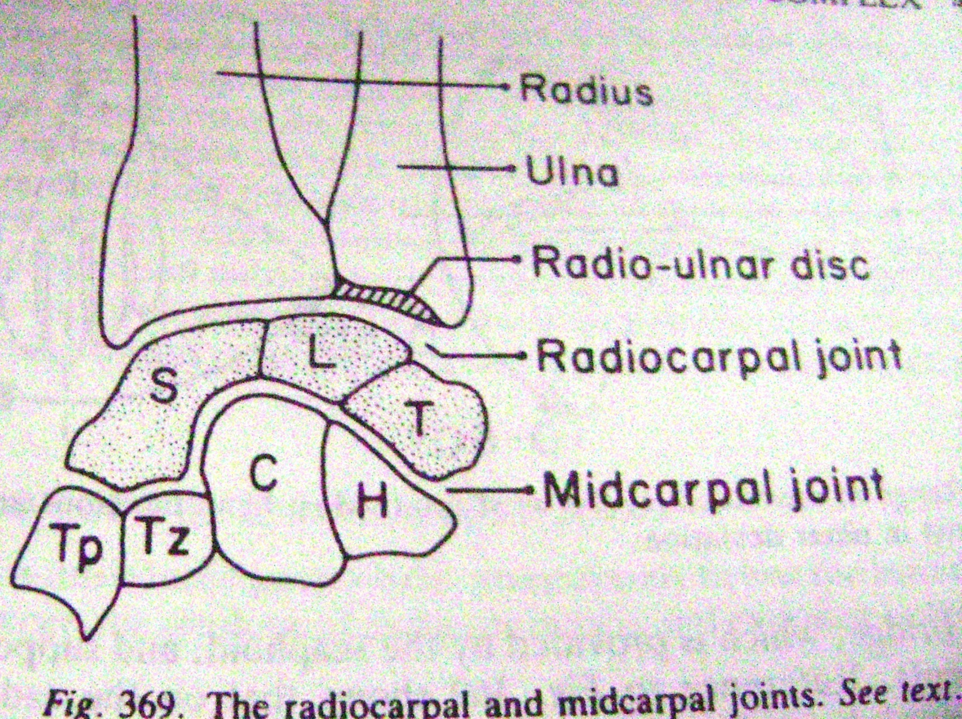

Slide 24
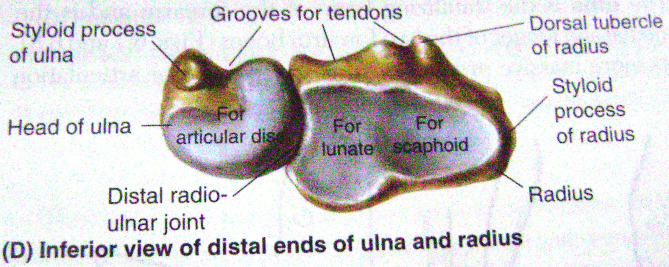

Slide 25
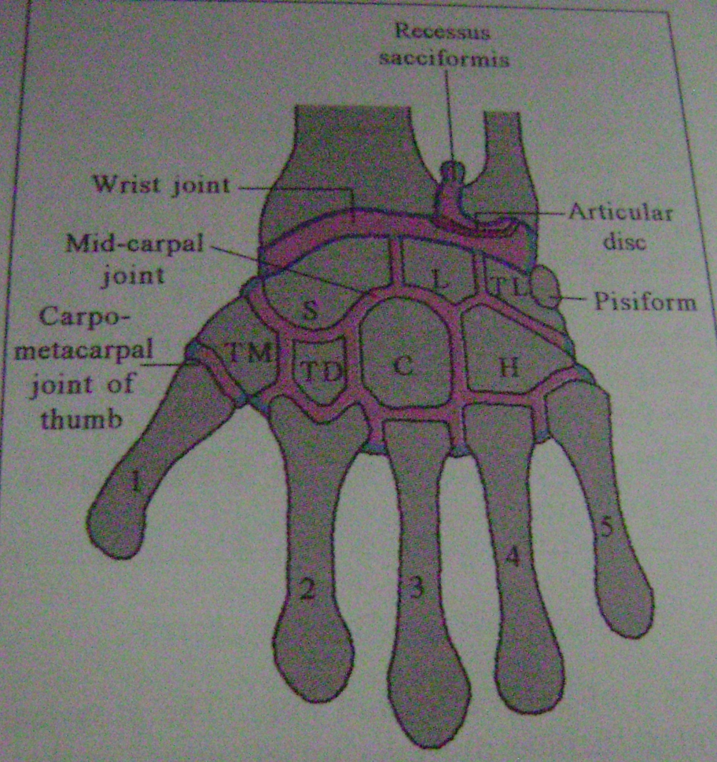

Slide 26
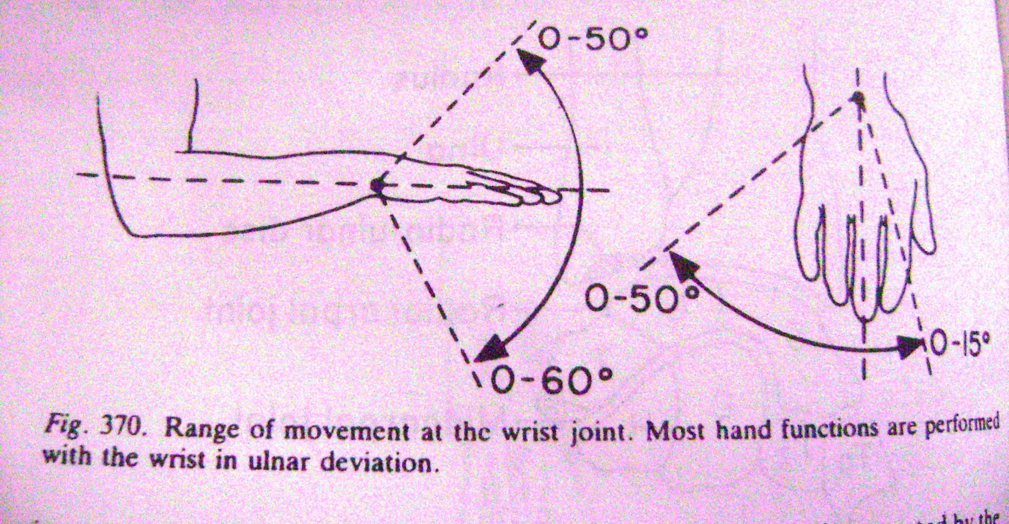

Slide 27
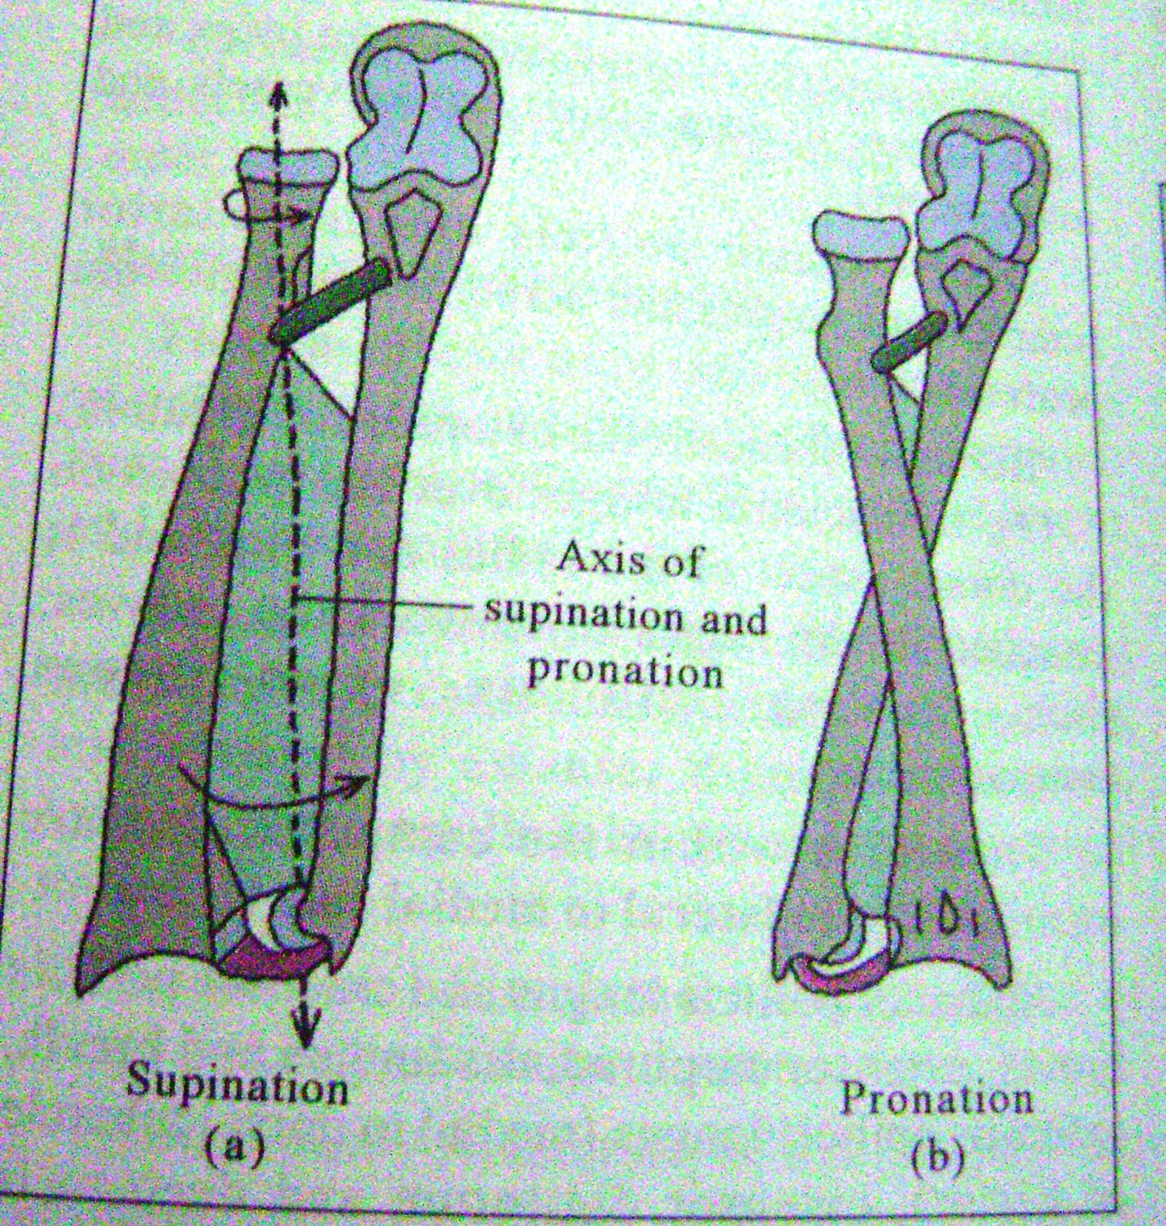

Slide 28
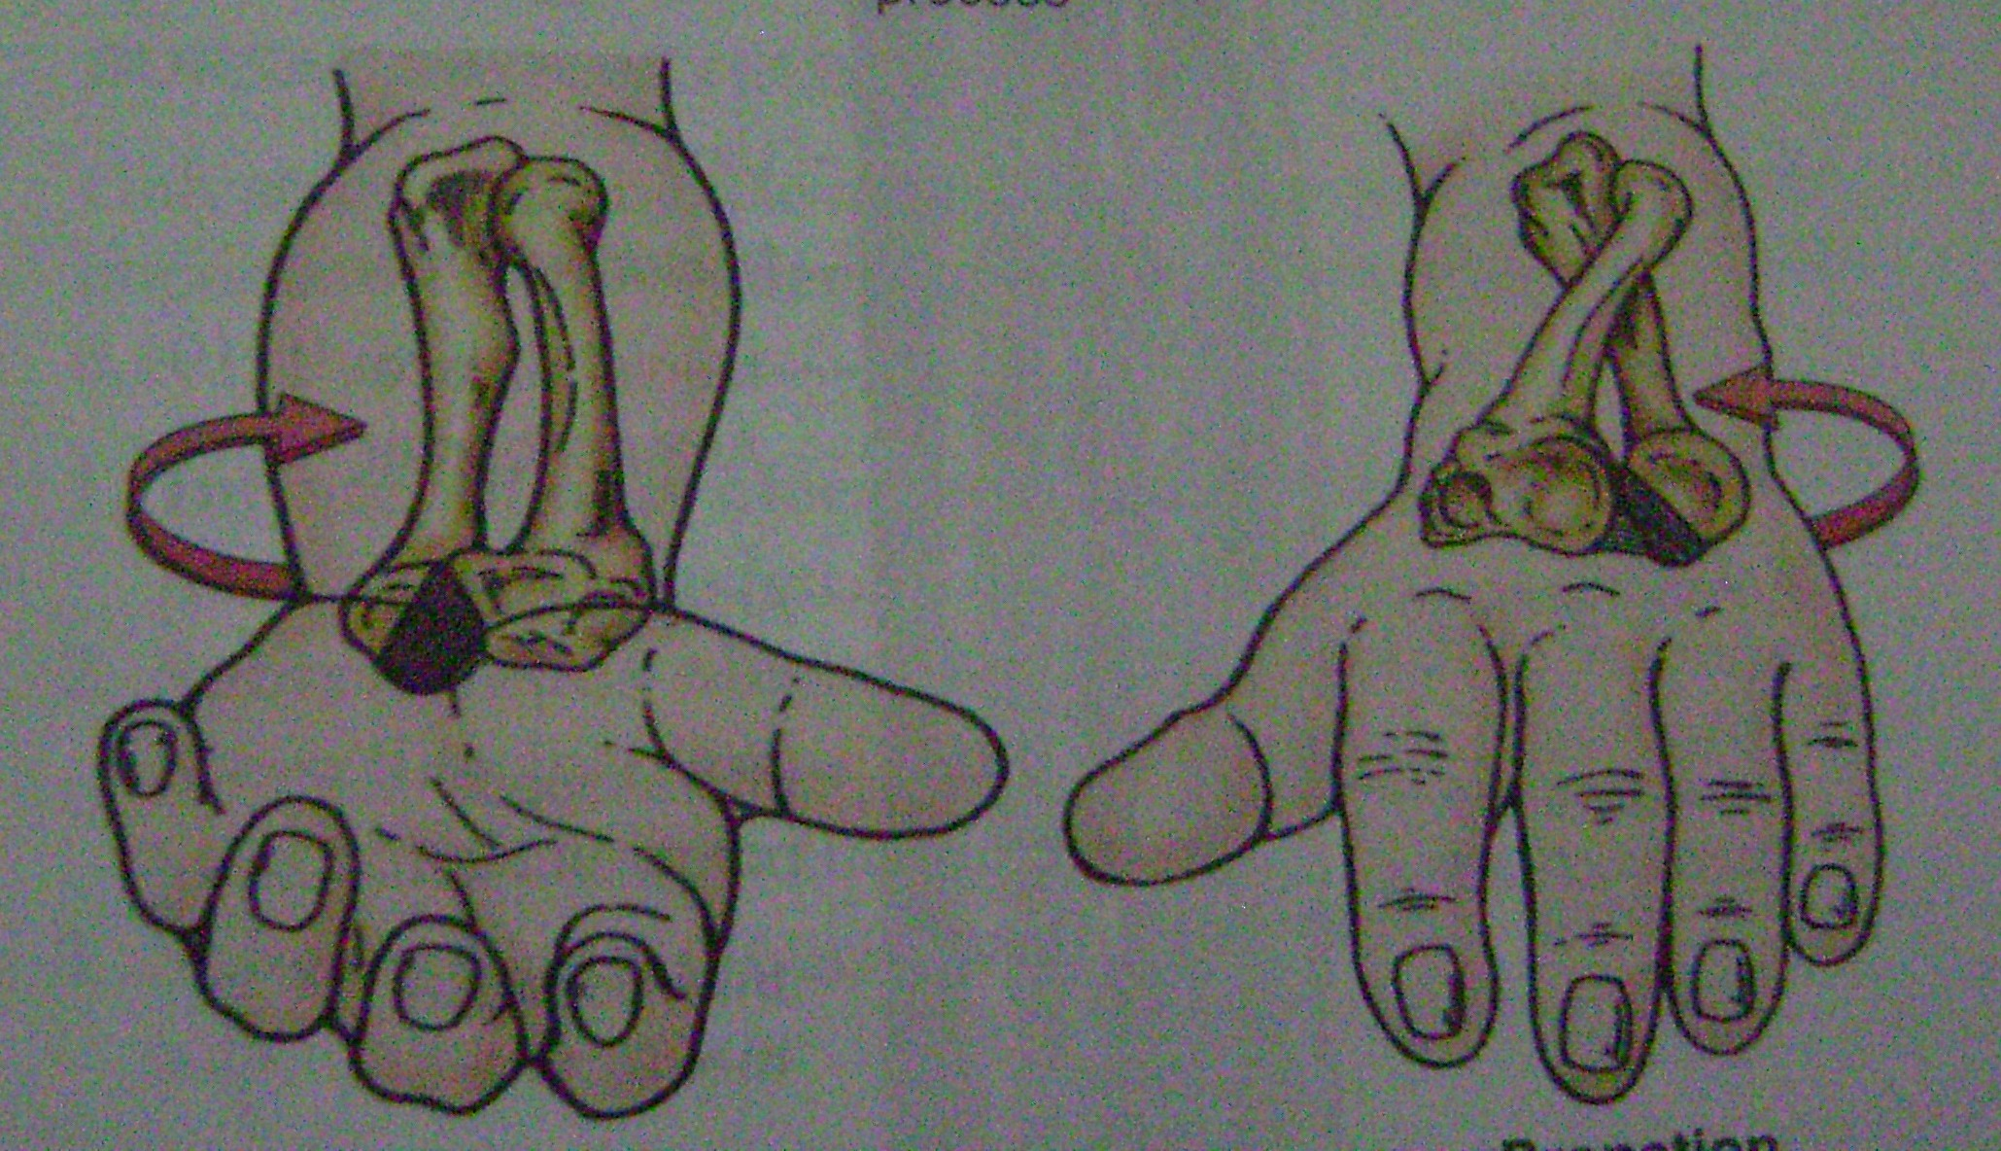

Slide 29
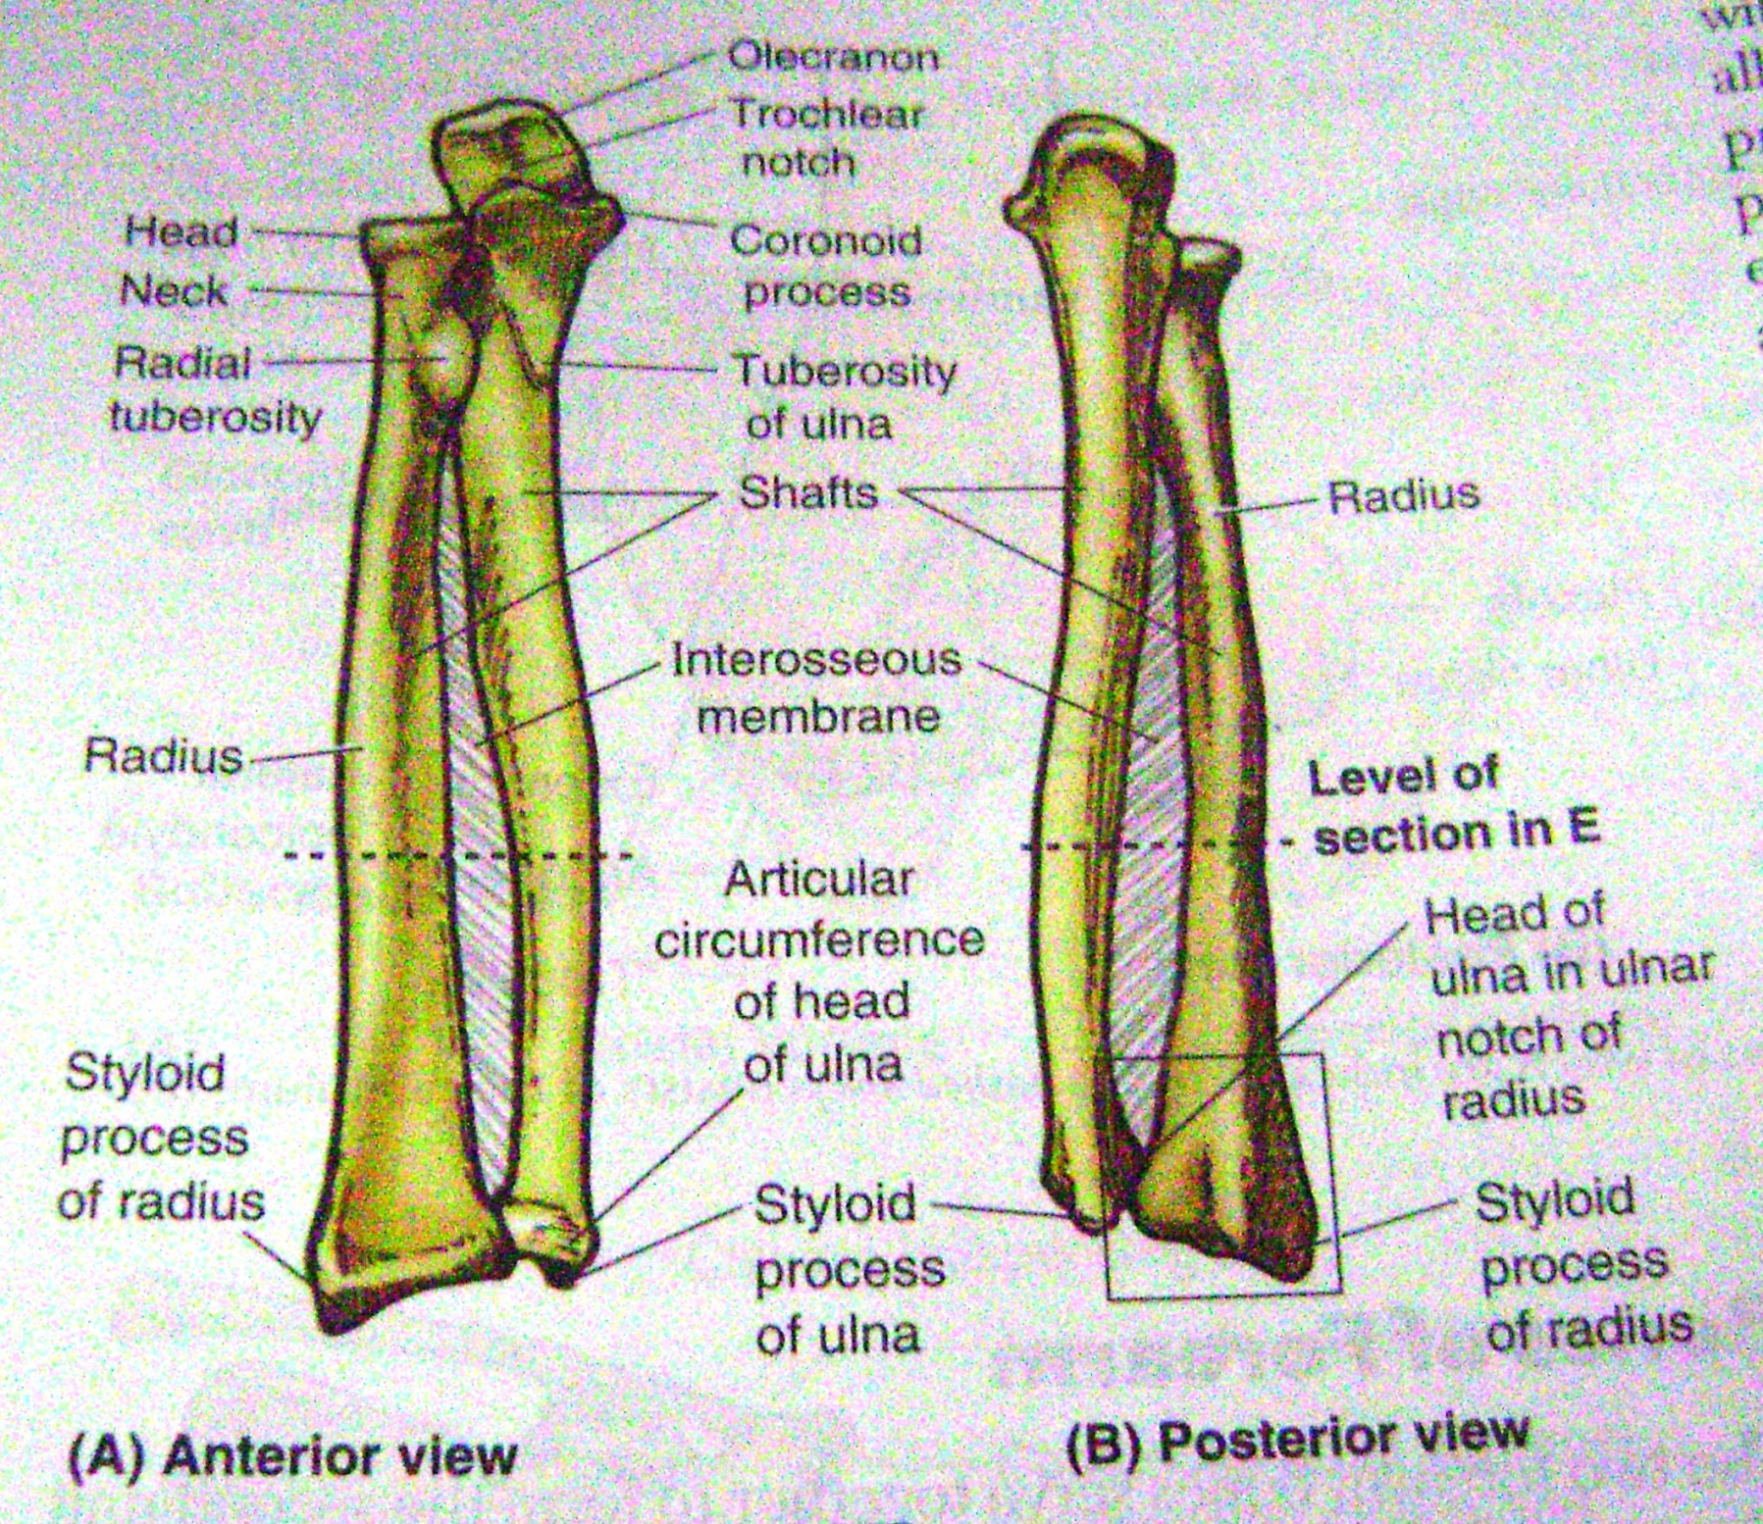

Slide 30
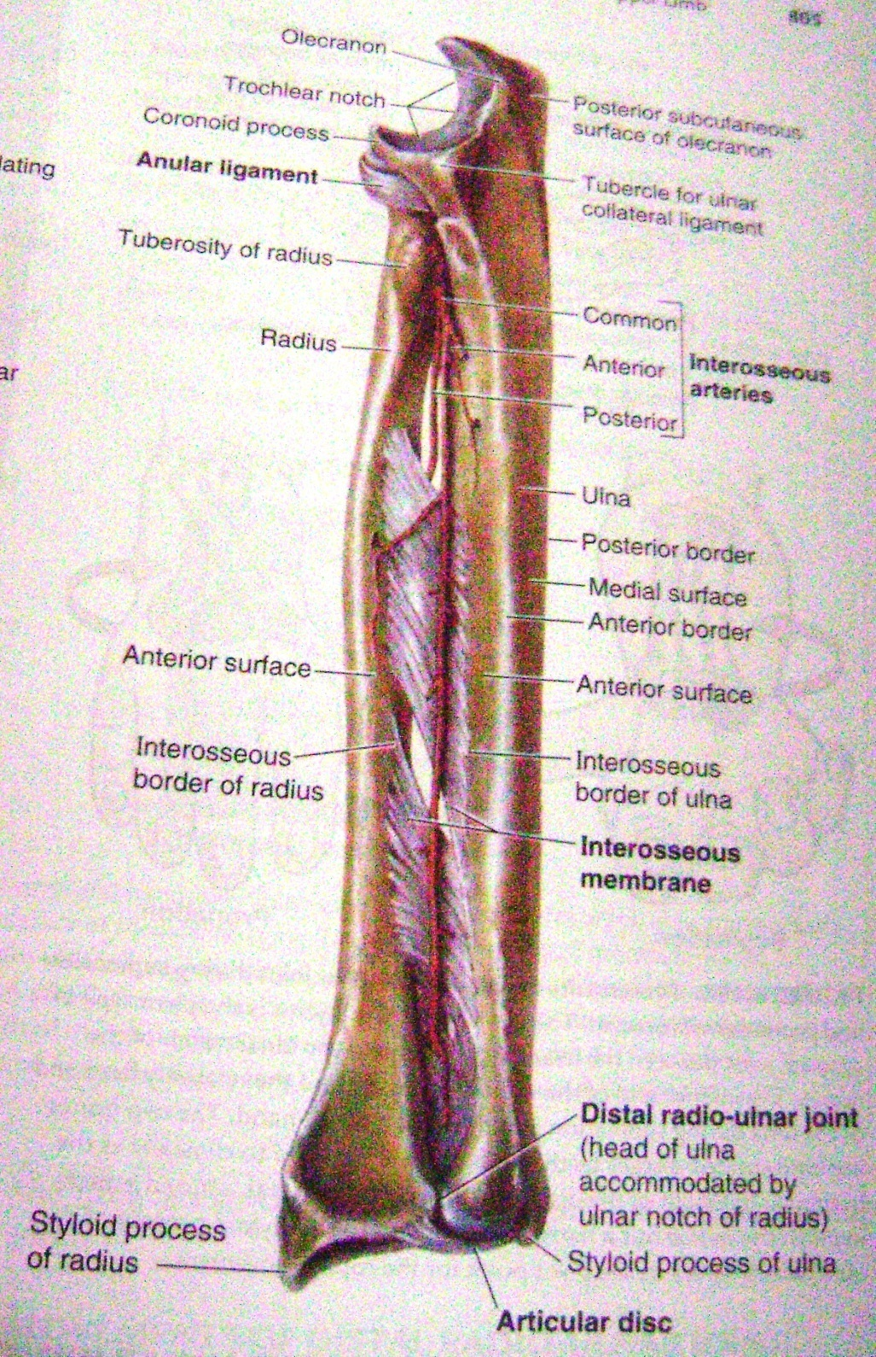

Slide 31
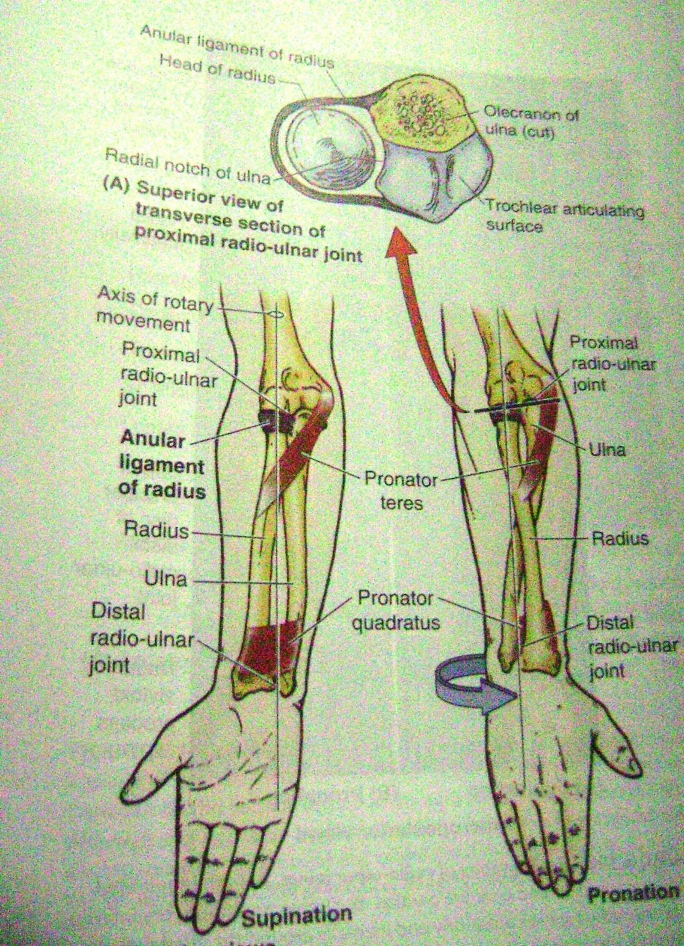

Slide 32
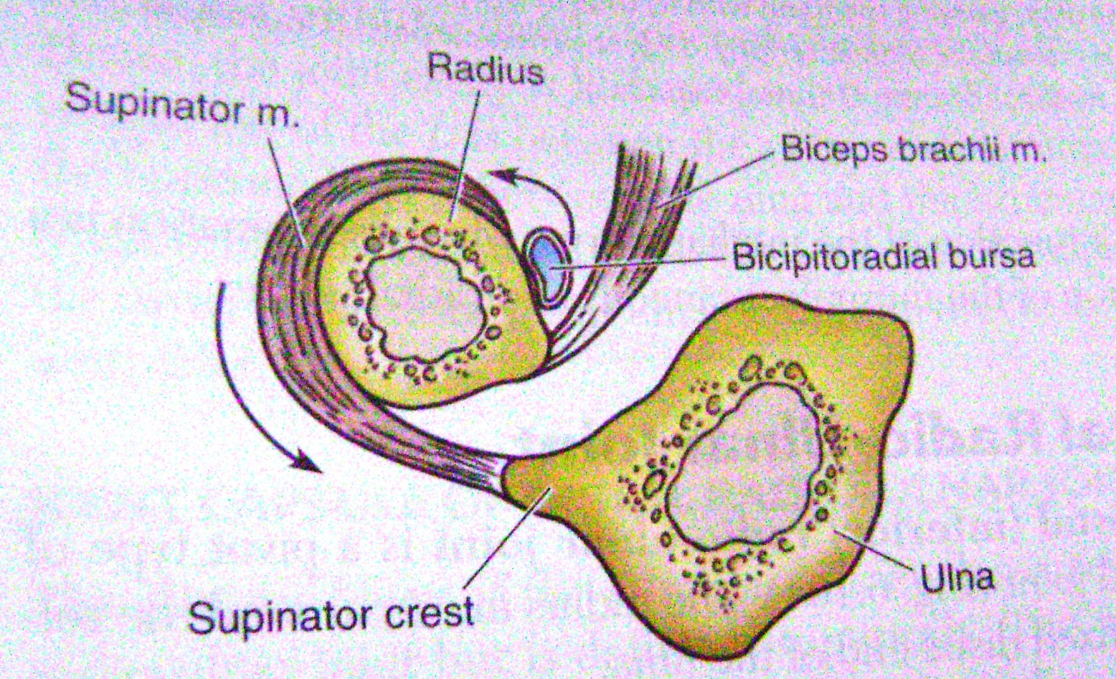

Slide 33
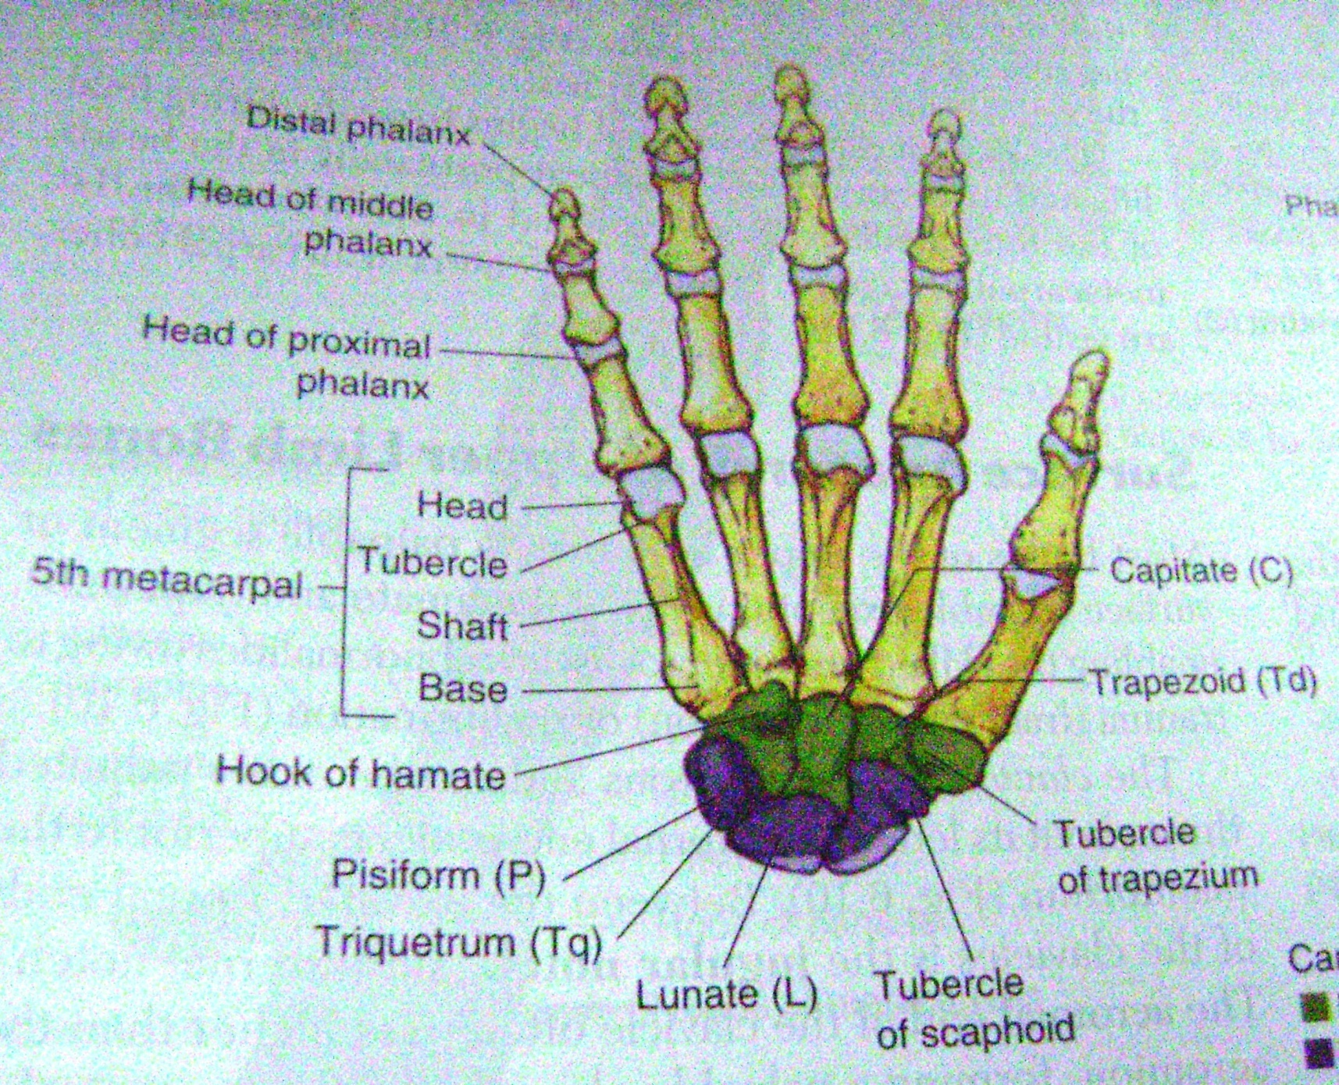

Slide 34
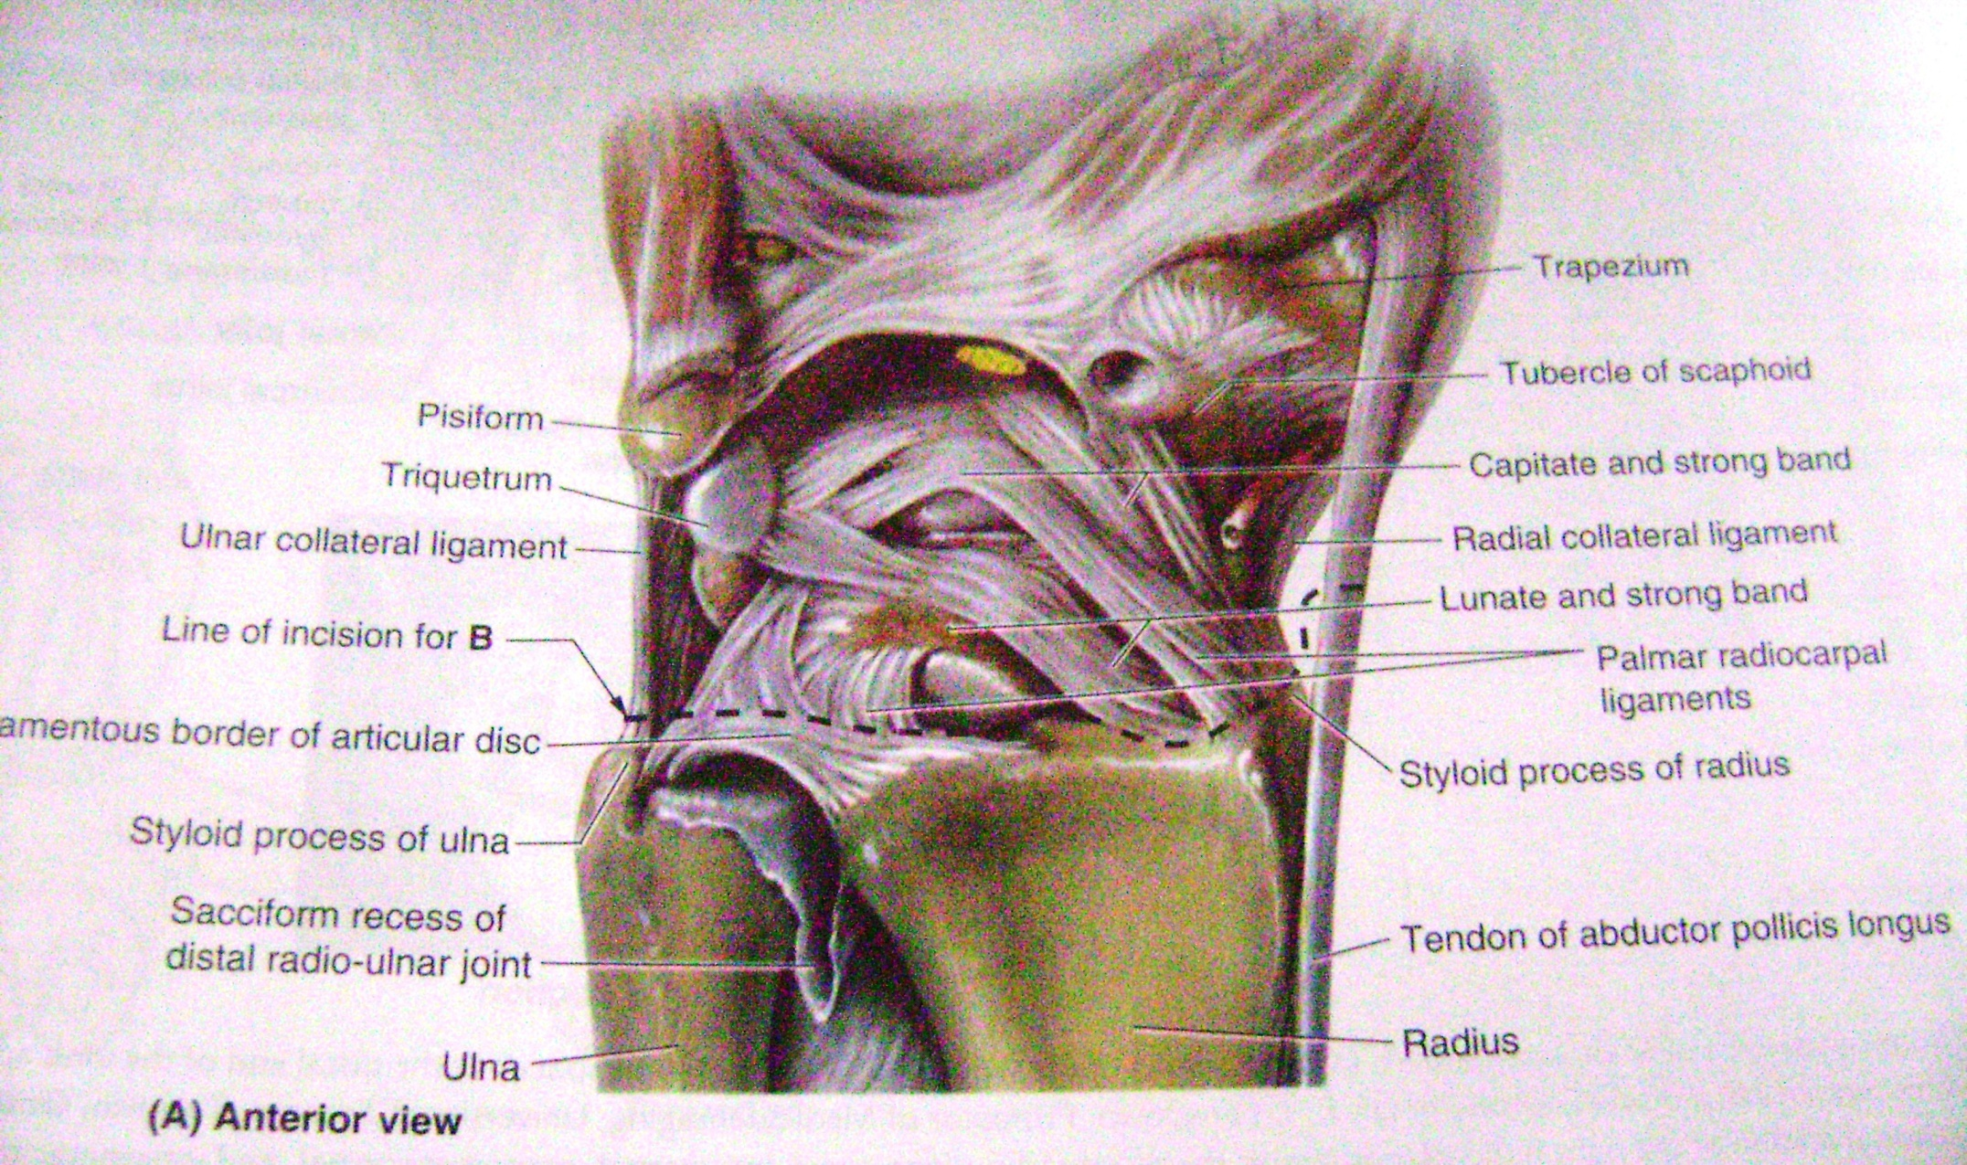

Slide 35
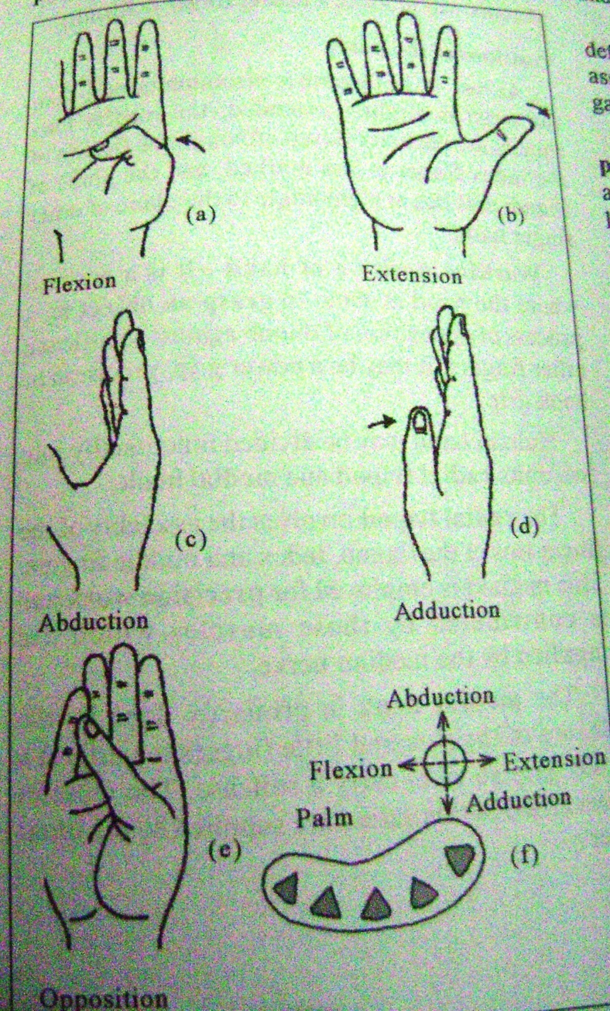

Slide 36
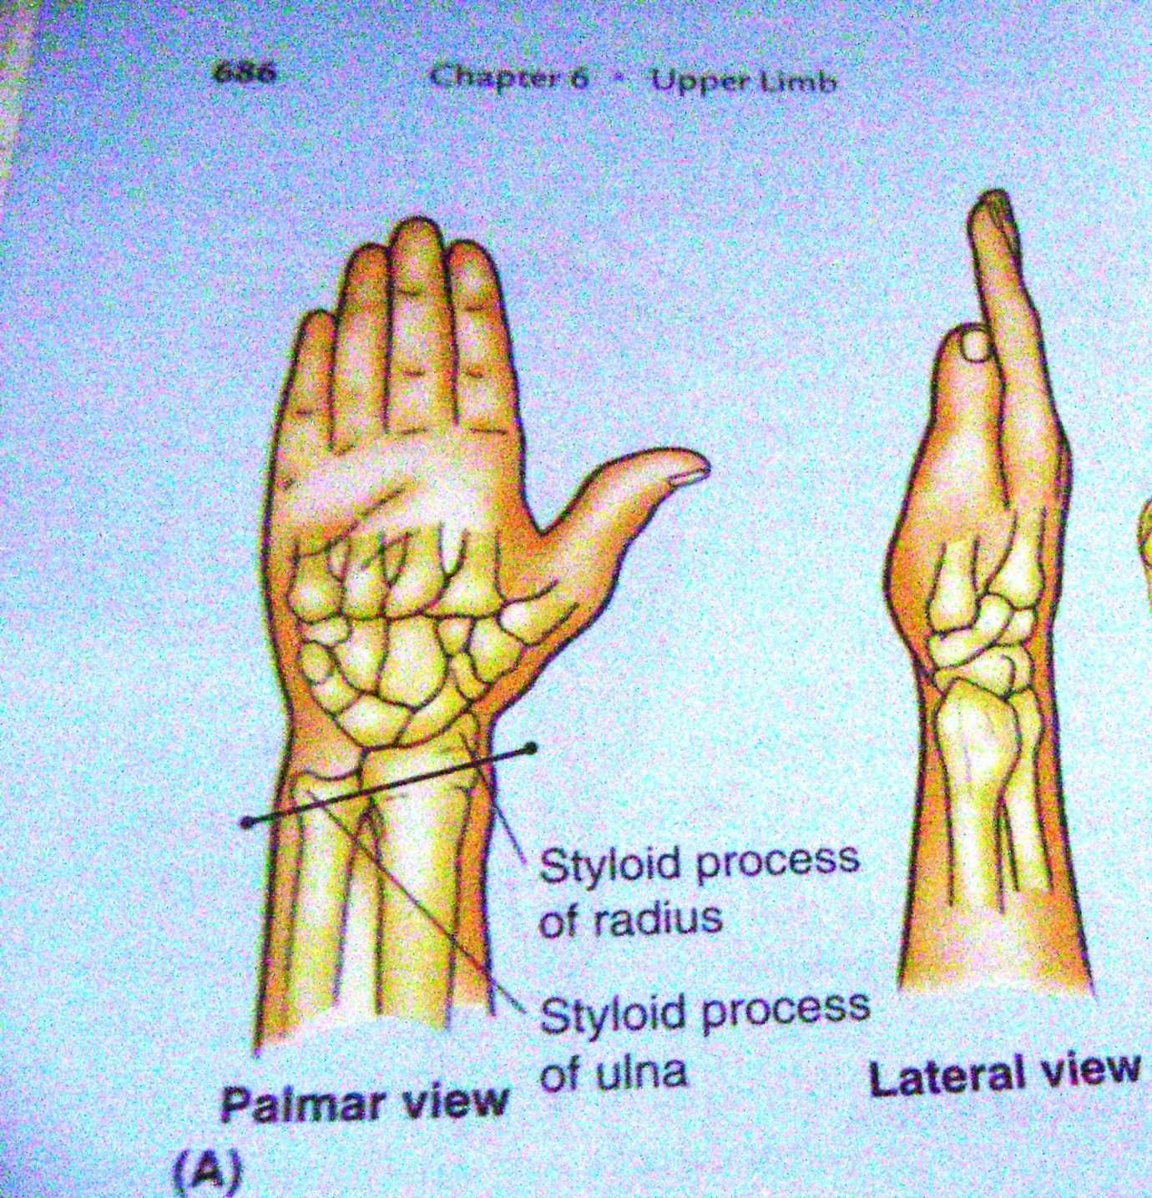

Slide 37
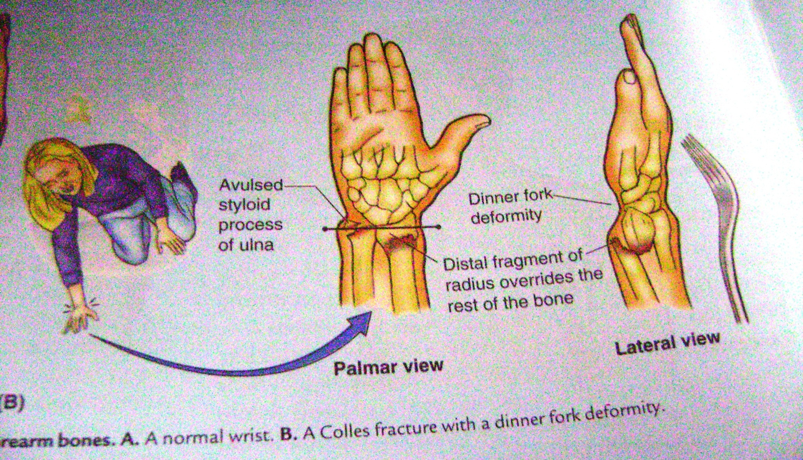

Slide 39
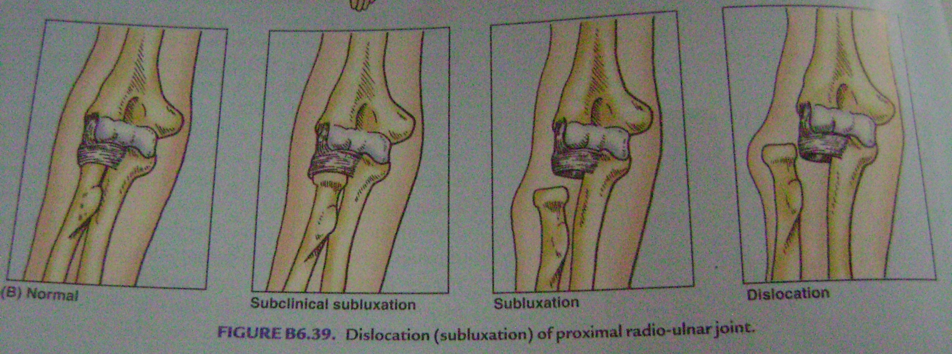

Slide 40
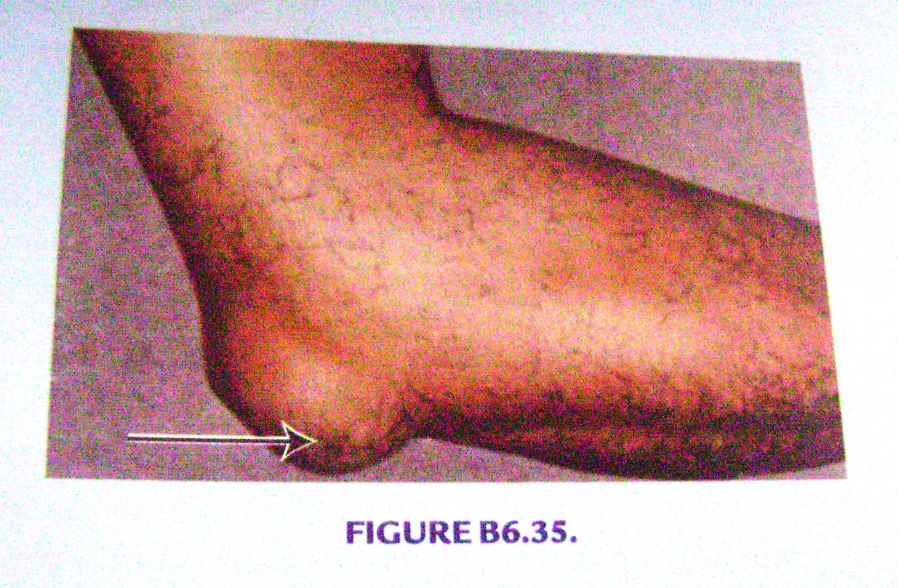

Slide 41
MCQ
Q The wrist joint is formed between
A Distal end of radius and articular disc above and scaphoid,lunate and triquetral bones below
B Distal end of ulna above and triquetral bone below
C Distal end of both radius and ulna above with scaphoid and lunate bones below
D Distal end of ulna and articular disc above and scaphoid bone below

Slide 42
MCQ
Q All are true about movements of pronation and supination except
A These take place at radioulnar joints
B pronation is more powerful in action than supination
C They take place around an oblique changeable axis
D pronation is performed by pronator teres

