Slide 1
INDUCTION

Slide 2
Enumerate Food Nutrients

Slide 3
Ghee
Butter
Cheese

Slide 4
Curds
Butter Milk
Milk

Slide 5
Chicken
Fish
Cheese

Slide 6
Food Nutrients
Body Constituents
Carbohydrates
Proteins
Lipids

Slide 7

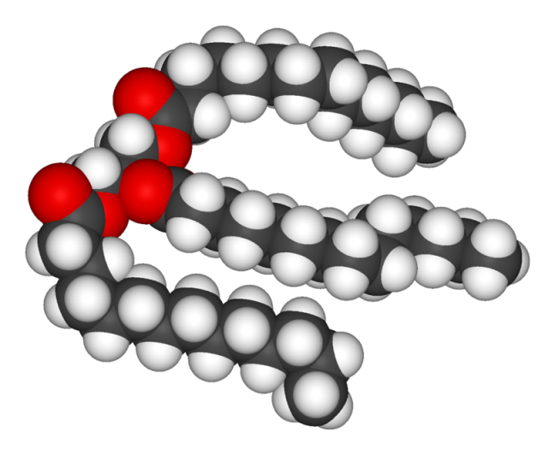
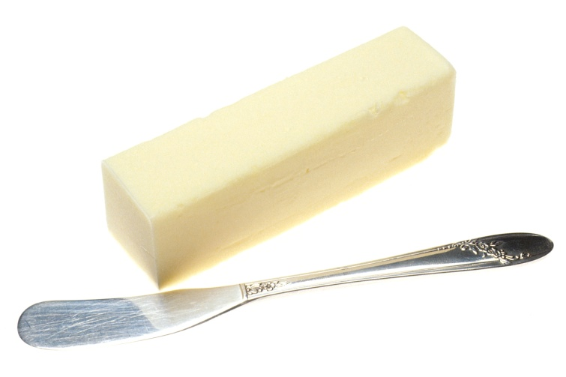
LIPIDS
CHEMISTRY AND FUNCTIONS

Slide 8
SYNOPSIS/CONTENTS
WHAT ARE LIPIDS?
DEFINITION OF LIPIDS
CLASSIFICATION OF LIPIDS
BIOMEDICALLY IMPORTANT LIPIDS
STRUCTURE,FUNCTIONS,PROPERTIES
AND RELATED DISORDERS OF LIPIDS.

Slide 9
INTRODUCTION

Slide 10
WHAT ARE LIPIDS?

Slide 11
Lipids are :
Organic Biomolecules
Occurs in Plants and Animals
Hydrophobic
Heterogeneous
Esters
Food Nutrient
Secondary Source of Energy
Structural Components

Slide 12
Heterogeneous Nature Of Lipids

Slide 13
Features Of Lipids
L
I
P
I
D
S
Heterogeneous
Structure
Functions

Slide 14
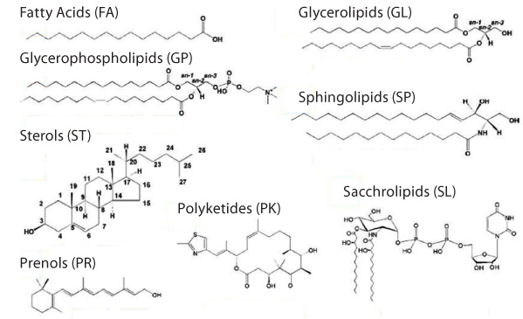

Slide 15
Lipids are biomolecules relatively :
  Smaller in size
  Less dense

Slide 16
Unlike Carbohydrates and Proteins Lipid structures
are not Bio-Polymers.
(Lipid structure contains no repeatedly linked Monomeric units)

Slide 17
Solubility Of Lipids

Slide 18
Solubility Of Lipids
Lipids are relatively Insoluble in Water/Polar Solvent Water/polar solvents
Since they are Non polar and Hydrophobic

Slide 19
Solubility of Lipids
  Lipids are readily soluble in non polar Organic solvents /Fat Solvents
  Acetone
  Alcohol (Hot)
  Benzene
  Chloroform
  Ether

Slide 20
Chemical Nature Of Lipids

Slide 21
Chemically Lipids are Esters :
Lipids are Esters of Fatty acids with Alcohol and attached with other groups.
Lipids are relatively or potentially associated with Fatty acids.

Slide 22
DEFINITION OF LIPIDS

Slide 23
Lipids Bloor’s Definition
Lipids are Organic, Heterogeneous Hydrophobic Biomolecules
Relatively insoluble in water and soluble in organic solvents.
Chemically Esters of Fatty acids with Alcohol.
Utilized by body to produce ATP

Slide 24
Classification Of Lipids
With Examples of Biomedically Important Lipids
Notes:
\

Slide 25
Lipids are Classified
Into
Three Main Classes

Slide 26
Three Main Classes of Lipids are:
  Simple Lipids
  Compound /Complex Lipids
  Derived Lipids

Slide 27
1. Simple Lipids/Neutral Lipids
Chemically Simple Lipids are:
Esters of Fatty acids with an Alcohol

Slide 28
Sub Classes Of Simple Lipids

Slide 29
Depending upon the type of Alcohol :
Simple Lipids are of two sub types:
    Fats/Oils
    (Alcohol is Glycerol)
    Waxes
    (Alcohol- Cholesterol/ Retinol)

Slide 30
Fats/Oils/TAG

Slide 31
Chemical name of Fat /Oil
Triacylglycerol

Slide 32
Fats/Oils/TAG:
Chemically Esters of Fatty acids with Glycerol(Trihydric Alcohol)
Three Fatty acids linked to a Glycerol molecule.

Slide 33
Waxes :
Waxes are Simple Lipids
Waxes are chemically Esters of Fatty acids with higher complex, monohydric ,Alcohols, other than Glycerol.

Slide 34
Examples Of Human Body Waxes :
Cholesterol Ester
(Cholesterol Palmitate)
Retinol Ester
(Retinol Palmitate)

Slide 35
Compound/Complex Lipids
Compound Lipids is a class of Lipids
Chemically composed of Fatty acids Alcohol and an Additional group.

Slide 36
Depending upon the
Type of Additional group
Types of Compound Lipids are:

Slide 37
Four Names Of Compound Lipids
Phospholipids
Glycolipids
Lipoproteins
Sulfolipids

Slide 38
      Phospholipids
        Glycerophospholipds
        Sphingophospholipids

Slide 39
      Glycosphingolipids
        Cerebrosides
        Gangliosides
        Globosides
        Sulfatides

Slide 40
      Lipoproteins
        Chylomicrons
        VLDL
        LDL
        HDL

Slide 41
Derived Lipids
Derived Lipids are Hydrolytic products of Simple or Compound Lipids and their derivatives.

Slide 42
Examples of Derived Lipids:
  Fatty Acids
  Alcohols:
      Glycerol
      Sphingol
      Cholesterol

Slide 43
Other Examples Of Derived Lipids
Lipid like compounds Derived from Fatty acids and Sterols:
  Steroidal Hormones: Derived from Cholesterol
  Fat Soluble Vitamins (A,D,E and K)
  Eicosanoids (Prostaglandins , Leukotrienes ,Thromboxanes)
  Ketone Bodies (Partial Oxidized Products of Fatty acids)

Slide 44
Bloor’s Classification Of Lipids

Slide 45
Four Classes of Lipids By Bloor
Simple Lipids
Complex/Compound Lipids
Derived Lipids
Miscellaneous Lipids

Slide 46
A. Simple Lipid
Simple Lipids are Ester of fatty acids with various alcohols
Fats and Oils
  Triglycerides
Waxes
  Cetyl alcohol esters of fatty acids(Bees wax)
  Cholesterol Esters
  Vitamin A Esters
  Vitamin D Esters

Slide 47
B. Compound lipid
Compound Lipids are Esters of fatty acids with alcohol with an additional groups
  Phospholipids : contains phosphoric acid and often a nitrogenous base
  Glycolipids: contains aminoalcohol Spingosine, carbohydrate, N-base;
  Lipoproteins : Lipids attached to plasma/other proteins
  Sulfolipids : contains sulfate group
  Lipopolysaccharides: lipids attached to polysaccharides

Slide 48
Derived Lipids –
Hydrolytic products of Simple & Compound Lipid
  Diacylglycerol
  Monoacylglycerol
  Fatty acids
  Alcohols : Cholesterol

Slide 49
Miscellaneous Lipids
Substances with Lipid characters
  Carotenoids: β-Carotenoid
Squalene :
Vitamin E and K
Eicosanoids

Slide 50
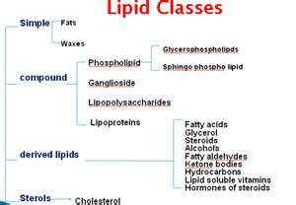

Slide 51
Classification of Lipids
Simple and complex lipids
Simple
Complex
Glycerophospholipids
Glycolipids
Phosphoglycerides
Sphingolipids
FA
FA
FA
GLUCOSE
GALACTOSE
Glycerol
FA
Glycerol
FA
Sphingosine
Sphingosine
Sphingosine
FA
PO₄³⁻
ALCOHOL
PO₄³⁻
CHOLINE
FA

Slide 52
Human body Lipids

Slide 53
Types of Lipids
Depending On
Saponification Property

Slide 54
Lipid Classification
Lipids
Nonsaponifiable
Saponifiable
17.1 Biological Functions of Lipids
Steroids
Prostaglandins
Simple
Complex
Sphingolipids
Phosphoglycerides
Waxes
Triglycerides

Slide 55
Types of Lipids
Depending Upon Polarity

Slide 56
Neutral Lipids: (Non Polar Lipids)
        Triacylglycerol
        Cholesterol Ester (Cholesterol Palmitate)
Amphipathic/Amphiphillic Lipids:
(Contain Polar and Non polar Groups)
          Phospholipids
          Cholesterol

Slide 57
Types of Lipids
Depending Upon Functions

Slide 58
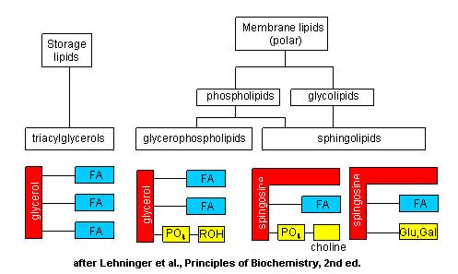

Slide 59
Types Of Lipids
Based On Alcohol

Slide 60
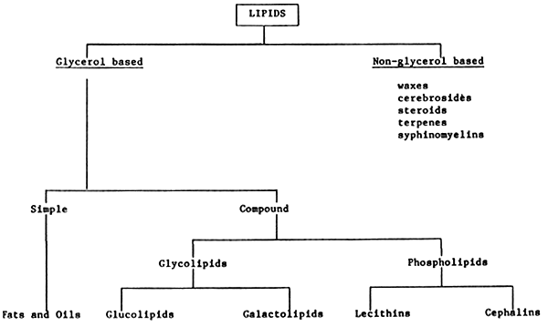

Slide 61
Types Of Lipids
Based Upon the
Main Components

Slide 62
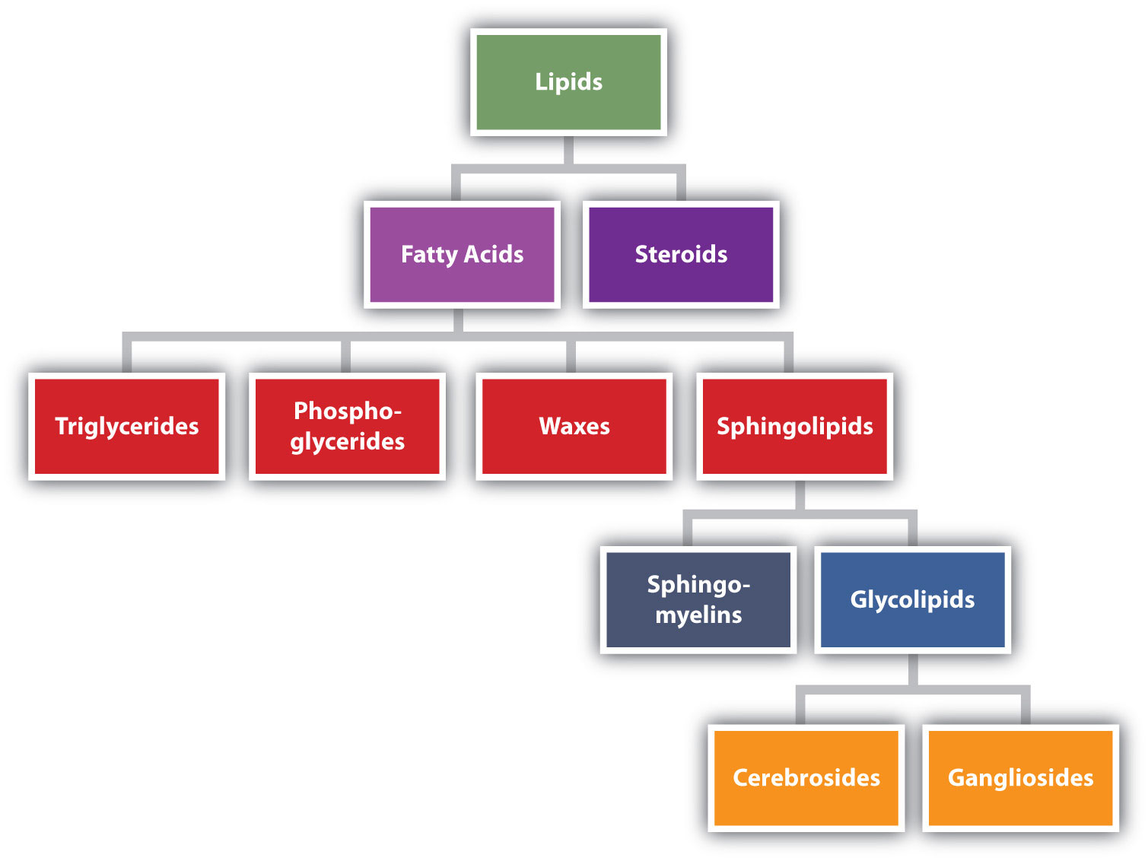

Slide 63
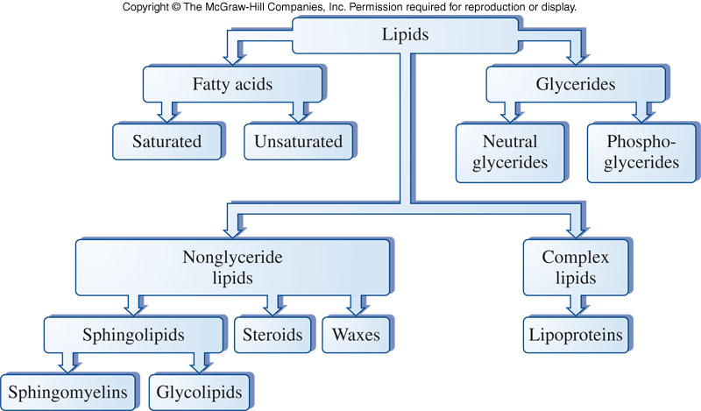

Slide 64
Names Of Important
Body Lipids

Slide 65
Biomedically Important Lipids
Fatty Acids (FAs)
Triacylglycerol (TAG)
Phospholipids (PL)
Lipoproteins (LP)
Glycolipids
Cholesterol (Free)
Cholesterol-Ester (Esterified)

Slide 66
Biological Functions Of Lipids

Slide 67
Lipids have dietary and Calorific value

Slide 68
Lipids are chief constituents of human food.
Dietary Lipids Ingested (eaten) are digested, absorbed and assimilated in human body.

Slide 69
Lipids are highly reduced substances with CH2 bonds.
Oxidation of the CH2 bonds of Fatty acids, generate chemical form of energy ATP.

Slide 70
Thus Lipids serve as a secondary source of energy (ATPs) to human body.

Slide 71
Lipids are Reservoir of Energy

Slide 72
In a Well Fed Condition
Lipid Triacyl Glycerol (TAG) subcutaneously is stored in Adiposecytes
In unlimited amount and in anhydrous concentrated form.
It provide high potential source of energy for cellular use.

Slide 73
Lipids
Superior Than
Carbohydrates

Slide 74
Lipids are Superior Than Carbohydrates
  Lipids have Higher Calorific value (9Kcal/gm)
  High storage content , can be stored in unlimited amount.
  They provide energy source for longer duration.
  (During Marathon Races)

Slide 75
Thus Lipids serve as major reservoir of energy for long term use in human beings.

Slide 76
Other Importance Aspect Of Dietary Lipids

Slide 77
Fatty Foods are associated with Fat soluble Vitamins
(Vit A,D,E and K)
Dietary Lipids (TAG and PL) are sources of essential Fatty acids to human body.

Slide 78
Structural Role Of Lipids

Slide 79
Lipids are fundamental structural components of biomembranes

Slide 80
Biomembranes Lipids
Phospholipid bilayer
Glycosphingolipids
Cholesterol

Slide 81
Study Of Various Classes Of Lipids

Slide 82
Study Of Derived Lipids

Slide 83
Study Of Fatty Acids

Slide 84
FATTY ACIDS( FAs)
Derived Lipids
BASIC COMPONENT
OF LIPIDS

Slide 85
Fatty Acids (FA)
Fatty Acids (FA) are relatively or potentially related to various Lipid structures.

Slide 86
Fatty Acids (FA)
Fatty acids are responsible to form different forms of Lipids:
  Simple Lipids
  Compound Lipids
  Miscellaneous Lipids

Slide 87
Fatty Acids Are Derived Lipids
Fatty acids are classified under Derived Lipids:
  Since Fatty acids are Hydrolytic products of Simple and Compound Lipids.

Slide 88
Definition of Fatty acids

Slide 89
Fatty acids are chemically Organic acids
With Aliphatic Hydrocarbon chain (of varying length C2 to C24) with Mono terminal Carboxylic acids.

Slide 90
Structure Of Fatty Acids

Slide 91
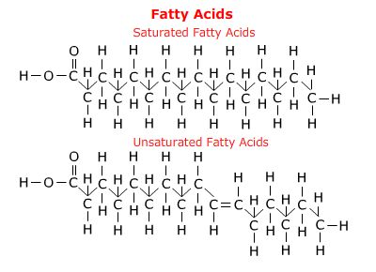

Slide 92
Different Forms Of
Fatty acids In Body

Slide 93
  Free Fatty acid /Unesterified Fatty acid
    Fatty acid has free Carboxylic group
    Fatty acid not linked to an Alcohol by an Ester bond.

Slide 94
  Esterified Fatty acid/Bound form of Fatty Acid
    Fatty has no free Carboxylic group
    Fatty acid is linked to an Alcohol with an Ester bond.

Slide 95
In living beings Fatty acids are not generally present in free form.
Fatty acids are naturally and mostly present in bound form in the plant and animals.
Fatty acids are linked to Hydroxyl group of an Organic Alcohol by an Ester linkage.

Slide 96
Thus Fatty acids are mostly present as Esterified form in natural living beings.
(Plant, Animal and Human Bodies)

Slide 97
Classification of Fatty acids
With Different Modes:

Slide 98
Classification of FAs Based on:
Total number of Carbon atoms in a Fatty acid structure.
Hydrocarbon chain length of Fatty acid
Bonds present in Fatty acid
Nutritional requirement of Fatty acid
Chemical nature and structure of Fatty acids
Geometric Isomerism of UFAs

Slide 99
Fatty acids Based on
Total Number of Carbon atoms

Slide 100
    Even numbered Carbon Atom Fatty acids
    Odd numbered Carbon Atom Fatty acids

Slide 101
Most naturally occurring Fatty acids are even carbon numbered FAs.
Since biosynthesis of Fatty acids uses 2 Carbon units Acetyl-CoA(C2).

Slide 102
Examples of Even Carbon Numbered Fatty acids:
  Butyric Acid (C4)
  Palmitic Acid (C16) (Most Common)
  Stearic Acid (C18)
  Arachidic acid (C20)

Slide 103
Odd Carbon numbered Fatty acids are less related to human body
Examples of Odd carbon Fatty acid
  Propionic Acid ( 3C)
  Valeric acid (5C)

Slide 104
Types Of Fatty acids Based on Hydrocarbon chain length

Slide 105
  Short Chain Fatty acids (2-6 Carbon length)
Examples:
  Acetic acid (C2)
  Propionic acid (C3)
  Butyric acid (C4)
  Valeric acid (C5)
  Caproic acid (C6)

Slide 106
Medium Chain Fatty acids (8-14 Carbon length)
Examples:
  Caprylic acid (C8)
  Capric acid (C10)
  Lauric acid (C12)
  Myristic acid (C14)

Slide 107
Long Chain Fatty acids ( 16-20 Carbon length)
Examples:
  Palmitic acid (C16)
  Palmitoleic acid (C16)
  Stearic acid (C18 )
  Arichidic acid (C20)
  Arachidonic acid /ETA(C20)
  Timnodonic acid/EPA (C20)

Slide 108
Very Long Chain Fatty Acids (C22 onwards )
Examples:
  Behenic acid/Docosanoic (C22)
  Cervonic acid/DocosaHexaEnoic (C22)
  Clupanodonic (C22)
  Erucic acid/Docosa 13 Enoic (C22)
  Lignoceric acid (C24)
  Nervonic /Tetracosaenoic (C24)
  Cerotic acid/Hexacosanoic (C26)

Slide 109
Fatty acids Based on the number of Bonds present

Slide 110
Saturated Fatty acids(SFAs)
Fatty acids having single bonds in hydrocarbon chain structure.
Examples:
  Acetic acid (C2)
  Butyric acid (C4)
  Palmitic acid (C16)
  Stearic acid (C18)
  Arachidic acid(C20)

Slide 111
Unsaturated Fatty acids(UFAs)
Fatty acids having double bonds in its structure.
Types of UFAs:
Monounsaturated Fatty acids (MUFAs)
Polyunsaturated Fatty acids (PUFAs)

Slide 112
Monounsaturated Fatty Acids(MUFAs):
MUFAs have one double bond in a fatty acid structure
Examples:
  Palmitoleic acid (C16:1;9) (ω7)
  Oleic acid (C18:1;9)(ω9)

Slide 113
Poly Unsaturated Fatty Acids (PUFAs):
UFAs with two or more double bonds in
the structure are termed as PUFAs.
Examples:
  Linoleic(18:2;9,12) (ω6)
  Linolenic(18:3;9,12,15) (ω3)
  Arachidonic(20:4;5,8,11,14) (ω6)
  Timnodonic (20:5;5,8,11,14,17) (ω3)
  Cervonic/Docosa Hexaenoic acid(DHA) (22:6;4,7,10,13,16,19) (ω3)

Slide 114
Remember
Double bonds are weaker /unstable bonds.
They get easily cleavable/metabolized

Slide 115
  More the degree of Unsaturation in Fatty acids.
  More is the unstability of Fatty acids.

Slide 116
Fatty acids Based on the Nutritional Requirement

Slide 117
  Nutritionally Essential Fatty acids

Slide 118
  Nutritionally Essential Fatty acids:
  The Fatty acids which are not biosynthesized in the body and are taken through nutrition/diet essentially.
  PUFAS are nutritionally essential Fatty acids.

Slide 119
Examples of Essential Fatty Acids/PUFAs:
  Linoleic
  Linolenic
  Arachidonic acids
  Timnodonic and
  Cervonic

Slide 120
Human body have no Enzyme system to introduce double bond beyond Carbon atom 10 in the hydrocarbon chain.
Hence PUFAs not biosynthesized
in human beings.

Slide 121
Nutritionally Non essential Fatty acids

Slide 122
Nutritionally Non essential Fatty acids:
Fatty acids which are biosynthesized in the body and are nutritionally non essential Fatty acids.
  Saturated Fatty acids and MUFAs are non essential Fatty acids.

Slide 123
Examples Of Non Essential Fatty Acids
Palmitic
Stearic
Oleic acid

Slide 124
Fatty acids Based on
Chemical nature and Structure

Slide 125
  Aliphatic Fatty acids:
  Straight Hydrocarbon chain
Examples:
  Palmitic acid (C16)
  Stearic acid (C18)

Slide 126
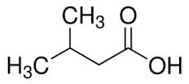
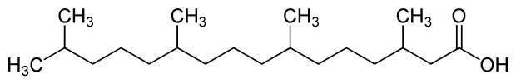
Branched Chain Fatty acids:
Possess Branched chains
Examples:
  Isovaleric (C5)
  Phytanic acid (Butter , dairy products)

Slide 127
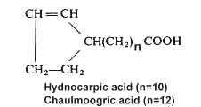
Cyclic Fatty acids :
Contains Ring structure
Examples:
  Chaulmoogric acid
  (Used for Leprosy treatment in olden days)
  Hydnocarpic acid

Slide 128
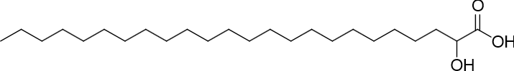
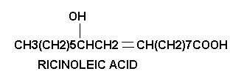
Hydroxy Fatty acids:
Contain Hydroxyl Groups
Examples:
  Cerebronic acid (C24)/
  2-HydroxyTetracosanoic acid
  Ricinoleic acid(C18) (Castor oil)

Slide 129
Based on Geometric Isomerism of Unsaturated Fatty acids

Slide 130
Cis Fatty Acids:
The Groups around double bond of Unsaturated FAs are on same side.
Examples:
  Cis Oleic acid (rich in Olive oil)
  Palmitoleic acid

Slide 131
Trans Fatty Acids :
The groups around double bond of UFAs are on opposite side
Example :
  Elaidic acid /Trans Oleic acid (Hydrogenated Fats )

Slide 132
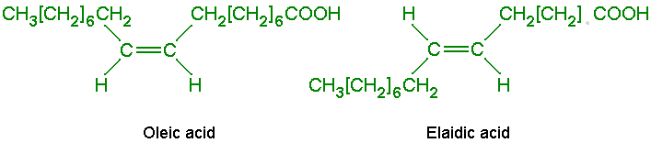

Slide 133
Structures Of Fatty Acids

Slide 134
The Hydrocarbon chain of each Fatty acid is of varying chain length (C2 - C24).

Slide 135
Fatty acid structure have two ends:
  Carboxylic group(-COOH) at one end (Delta end denoted as ∆ )
  Methyl group (-CH3) at another end (Omega end denoted as ω)

Slide 136
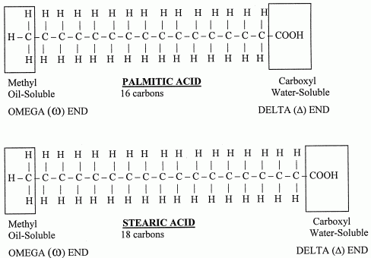

Slide 138
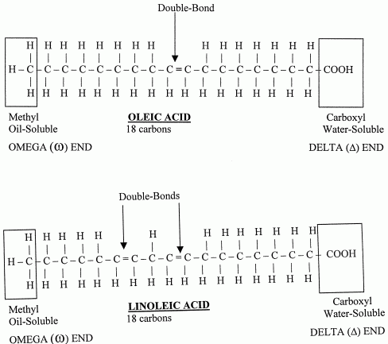

Slide 139
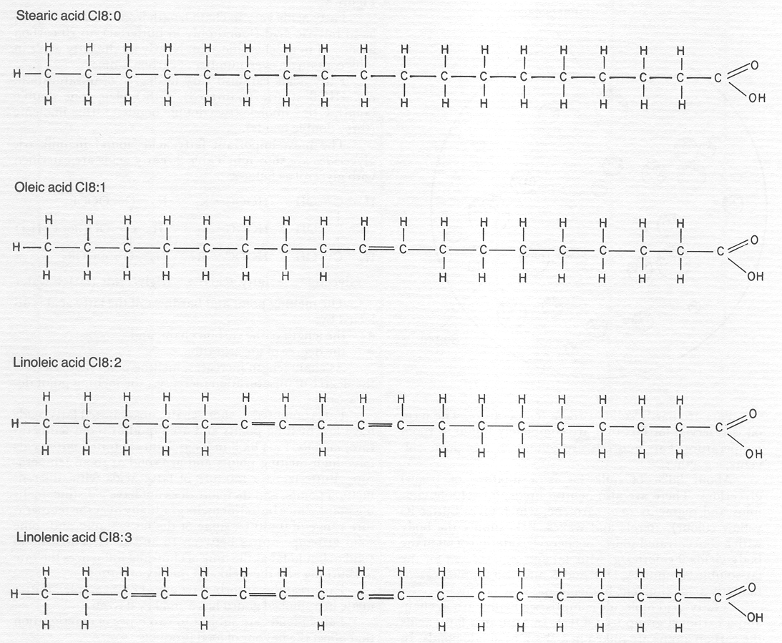

Slide 140
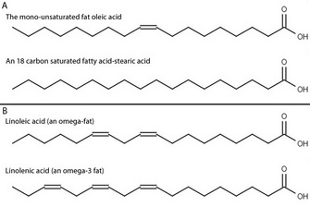

Slide 141
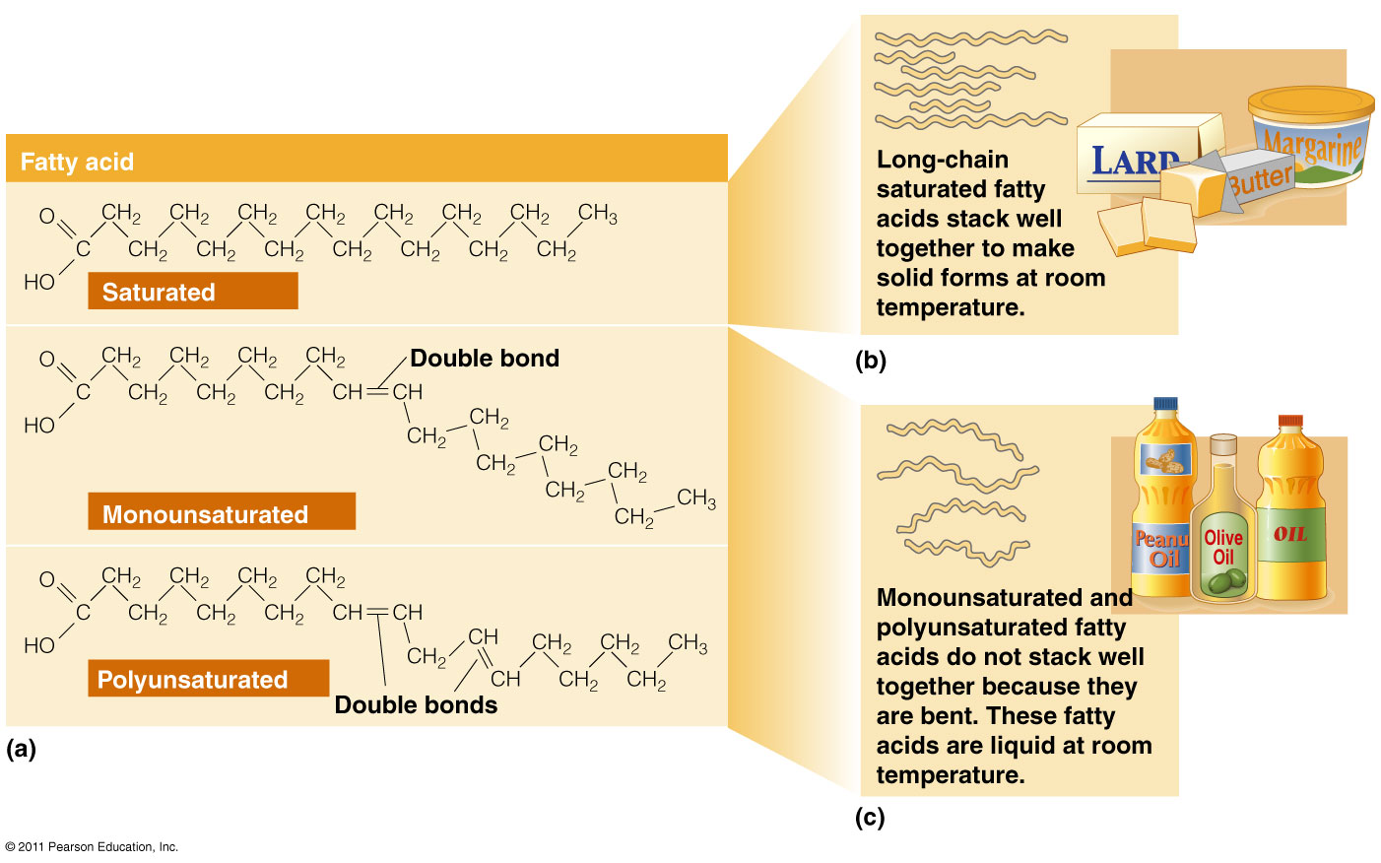

Slide 142
Saturated Fatty acids structures are Straight.
Unsaturated Fatty acids structures are bent(Kink).

Slide 143
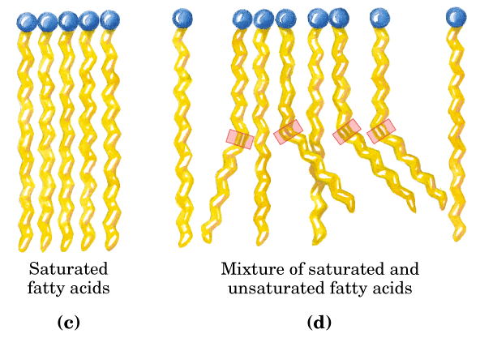

Slide 144
More the degree of unsaturation in FA/More double bonds in FA structure
More is the bent of Fatty acid structure.

Slide 145
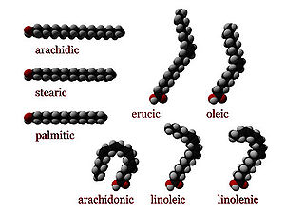

Slide 146
Saturated FAs: with straight structures are tightly packed together.
Unsaturated FAs: with bent structures are not compact and has no tight packing.

Slide 147
Fatty acid Composition of Human Body
Fatty acid | Percentage
Oleic acid | 50% (MUFA)
Palmitic acid | 35% (SFA)
Lionleic acid | 10% (PUFA)
Stearic acid | 5% (SFA)

Slide 148
Thus the most abundant Fatty acids present in human Lipids are:
  Oleic acid (50%)
  Palmitic acid(35%)

Slide 149
Most abundant Fatty acid in a healthy human body is Oleic acid
(Rich in MUFA).
Oleic acid is richly associated with Olive oil.
Hence eating Olive oil is advisable for proper body development and good health.

Slide 150
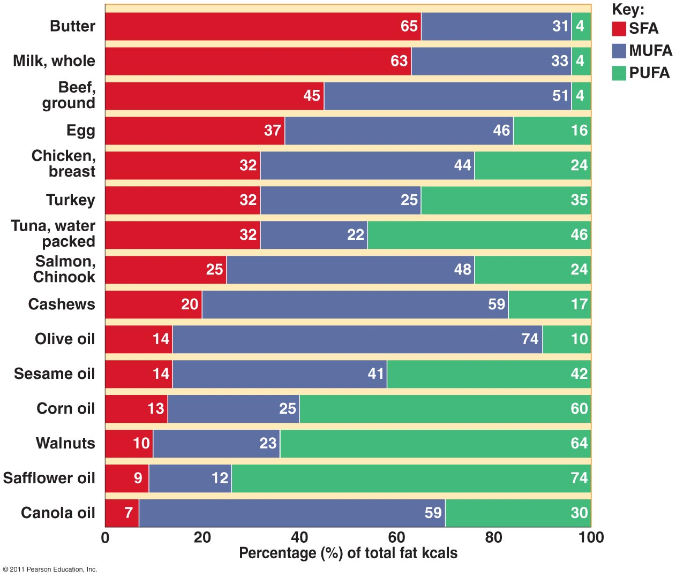

Slide 151
Nomenclature Of Fatty acids

Slide 152
Naming And Numbering
Of Fatty Acids

Slide 153
Every Fatty acids has a:
  Common Name
  Systematic Name
Most of the Fatty acids are known by their common names.(since easy to use)

Slide 154
Systematic names of Fatty acids are limited in use.
(Since not easy to use)

Slide 155
Long chain Fatty acids are termed as Acyl chains.

Slide 156
The systematic names of Saturated Fatty acids are named by adding suffix ‘anoic’.
Example : Hexadecanoic acid(Palmitic acid- C16)

Slide 157
The systematic names of Unsaturated Fatty acids are named by suffix ‘enoic’.
Example: Octadecaenoic acid(Oleic acid- C18)

Slide 158
S.N | Common Name | Systematic Name
1 | Palmitic Acid | Hexadecanoic Acid
2 | Stearic Acid | Octadecanoic Acid
3 | Oleic acid | Octadecaenoic acid
4 | Linoleic Acid | Octadecadienoic acid
5 | Linolenic Acid | Octadecatrienoic acid
6 | Arachidonic acid | Eicosatetraenoic acid

Slide 159
Numbering Of Fatty Acids

Slide 160
Numbering of Fatty acids is done from :
  Both the ends of Fatty acids ∆ and ω
  From Carboxyl Group end(∆) : the Carboxylic acid group of Fatty acid is C1, C2 is next adjacent ,C3 and so onn.

Slide 161
The name of Carbon atom next to the functional group –COOH of a Fatty acid is α , next Carbon is β, γ,δ ,ε and so onn.

Slide 162
Carbon atoms from Methyl(–CH3) group at non polar end(ω) of a fatty acid are numbered as ω1,ω2,ω3 and so onn.

Slide 164
Fatty Acid Nomenclature

Slide 165
FA Nomenclature is Based On
Chain length
  Number of Carbon atoms in FA
Number and Position of Double bonds
  Position of double bond from Methyl/Omega or Carboxyl/Delta end

Slide 166
Short Hand Representations of Fatty acids

Slide 167
Short Hand Representations
of Fatty acids:
  Palmitic Acid (16:0)
  Palmitoleic acid (16:1;9)
First digit stands for total number of carbon atoms in the fatty acid.
Second digit designates number of double bonds.
Third digit onwards indicates the position of double bonds.

Slide 168
Fatty-acid Nomenclature
Named according to chain length
  C18

Slide 169
Fatty-acid Nomenclature
Named according to the number of
double bonds
  C18:0
Common name:
Stearic acid

Slide 170
Fatty-acid Nomenclature
Named according to the number of
double bonds
  C18:1
Common name:
Oleic acid

Slide 171
Fatty-acid Nomenclature
Named according to the number of
double bonds
  C18:2
Common name:
Linoleic acid

Slide 172
Fatty-acid Nomenclature
Named according to the number of
double bonds
  C18:3
Common name:
Linolenic acid

Slide 173
  Omega System Nomenclature
Named according to the
location of the first double bond from the non-carboxyl Methyl end (count from the Methyl end /Omega end ω)

Slide 174
Omega Fatty-acid Nomenclature
Omega 9 or n–9 fatty acid
Omega 6 or n–6 fatty acid
Omega 3 or n–3 fatty acid

Slide 175
  Stearic acid (18:0)
  Oleic acid (18:1;9)
  Linoleic acid (18:2;9,12)
  Linolenic acid (18:3;9,12,15)
  Arachidonic acid (20:4;5,8,11,14)

Slide 176
A Fatty acid may also be designated as :
Linoleic acid (18C;∆^{9,12})
Linolenic acid (18C;∆^{9,12,15})
∆ indicates from COOH end.
9,12,15 are double bond positions from delta end.

Slide 177
Short Hand Presentation of FA
14:0 Myristic acid
16:0 Palmitic acid
18:0 Stearic acid
18:1 cis Δ⁹ Oleic acid (ω9)
18:2 cisΔ^{9,12} Linoleic acid(ω6)
18:3 cisΔ^{9,12,15} α-Linolenic acid (ω3)
20:4 cisΔ^{5,8,11,14} Arachidonic acid(ω6)
20:5 cisΔ^{5,8,11,14,17} Eicosapentaenoic acid(ω3 )

Slide 178
Omega Series Fatty Acids

Slide 179
Omega Fatty Acids
Omega Fatty acids are Unsaturated Fatty acids (UFAs)
In whom the position of double bond is counted from Omega end/Methyl end as(ω) carbon atom
Terminal Methyl group is ω1

Slide 180
Classification/Types
Of
Omega Fatty Acids

Slide 181
Types Of Omega Fatty acids
    ω3 Fatty acids
    ω6 Fatty acids
    ω7 Fatty acids
    ω9 Fatty acids

Slide 182
Omega Classification of Fatty acids is used frequently in
  Nutrition and Clinical practice.

Slide 183
Omega 3 Fatty Acids

Slide 184
Omega 3 Fatty Acids
Fatty acids having their first double bond at
ω3 carbon atom are Omega 3 Fatty acids.

Slide 185
Examples of ω3 Fatty acids
Linolenic (18:3;9,12,15) (ω3)
Timnodonic/EPA (20:5;5,8,11,14,17)(ω3)
Clupanodonic acid/(Docosa Pentaenoic Acid): (DPA) (C22:5;7,10,13,16,19 )(ω3)
Cervonic/Docosa Hexaenoic Acid (DHA)(22:6;4,7,10,13,16,19)(ω3)

Slide 186
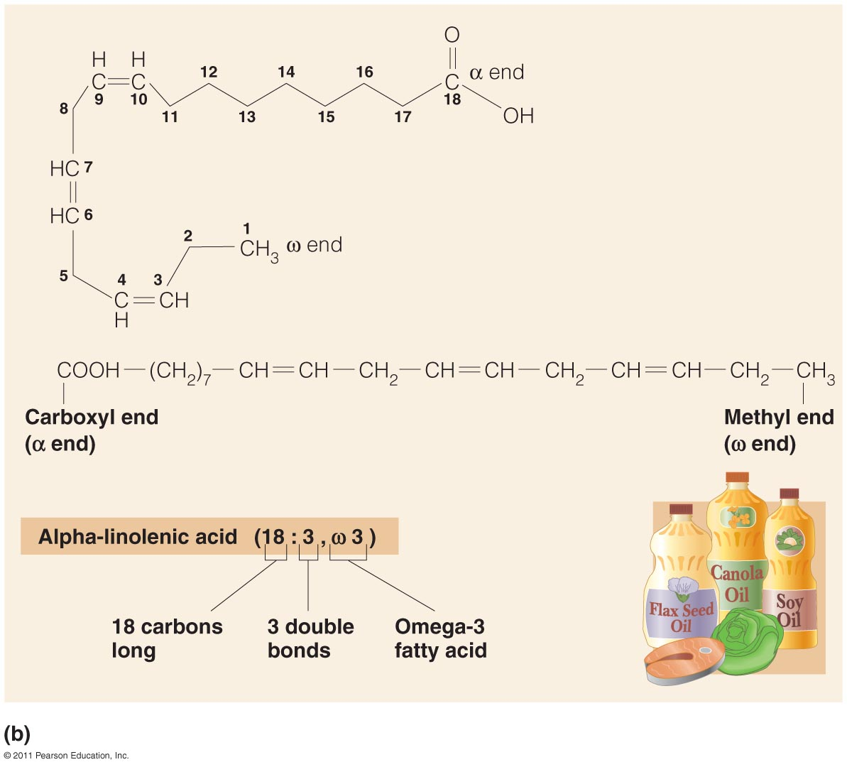

Slide 187
Omega 3 Fatty acids are PUFAs
Not biosynthesized in human body.
Nutritionally essential Fatty acids.
They have to be taken essentially through diet .

Slide 188
Dietary Sources Of
Omega 3 Fatty Acids

Slide 189
Omega 3 Fatty acids are richly present in:
  Green leaves
  Algae
  Fishes
  Animal Meat
  Natural Plant Oils

Slide 190
Dietary rich sources of
Omega-3 Fatty acids
Are Fish and Fish oils:
  Docosahexaenoic acid (DHA)/Cervonic acid
  Eicosapentaenoic acid (EPA)/Timnodonic acid

Slide 191
Functions Of Omega 3 FAs
Omega 3 Fatty acids are components
of cell biomembranes.
Omega 3 Fatty acids are more associated to Human brain.
Helpful in growth ,development
and functioning of brain.

Slide 192
Thus Omega 3 fatty acids plays good role in
Developing mental well being of infants and adults.

Slide 193
Since Omega 3 Fatty Acids are PUFAS
They are easily metabolizable in human body

Slide 194
Omega 3 Fatty acids Reduces risk of heart disease:
  By stimulating Prostaglandins and Prostacyclin's that reduces Platelet aggregation.
  Which reduces blood clotting and Thrombus formation.

Slide 195
Omega 3 Fatty acids have pleiotropic effects(more than on effect):
  Cardio protective effect
    Lowers Blood pressure
    Anti-Inflammatory
    Anti-Atherogenic
    Anti-Thrombotic

Slide 196
Thus Fish Eaters has good
Brain development with an efficient nervous function.
Protected from Heart attacks.

Slide 197
Deficiency Of Omega 3 Fatty acids
Deficit of omega 3 fatty acids affect the normal growth ,development and functioning of brain.
Persons may suffer from mental illness like:
  Depression
  Attention deficit
  Dementia

Slide 198
Deficiency of Omega 3 Fatty acids :
  Alters the cell membrane structure.
  Increases the risk of heart attack.

Slide 199
Omega 6 Fatty Acids
Omega 6 Fatty Acids: These fatty acids has their first double bond at ω6 carbon atom.
Examples of ω6 Fatty acids:
  Linoleic acid(18:2;9,12) (ω6)
  Arachidonic acid(20:4;5,8,11,14) (ω6)

Slide 200
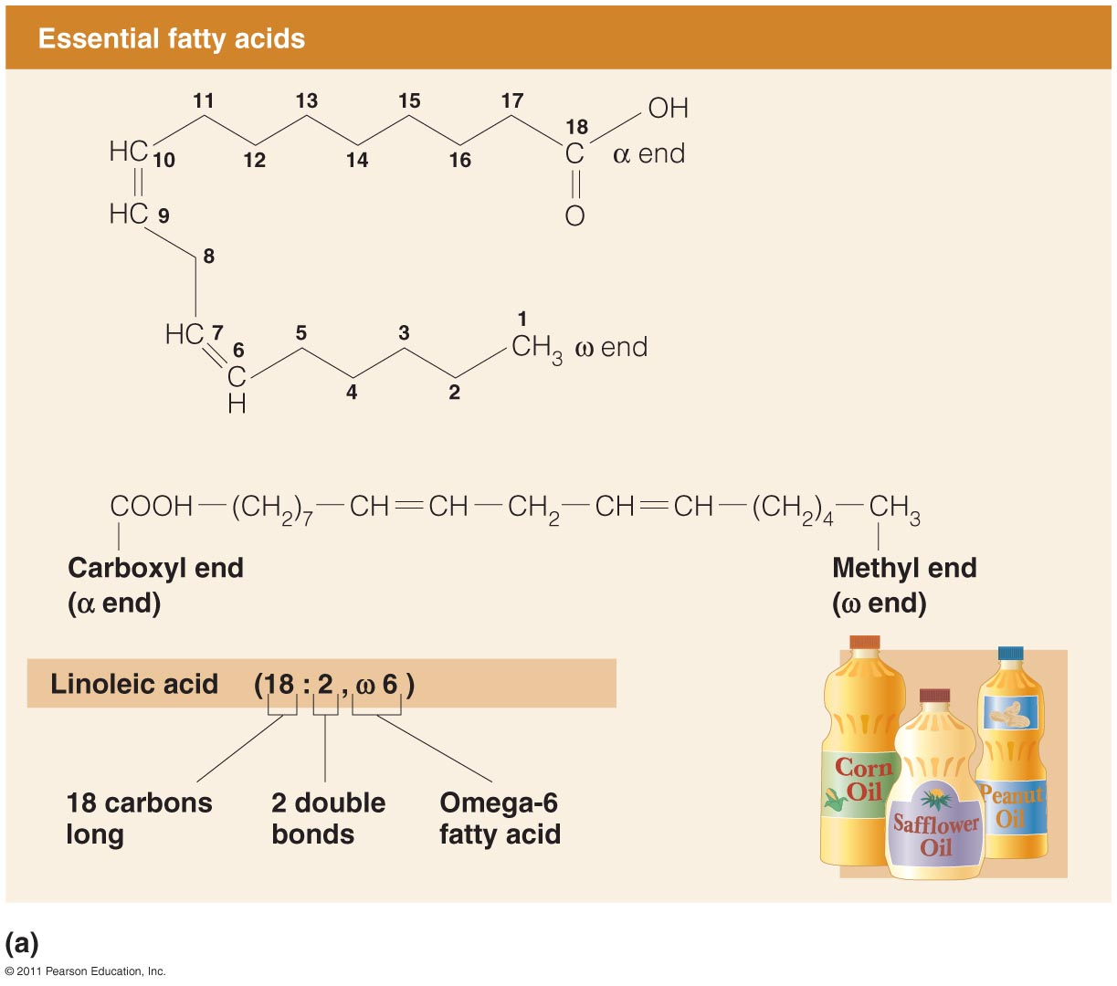

Slide 201
Omega 7 Fatty Acids
Omega 7 Fatty Acids fatty acids has their first double bond at ω7 carbon atom.
  Palmitoleic acid (C16:1;9) (ω7)

Slide 202
Omega 9 Fatty Acids
Omega 9 Fatty Acids: These fatty acids has their first double bond at ω9 carbon atom.
Examples of ω9 fatty acids:
    Oleic acid (C18:1;9)(ω9)
    Nervonic acid (C24:1;9)(ω9)

Slide 203
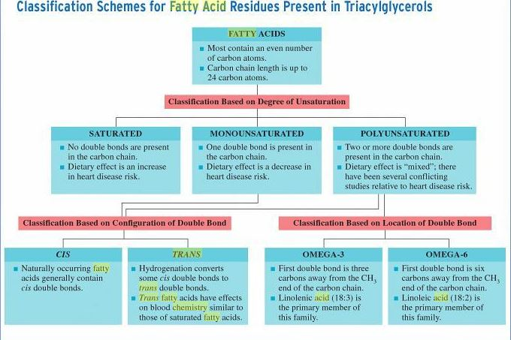

Slide 204
Poly Unsaturated Fatty Acids
(PUFAs)

Slide 205
Dietary Rich Sources Of
PUFAs
PUFAs are nutritionally essential since they are not biosynthesized by human beings
Hence Human beings should take dietary Lipids to get essential Fatty acids.

Slide 206
Rich sources of dietary essential PUFAs are:
  Vegetable Oils
  Fish and Fish oils
  Green Leaves, Algae

Slide 207
Arachidonic acid(PUFA) can be synthesized from Linoleic acid(PUFA) in human body.

Slide 208
Proper Requirement
Of Fatty Acids To Human Body

Slide 209
It is ideal to consume ratio of:
1 : 1 : 1
SFA MUFA PUFAs
respectively from the diet to maintain good health.

Slide 210
Naturally there is no single oil which has all 3 types of fatty acids in ideal proportion.
Hence it is always advisable to mix a combination of oils and consume.

Slide 211
Oils Rich In SFAs | Oils rich in MUFAs | Oils rich in PUFAs
Coconut Oil | Olive Oil (75%) | Flax seeds/ Linseed Oil
Palm Oil | Sunflower Oil (85%) | Soya /Safflower Oil
Butter | Ground nut / Pea nut Oil | Almond Oil
Animal Fat | Almond Oil | Rice Bran
 | Sesame Oil | Walnuts Oil
 | Beef Fat (Tallow Fat) 50% | Corn Oil
 | Lard (Pork Fat) 40% | Marine Fish

Slide 213
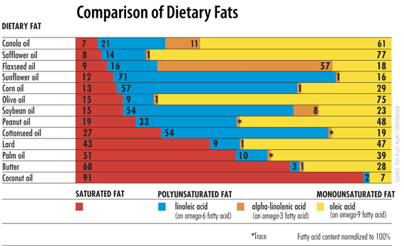

Slide 214
Fatty Acids | Carbons | Double bonds | Abbreviation | Source
Acetic | 2 | 0 | 2:0 | bacterial metabolism
Propionic | 3 | 0 | 3:0 | bacterial metabolism
Butyric | 4 | 0 | 4:0 | butterfat
Caproic | 6 | 0 | 6:0 | butterfat
Caprylic | 8 | 0 | 8:0 | coconut oil
Capric | 10 | 0 | 10:0 | coconut oil
Lauric | 12 | 0 | 12:0 | coconut oil
Myristic | 14 | 0 | 14:0 | palm kernel oil
Palmitic | 16 | 0 | 16:0 | palm oil
Palmitoleic | 16 | 1 | 16:1 | animal fats
Stearic | 18 | 0 | 18:0 | animal fats
Oleic | 18 | 1 | 18:1 | olive oil
Linoleic | 18 | 2 | 18:2 | grape seed oil
Linolenic | 18 | 3 | 18:3 | flaxseed (linseed) oil
Arachidonic | 20 | 4 | 20:4 | peanut oil, fish oil

Slide 215
Functions/Role/Significance Of Fatty Acids/PUFAS

Slide 216
1.Secondary Source Of Energy

Slide 217
Fatty acids/PUFAs are essential components of different forms of simple and compound lipids.
Fatty acids are highly reduced compounds.
Oxidation of FAs in the body provide secondary source of energy (ATP).

Slide 218
2.Components Of Biomembranes

Slide 219
PUFAs are component of Phospholipids.
Since the second Fatty acid in Phospholipid is mostly PUFA.
PUFAs are important constituents of biomembranes of every body cell and cell organelles.

Slide 220
PUFAs of membrane play role in:(Less compact)
  Membrane fluidity
  Selective permeability

Slide 221
3.PUFAs Lower Blood Cholesterol Levels

Slide 222
Essential Fatty acids lower the serum levels of Cholesterol.
By esterifying Cholesterol.
Cholesterol ester is later degraded and excreted out through feces via bile.

Slide 223
4.PUFA Precursor for Eicosanoid Biosynthesis

Slide 224
Arachidonic acid (20 Carbon PUFA) is a precursor for biosynthesis of various Eicosanoids.

Slide 225
5.Structural Component Of Organs

Slide 226
PUFAs has role in Brain development and its functions.
Maintains the viability of islet cells of Pancreas.

Slide 227
Essential fatty acids are structural components of gonads.
Lionlenic acid increases vision.

Slide 228
Essential fatty acids prevents Fatty Liver.
By helping in formation of Lipoproteins and mobilizing out the Lipids from Liver.

Slide 229
PUFAs prevents early ageing.
EFAs Prolongs Clotting time.

Slide 230
6.PUFAs Protect Heart

Slide 231
Dietary PUFAs are easily metabolized in the body.
Since the double bonds are unstable and easily cleavable.
PUFAs do not get accumulated in the blood arteries and capillaries.
Thus PUFAs have low risk of Atherosclerosis and Cardio vascular disorders.

Slide 232
Deficiency Of PUFAs

Slide 233
Deficiency Of PUFAs is Rare.
May be Suffered by:
Infants :Not fed with natural milk and natural food items.
But fed with formula diets which have low fat content.
Adults : Eating poor diet not containing PUFAs for long periods.

Slide 234
Phrynoderma /Toad Skin is due to PUFA deficiency.

Slide 235
Phrynoderma /Toad Skin Symptoms
The skin becomes dry with lesions
(Scaly Dermatitis).
Presence of horny erruptions on the posterior and lateral parts of limbs, back and Buttock.
Loss of hair
Poor wound healing

Slide 236
Deficiency of Essential Fatty acids :
Affects every cell ,organ and system
  Growth retardation
  Problems with reproduction
  Skin lesions
  Kidney and Liver disorders
  Brain disorders/Behavioral disorders.

Slide 237
Transportation Of Fatty Acids Through Blood Circulation

Slide 238
Fatty acids Transportation In body
More than 90% of the fatty acids found in plasma are in the form of Fatty acid esters.
  Fatty acids are in bound form as:
  Triacylglycerol
  Cholesteryl esters
  Phospholipids

Slide 239
Bound form of Fatty acids are Transported through various Lipoproteins.

Slide 240
Unesterified/Free Fatty acids are very less amount in body.
FFA are transported in the blood circulation in association with Albumin.

Slide 241
Properties Of Fatty Acids

Slide 242
Solubility Of Fatty acids:
Solubility of Fatty acids depends upon :
The hydrocarbon chain length
Fatty acids with small chain length are more soluble.

Slide 243
Solubility of Fatty acids decreases
With increase in Fatty acid hydrocarbon chain length.

Slide 244
Acetic acid most simplest fatty acid is soluble in water.
Palmitic acid ,Stearic acid are insoluble in water.

Slide 245
Melting Point Of Fatty acids:
Melting point of a Fatty acid depends upon:
  Chain length of FA
  Nature of bonds in hydro carbon chain of FA.

Slide 246
  Short and unsaturated Fatty acids has low melting point.
  Long and Saturated Fatty acids are has high melting point.

Slide 247
Thus melting point of Fatty acids(FAs):
  Increases with increase in chain length of FAs.
  Decreases with decrease in chain length of FAs.

Slide 248
Melting Points
Affected by chain length
  Longer chain = higher melting temp
Fatty acid: C12:0 C14:0 C16:0 C18:0 C20:0
Melting point: 44°C 58°C 63°C 72°C 77°C

Slide 249
Fatty Acids

Slide 250
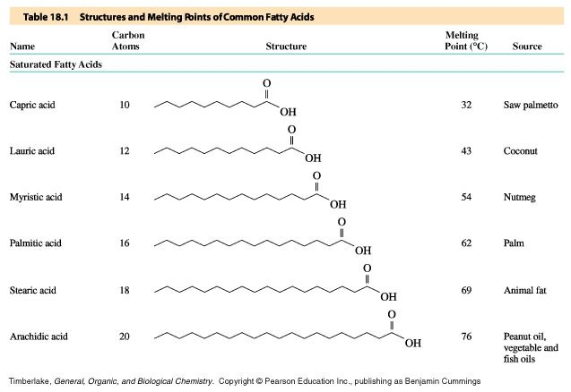
Structures and Melting Points of Saturated Fatty Acids

Slide 252
Melting Points
Affected by number of double bonds
  More saturated = higher melting temp
Fatty acid: C18:0 C18:1 C18:2 C18:3
Melting point: 72°C 16°C –5°C –11°C

Slide 253
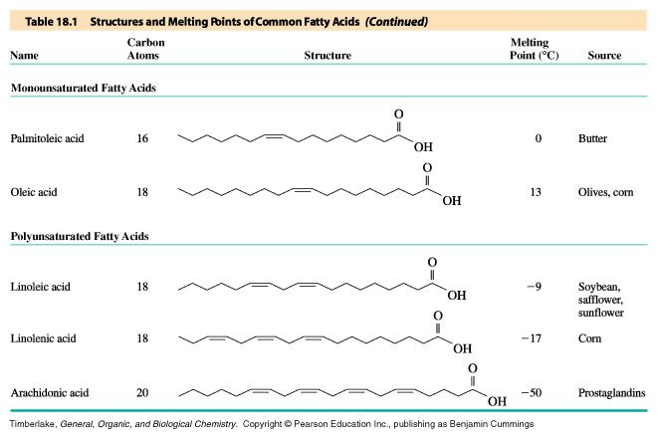
Structures and Melting Points of Unsaturated Fatty Acids

Slide 254
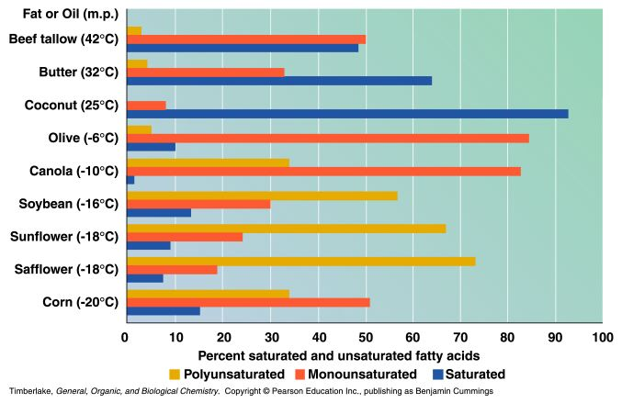
Melting Point and Fatty Acid Composition of Some
Fats and Oils

Slide 255
Saturated Fatty acids has straight and extended conformation which can be packed into compact structure.
More heat energy is required to remove the compact structures of Saturated Fats.

Slide 256
Unsaturated fatty acids has rigid bends in its structure hence not packed compactly.
Less heat energy is required to separate these less compact Unsaturated fatty acids.

Slide 257
Membrane Lipids are fluid by consistency as they are more composed of unsaturated fatty acids.
Storage Lipids which are anhydrous has Long saturated Fatty acids.

Slide 258
Significance Of -COOH group
Of Fatty Acids

Slide 259
Saponification /Salt Formation
The Carboxyl groups of Fatty acids reacts with strong Alkalies KOH/NaOH
To form their Salts which are Soaps.
This property is used for commercial manufacture of Soaps.

Slide 260
Ester Formation
The Carboxyl group of Fatty acids reacts with Hydroxyl groups of Alcohols Glycerol/Sphingosine)
To form Esters bonds, of Simple and Compound Lipids.

Slide 261
Fatty acids get esterified with Alcohols to form various simple and compound Lipids:
  Triacylglycerol
  Waxes: Cholesterol ester
  Phospholipids
  Glycolipids
  Lipoproteins

Slide 262
Hydrogenation Of Fatty Acids
Hydrogenation of Fatty acids is a conversion of
Double bonds of a unsaturated fatty acid to single saturated bonds.

Slide 263
Thus process of Hydrogenation transforms Unsaturated Fatty acids to Saturated Fatty acids.

Slide 264
The process of Hydrogenation also transforms naturally occurring Cis Fatty acids to Trans Fatty acids.

Slide 265
Halogenation Of Fatty acids
Adding Halogens like Cl, Br or I at double bonds of UFAs and making saturated.

Slide 266
The number of Halogen atom taken up are dependent on the number of double bonds in the structure of Fatty Acid.

Slide 267
Significance Of Halogenation
Halogenation of fatty acids is an index of assessing the degree of unsaturation

Slide 268
Iodine Number is a process of Halogenation which checks the content of SFA and PUFAs of Fats and Oils.
SFA has zero Iodine number.
PUFAs has high Iodine number.

Slide 269
Geometric Isomerism Of Unsaturated Fatty acids

Slide 270
Depending on orientation of atoms or groups around the axis of double bonds.
  Cis form of Fatty acids
  Trans form of Fatty acids

Slide 271
Cis Form Fatty acids
Most naturally occurring UFAs are of cis form.
The groups around double bond are on same side.

Slide 272
All Cis FA has an angle of 120 degree at the double bond.
Cis forms are L shaped structures
(due to bend /kink in structure).

Slide 273
Phospholipids of biological membranes contain Cis form of fatty acids which has kinks/bents .
This prevent compact packing of fatty acid chains and are responsible for the fluidity of membranes.

Slide 274
All-Cis Fatty acids
Good for Health
Human body contain Enzyme system to metabolize Cis form of Fatty acids.
Cis forms when ingested through food are easily metabolized and does not retain in the body.
Hence good for health and no risk of Atherosclerosis and CVD.
All Cis form of fatty acids are unstable and easily metabolizable.

Slide 275
Trans Form Of Fatty acids
Trans fatty acid structures are straight and has no bend.
The groups around the double bonds are on opposite sides.
Trans form of fatty acids are stable and less metabolizable.

Slide 276
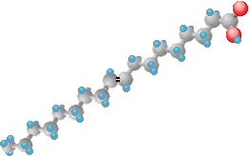

Named According to Location of H’s
  Cis or trans fatty acids
Cis-9-octadecenoic acid (Oleic acid) | Trans-9-octadecenoic acid (Elaidic acid)

Slide 277
Cis and Trans Fatty Acids
H
2
H
2
H
2
H
H
3
C
C
C
C
C
C
C
C
C
H
2
H
2
H
2
H
2

Slide 278
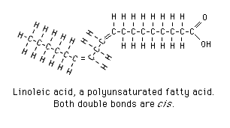
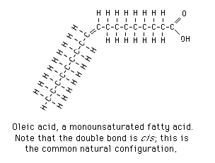
Cis Fatty Acids

Slide 279
Trans form of Fatty acids
  Less occur in natural foods.
  Obtained as byproducts of Hydrogenation of oils.

Slide 280
More content of Trans Fatty acids are found in processed foods viz:
  Hydrogenated Oils (Vanaspati Dalda)
  Ghee
  Margarine
  Bakery products /Fast foods
  Deeply Fried recipes in Oils which are prepared in repeatedly heated oils.

Slide 281
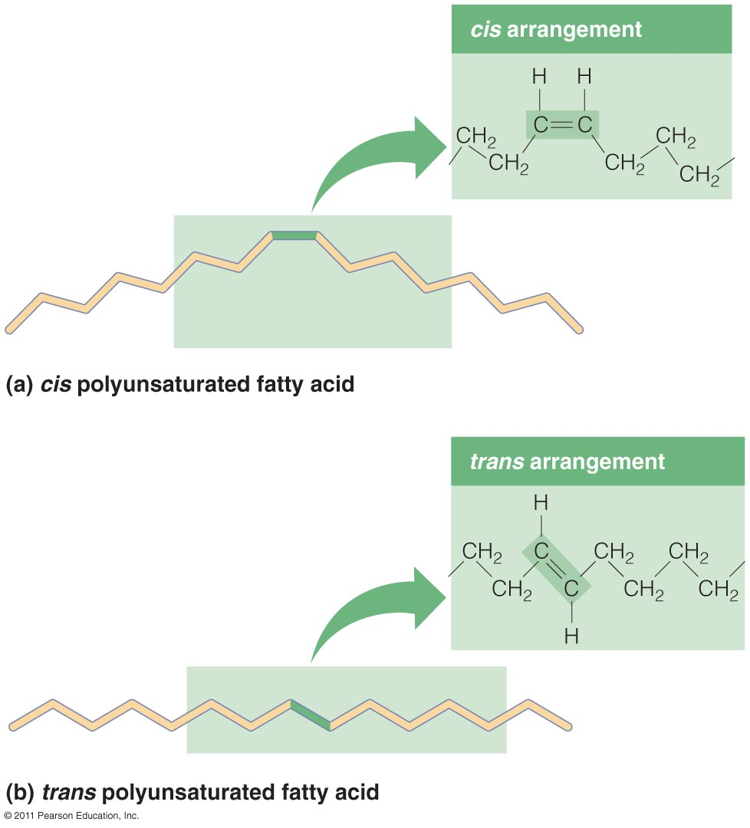

Slide 283
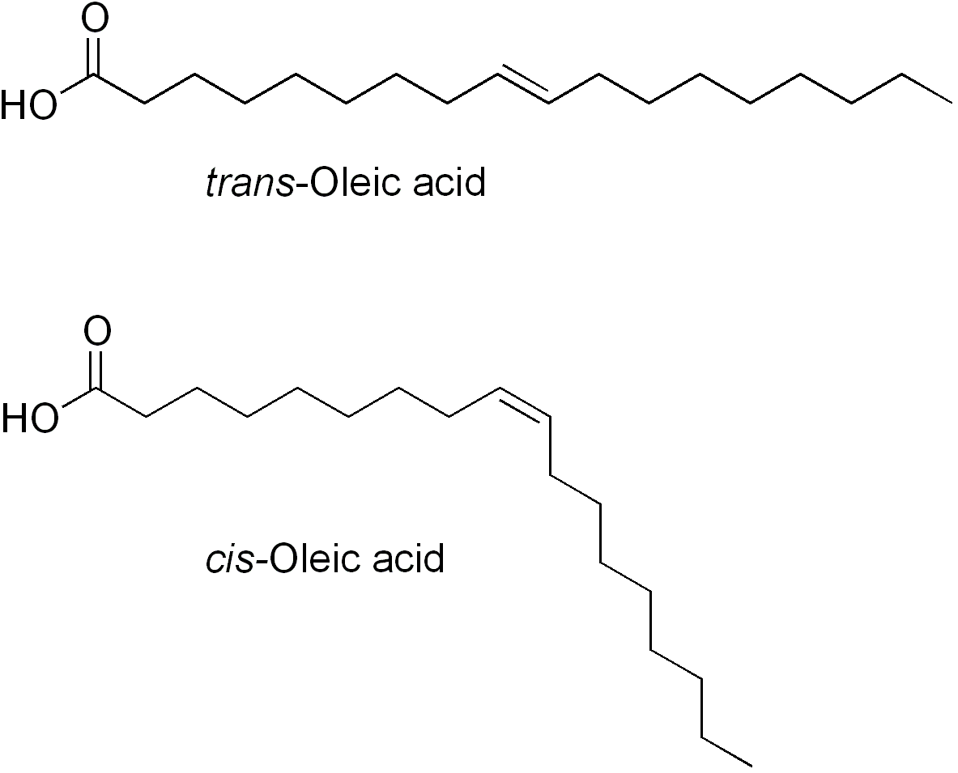

Slide 284
Trans Fatty Acids
Detrimental to Health

Slide 285
Trans Fatty Acids
Not Metabolized Easily
Human body has no Enzyme system to metabolize the Trans Fatty acids.
Foods ingested with rich concentration of Trans fatty acids do not get metabolized.
Trans fatty acids get retained in body tissues, blood vessels(harden the blood vessels).
They increases risk of Atherosclerosis.
Block or reduce the blood supply to tissues.

Slide 286
Trans fatty acids increases risk of :
  Atherosclerosis
  Cardio Vascular disorders:
    Ischemia
    Myocardial Infarction
  Stroke(Brain attack)

Slide 287
Study Of Derived Lipids Alcohols

Slide 288
Alcohols Involved In
Lipid Structures

Slide 289
3 Alcohols Involved In Lipids
1. Glycerol
(C3-Trihydric Alcohol)
2. Sphingol/Sphingosine
(C18-Dihydric Alcohol)
3. Cholesterol
(C27-Monohydric Alcohol)

Slide 290
Alcohols Of Lipids
Are
Classified
As
Derived Lipids

Slide 291
Glycerol/ Glycerin
Glycerol [C3 ]is a POLYOL
Glycerol is chemically Trihydric Alcohol (3 –OH groups)
In human body Glyceraldehyde on reduction gives Glycerol.

Slide 292
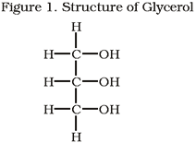

Slide 293
Glycerol is a backbone of Glycerol based Lipids viz:
  Triacylglycerol
  Glycerophospholipids

Slide 294
Glycerol is a
Derived Lipid
Obtained from Hydrolysis of Simple and Compound Lipids

Slide 295
SPHINGOSINE/SPHINGOL

Slide 296
Sphingosine is a C18, complex Dihydric, Amino alcohol.
Serine provides NH2 group of Sphingosine.

Slide 297
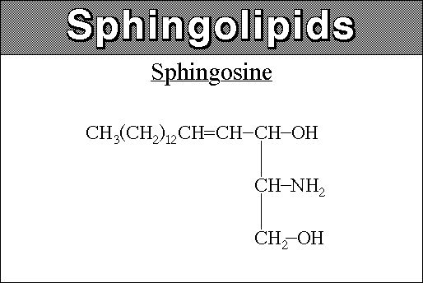

Slide 298
What Is a Ceramide?
A Fatty acid linked to an amino group of Sphingosine
With an amide linkage form a Ceramide.

Slide 299
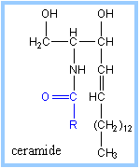

Slide 300
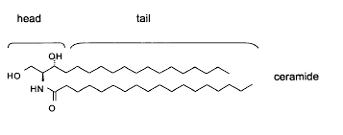

Slide 301
Ceramide if linked to Phosphate and Nitrogenous groups forms Sphingophospholipids.
Ceramide linked to Carbohydrate moieties form Glycolipids.

Slide 302
Sphingosine forms Sphingolipids /Compound Lipids with Alcohol Sphingol
Examples of Sphingolipids:
    Sphingophospholipids
    Glycolipids

Slide 303
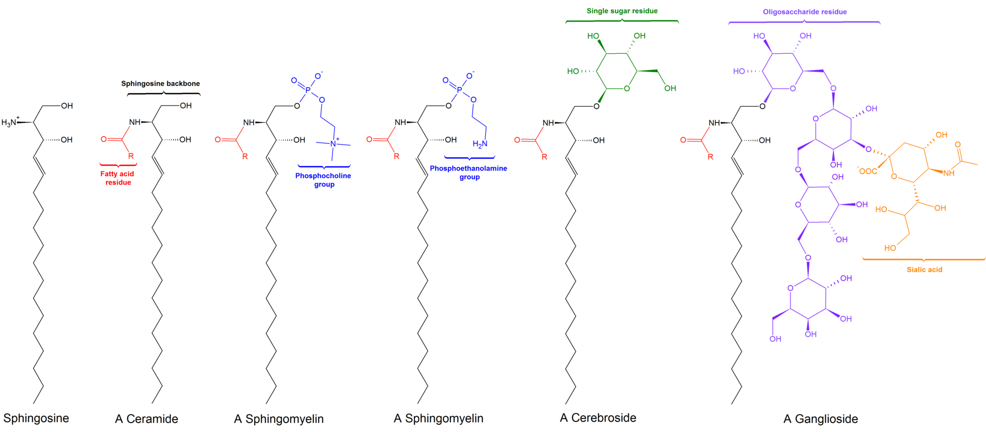

Slide 304
Sphingosine is a derived Lipid.
Obtained from Hydrolysis of Sphingolipids

Slide 305
Sterols

Slide 306
Sterols are chemically complex, cyclic ring structures.
Sterols are complex organic monohydric Alcohols.

Slide 307
Examples Of Sterols
Cholesterol (Animal Sterol)
7 Dehydrocholesterol( Provitamin D)
Ergosterol (Plant Sterol)
Sitosterol (Plant Sterol)
Coprosterol (Excretory form of Cholesterol)

Slide 308
Sterols have a parent ring
Cyclo Pentano Perhydro Phenantherene (CPPP) nucleus.

Slide 309
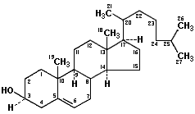
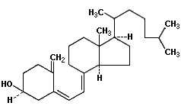
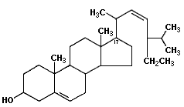
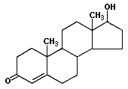
Common Sterol Compounds
Vitamin D3
(cholecalciferol)
Cholesterol
(a sterol)
Stigmasterol (a phytosterol)
Testosterone
(a steroid hormone)

Slide 310
Cholesterol A Derived Lipid

Slide 311
Cholesterol is classified as Derived Lipid.
It is derived from Cholesterol Ester (Wax).

Slide 312
Cholesterol
Cholesterol is an Animal Sterol .
Cholesterol means Solid Alcohol as it was first obtained from gall stones of bile.
Cholesterol is richly composed in Gall stones.

Slide 313
Structure Of Cholesterol
Cholesterol is complex cyclic unsaturated, monohydric Alcohol.
Its molecular formula is C27H45 OH.

Slide 314
Cholesterol has parent nucleus as Cyclo Pentano Per hydro Phenantherene ring system(CPPP).
The structure of CPPP has four fused cyclic rings (A,B,C and D)

Slide 315
Hexane ring A,B,C is a Phenatrene nucleus.
D ring is Cyclopentane ring.

Slide 316
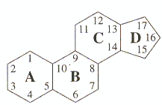
Pentahydrophenantrene (sterane)

Slide 317
The Structure of Cholesterol Possess:
Hydroxyl group (-OH) at C3.
Double bond between C5 and C6.
5 Methyl (-CH3) groups.
A 8 Carbon side chain linked to C17 of the structure.

Slide 318
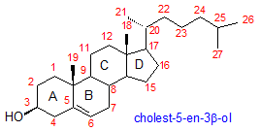

Slide 319
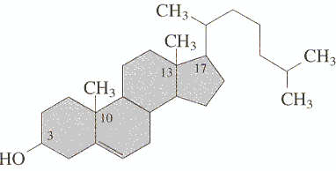
Cholesterol is the Most abundant Sterol of Human body

Slide 320
Forms Of Cholesterol
Cholesterol exists in two forms:
  Free Cholesterol - 30%
  (Amphipathic form)
  Cholesterol Ester - 70%
  (Non polar form)

Slide 321
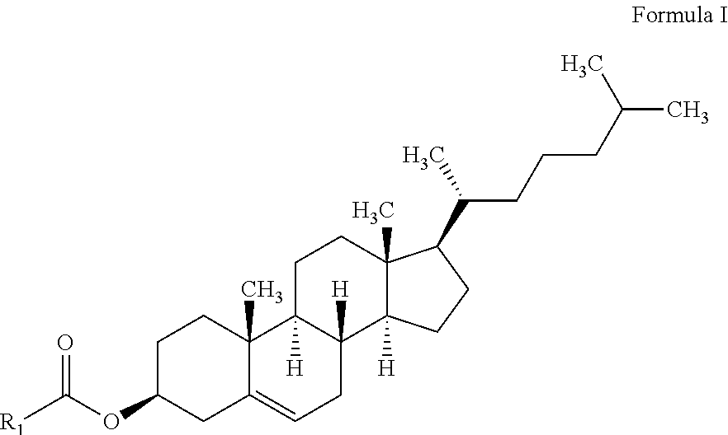

Slide 322
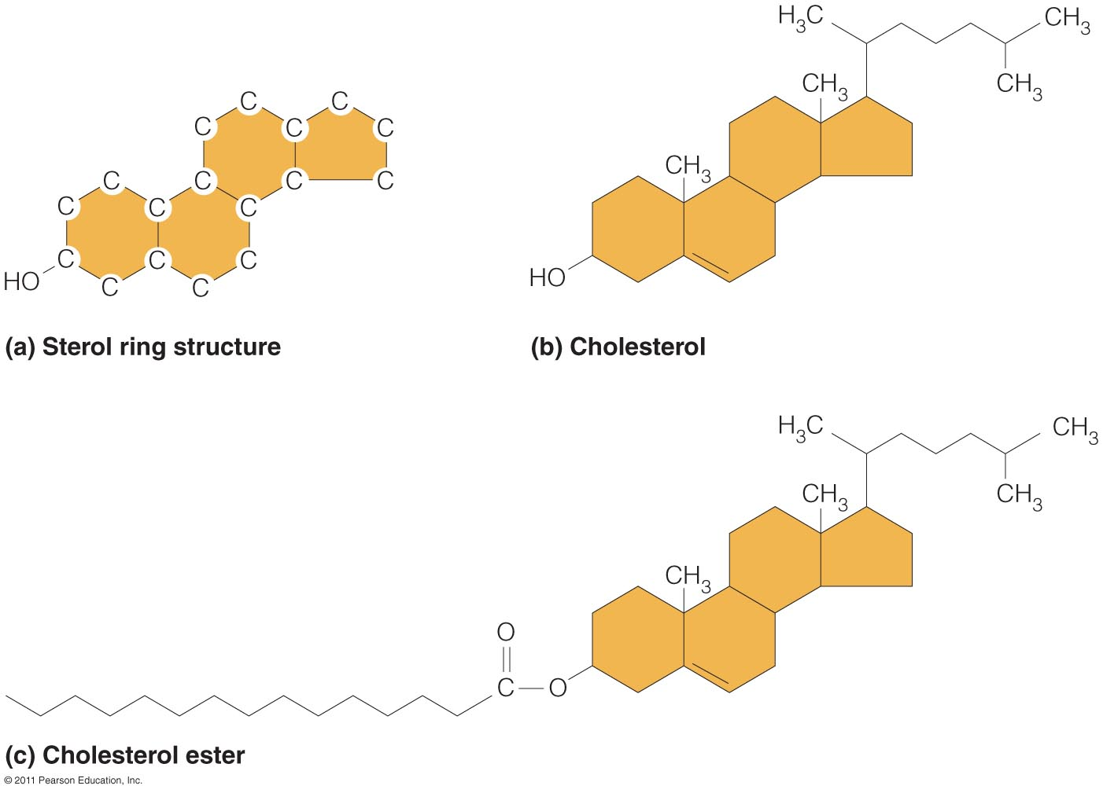

Slide 323
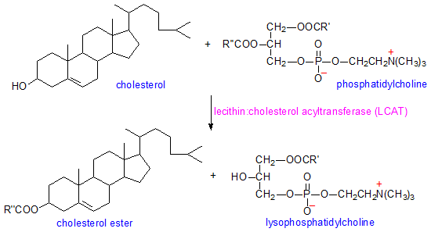

Slide 324


Slide 325
Properties Of Cholesterol
Cholesterol is white or pale yellowish, crystalline ,odorless compound.
Insoluble in water and soluble in organic solvents like Ether and Chloroform.
It forms crystal of rhombic plates with notched edges.

Slide 326



Slide 327
Qualitative Tests Of Cholesterol detection are:
  Liebermann Burchard Reaction
  Salkowski Reaction
  Zak’s Reaction

Slide 328
Sources Of Cholesterol
To Human Body

Slide 329
Exogenous Sources of Cholesterol:
  Animal Origin Food Items
Endogenous Source Of Cholesterol:
  Obtained In well fed condition from Excess Glucose

Slide 330
Dietary Sources Of Cholesterol
Cholesterol is exclusively present in animal body hence it is an animal sterol.

Slide 331
The dietary rich sources of Cholesterol are animal origin foods like:
  Egg Yolk
  Meat
  Milk
  Butter
  Cream

Slide 332
Remember Cholesterol is absent in plant origin food items.

Slide 333
Occurrence and Distribution Of Cholesterol in the Body

Slide 334
Cholesterol is richly present in Nervous tissue Brain.
Other organs containing Cholesterol are:
  Intestinal Mucosal cells
  Skin
  Liver
  Adrenal Cortex
  Gonads

Slide 335
  70 % of Cholesterol associated with cellular components
  30 % of Cholesterol is in the plasma.

Slide 336
Transportation Of Cholesterol
  Cholesterol in blood is transported by :
  HDL and LDL

Slide 337
Functions Of Cholesterol
Cholesterol is the constituent of biomembranes of the
cell and has structural importance.

Slide 338
Cholesterol richly present in nervous tissue and covers Myelin sheaths.

Slide 339
Cholesterol helps in nerve impulse transmission since:
  It has high dielectric constant.
  It is a poor conductor of heat and electricity.

Slide 340
Cholesterol Serve Precursor for Biosynthesis Of Many Steroids

Slide 341
Steroids
Steroids are derivatives of Sterols.
Chemical Compounds obtained from Cholesterol are termed as Steroidal compounds.

Slide 342
Examples of Steroidal Compounds
Vitamin D (Cholecalciferol)
Bile acids (Cholic and Chenodeoxycholic acid)
Bile Salts are obtained from Bile acids.
Steroidal Hormones
  ACTH
  Mineralocorticoids
  Glucocorticoids
  Sex Hormones: Androgens, Progesterone, Estrogen and Testosterone

Slide 343

Bile Acids and Bile Salts

Slide 344



Steroids Hormones

Slide 345
Disorders Related To Cholesterol

Slide 346
Serum Total Cholesterol of a Healthy human body is 150-200 mg%

Slide 347
Hypercholesterolemia
Causes for Hypercholesterolemia
High intake of dietary cholesterol(animal origin) is a exogenous source of Cholesterol.
Elevated endogenous Cholesterol biosynthesis when a very rich Carbohydrates is ingested.
Defect in Cholesterol transport by Lipoproteins in blood retains Cholesterol in blood.

Slide 348
Hypercholesterolemia leads to :
  Deposits of excess of Cholesterol in blood vessels.
  Atherosclerosis and atheroma /plaque formation.
  Increased risk of ischemia and Myocardial infarction and Stroke.

Slide 349
  Cholesterol Summary
  Cholesterol is exclusively found only in animals.
  Exogeneous Cholesterol comes from diet
  Endogeneous Cholesterol is biosynthesized by the Liver from Glucose product Acetyl-CoA.
  Cholesterol is an important component of biomembranes, steroidal hormones, bile acids and Vitamin D

Slide 350
Study Of
Simple Lipids/Neutral Lipids

Slide 351
Fats/Oils
Fats and Oils are simple /Neutral lipids

Slide 352
Fats/Oils are chemically esters of Fatty acids with Alcohol Glycerol (Trihydric Alcohol).

Slide 353
Chemically Fat/Oil is Triacylglycerol
(TAG).

Slide 354
Fatty acids are Stored as components of Triacylglycerols

Slide 355
Fatty acids are not stored in free form in living beings.
Fatty acids are stored in bound form as TAG.
Thus TAG is a storage form of Fatty acids .

Slide 356
Fatty acids are linked to an Alcohol Glycerol by ester bonds to form Triacylglycerol (TAG).

Slide 357
Three Fatty acids same or different (Acyl Chains) are esterified
With three hydroxyl groups of a Glycerol to form Triacylglycerol
(TAG)/Triglycerides(TG).

Slide 358
Hydrolytic Products Of TAG
  Monoacylglycerol (MAG) /(Monoglycerides): A Glycerol esterified with one fatty acid.
  Diacylglycerol (DAG) (Diglycerides):
  A Glycerol esterified with two fatty acids.

Slide 359
MAG and DAG are derived Lipids.
Monoacylglycerol and Diacylglycerol are hydrolytic products of Triacylglycerol.
These are produced during TAG metabolism in the body.

Slide 360
Most Common Fatty Acids in Triacylglycerol
Fatty acid | Carbon:Double bonds | Double bonds
Myristic | 14:0
Palmitic | 16:0
Palmitoleic | 16:1 | Cis-9
Stearic | 18:0
Oleic | 18:1 | Cis-9
Linoleic | 18:2 | Cis-9,12
Linolenic | 18:3 | Cis-9,12,15
Arachidonic | 20:4 | Cis-5,8,11,14
Eicosapentaenoic | 20:5 | Cis-5,8,11,14,17
Docosahexaenoic | 22:6 | Cis-4,7,10,13,16,19
CH₃(CH₂)_{n} COOH

Slide 361
Differences In Fat and Oil
Fat and Oils are different in Physical Characteristics
Fat is solid at room temperature.
Oil is liquid at room temperature.

Slide 362
Chemical Name of Both Fats and Oils is Triacylglycerols:
TAG of Fat is solid since chemically composed of long and saturated fatty acids.
Source of Fat is Animal foods.
TAG of Oil is liquid as composed of short and unsaturated fatty acids.
Source of Oil is plant.

Slide 363
Chain Length Of Fatty acids
IN TAG affects Melting Point
The chain length of the majority of Fatty acids will determine the “hardness” of the Fat/TAG.
  <10 carbons in FA = liquid
  >20 carbons in FA = solid
Acetic Acid (2 C) | Vinegar | Liquid
Stearic Acid (18 C) | Beef Tallow | Solid
Arachidic Acid (20 C) | Butter | Solid

Slide 364


Slide 365
Chemical Structures Of
Triacylglycerol (TAG)

Slide 366


Slide 367



Slide 368
Triacylglycerol is formed by linking of
Three same or different fatty acids to a Glycerol molecule by ester bonds.
The Carboxyl group of each fatty acid interacts with hydroxyl group of Glycerol(Trihydric Alcohol) to form Ester bond of TAG.

Slide 369
Types Of Triacylglycerol
Simple TAG
Mixed TAG

Slide 370
Simple TAG: Three same Fatty acids are esterified to Glycerol to form simple TAG.
Examples of Simple TAG:
  TriPalmitin
  TriStearin
  TriOlein

Slide 371

Olive Oil Rich In Simple TAG
Olive oil contains mostly TAG as Triolein, which has three Oleic acids.

Slide 372
Mixed TAG:
The 3 different Fatty acids esterified to Glycerol to form a mixed TAG.
Mixed TAG’s are more predominant in nature.

Slide 373
In a Mixed TAG
First Carbon C1 -has Saturated Fatty acid
Second position C2-has Unsaturated Fatty acid-PUFA
The 3 ^{rd} position C3 Fatty acid in TAG has- either Saturated/Unsaturated fatty acid

Slide 374
TAG is Neutral or Non polar lipid.
Since TAG structure has no charged/polar group in its structure.

Slide 375
Sources OF Triacylglycerol
To
Human Body

Slide 376
  Exogenesis source of TAG :
    Dietary Fat/Oil
  Endogenous source of TAG :
    Liver Lipogenesis in well fed condition
    Using Glucose product Acetyl-CoA.

Slide 377
Dietary Sources Of TAG
Animal Fat (Solid)
Plant Oils (Liquid)

Slide 378

Fats (solid Triacylglycerol)
Oil (a liquid Triacylglycerol)

Slide 379
Occurrence/Distribution Of TAG

Slide 380
TAG is a most widely distributed abundant natural lipid.

Slide 381
  The predominant Lipid form in Human diet is TAG 98%.
  95 % of human body Lipid is TAG.

Slide 382
  Storage form of Lipid in human body is TAG.

Slide 383
Because of insolubility of TAG in aqueous phase:
Body TAG are mostly found in isolated compartments as droplets.
TAG in anhydrous form is packed in Adipocytes
(Depot Fat)

Slide 384
Transportation Of TAG in blood is By Lipoproteins
        Chylomicrons :
        Transports exogenous dietary TAG
        VLDL:
        Transports endogenous TAG

Slide 385
Biomedical Importance Of TAG

Slide 386
Triacylglycerol is the predominant form of dietary Lipid (99%).

Slide 387
1.TAG Serves As Source Of Energy

Slide 388
  TAG serve as secondary source of energy when body Glucose get lowered.

Slide 389
TAG has high calorific value (9Kcal/gram) more than Carbohydrates (4 Kcal/gram ).

Slide 390
2.TAG Reservoir Of Energy

Slide 391
TAG When excess serves as an energy reservoir stored in Adipocytes as :
  Unlimited amount
  Concentrated
  Anhydrous form

Slide 392
Stores of TAG are utilized in between meals and starvation phase.

Slide 393
A good storage of depot Fat can suffice for 2-3 months in starvation condition.

Slide 394
TAG is highly reduced and anhydrous form.
Hence chosen as energy reserve of the body.

Slide 395
3.Store House Of TAG is High
In Comparison To
Glycogen Stores

Slide 396
TAG is stored in anhydrous form .
More content of energy can be stored by TAG in comparison to Glycogen stores.

Slide 397
1 gm of anhydrous TAG stores more than 6 times as much as energy as 1 gm of hydrated Glycogen.

Slide 398
Hydrated molecules requires more space.
TAG stored in anhydrous form
requires less space.
In contrast Glycogen being hydrated requires more space.
(1 gm of Glycogen binds with 2gm of water)

Slide 399
The stored TAG is used as long term energy source for body activities.
In long marathon race energy for muscle activity is provided by the hydrolysis of depot TAG.

Slide 400
4. TAG Regulates Body Temperature

Slide 401
The subcutaneous Fat layer is a TAG
TAG is a bad conductor of heat and electricity and serves as a thermal and electrical insulator.
Which prevents loss of heat from the body and plays important role in regulating body temperature.

Slide 402
5.TAG Protects Internal Visceral Organ and Systems

Slide 403
A presence of Fatty (TAG) pad around the soft delicate internal visceral organs
Protects from mechanical trauma or injury by acting as a shock absorber.

Slide 404
TAG provides shape to body and keep the skin smooth and supple.

Slide 405
  Remember TAG is not associated to biomembranes.

Slide 406
Tests To Check Purity Of
Fat and Oil

Slide 407
Several laboratory tests are employed to:
  Check the purity
  Degree of adulteration of fats and oils.

Slide 408
These tests also determine the biological value of Fat.

Slide 409
Iodine Number
Iodine number is Grams/Number of Iodine absorbed by 100 gram of Fat /Oil .
Iodine Number is calculated by method of Iodometry.

Slide 410
Use Of Iodine Number
Iodine number is useful to know
The index of unsaturation and content of unsaturated fatty acids present in the Fat/Oil.

Slide 411
Iodine number is directly proportional to the unsaturated bonds of PUFAs in a Fat/Oil.
High value of Iodine number of oil indicates more content of Unsaturated Fatty acids in it.

Slide 412
Name Of Oils | Iodine Number
Coconut Oil Butter | 7-10 (Least) 25-28
Ground Nut Oil | 85-100
Sunflower Oil Soya bean Oil | 125-145 135-150
Linseed Oil /Flax seed Oil | 175-200 (Highest)

Slide 413
Determination of Iodine number helps in knowing the degree of adulteration of tested oil sample.
If Linseed oil is adulterated with an oil whose content is high in saturated fatty acids will give lower Iodine number than the reference values.

Slide 414
Saponification Number
Saponification number is milligram/number of KOH molecules required to hydrolyze and saponify one gram of Fat/Oil.

Slide 415
The saponification number gives the idea of molecular size/chain length of Fatty acids present in 1 gram of Fat.

Slide 416
1 gram Fat/Oil with long chain fatty acids has low saponification number.
Since in 1 gram of Fat has few -COOH groups of fatty acids to react with KOH.

Slide 417
1 gram Oil with short chain fatty acids has higher saponification number.
Since it has more COOH groups for KOH reaction.

Slide 418
1 gram of Fat/oil with long chain fatty acids has lower saponification number.
As compared to an 1 gram of oil containing short chain fatty acids.

Slide 419
Oils | Saponification Number
Coconut Oil | 250-260
Butter | 230-250
Jojoba Oil | 69- 80
Olive Oil | 135-142

Slide 420
Acid Number
Acid number is milligram of KOH required for complete neutralization of free fatty acids present in one gram of Fat/Oil.
Acid number checks the purity of Refined oils.

Slide 421
Refined oils are free from free fatty acids and has zero Acid number.
Increased Acid number of refined oil suggests bacterial/chemical contamination and unsafe for human consumption.

Slide 422
Reichert Meissl (RM)Number
RM number is 0.1 N KOH required for complete neutralization of soluble volatile fatty acids distilled from 5 gram of Fat .

Slide 423
R.M Number of Butter is 25-30.
The R.M number of other edible oils is less than 1.

Slide 424
R.M number is useful in testing the purity of butter
Since it contains good concentration of free volatile fatty acids viz: Butyric, Caproic and Caprylic acid.

Slide 425
Adulteration of butter reduces its R.M number.

Slide 426
Chain Length Of Fatty acids
Of TAG affects Melting Point

Slide 427
The chain length of the majority of fatty acids will determine the “hardness” of the Fat/TAG.
  < 10 carbons in FA = liquid
  >20 carbons in FA = solid
Acetic Acid (2 C) | Vinegar | Liquid
Stearic Acid (18 C) | Beef Tallow | Solid
Arachidic Acid (20 C) | Butter | Solid

Slide 428
Hydrogenation Of Fat/Oil
Treatment of Oils(TAG) rich in PUFAs with Hydrogen gas, (H_{2).}
Catalyst required (Nickel).
Adding Hydrogen at double bonds of PUFAs.
It is also called “Hardening of Oils”
Hydrogenation also converts PUFAs with cis form to trans form.
Margarine
  Vanaspati Dalda Crisco, Spry, etc.

Slide 429
Advantages and Disadvantages Of Hydrogenation Of Fat /Fatty acids

Slide 430
Advantage Of Hydrogenation
Commercially Oils with Unsaturated Fatty acids are Hydrogenated to Saturated Fatty acids.

Slide 431
Hydrogenation makes the unstable ,unsaturated , liquid TAGs:
  To stable , saturated, solid TAGs
  Increases shelf life
  Reduces risk of Rancidity
  Example : Vanaspati Dalda ,Margarine.

Slide 432
Double bond containing /Unsaturated Fatty acids are unstable and ready for peroxidation and rancidity.
Single bond containing/Saturated Fatty acids are stable and less peroxidized and made rancid.

Slide 433
Disadvantage Of Hydrogenation Of Fat/Fatty acids

Slide 434
During Hydrogenation some of the Cis form Fatty acids are transformed to Trans Fatty acids.

Slide 435
Trans Fats increases the risk of Atherosclerosis and CVD.

Slide 436
Hydrogenated trans Fatty acids are more stable.
Body has no enzyme system to oxidize and metabolize trans fatty acids.

Slide 437
Thus trans Fats containing trans Fatty acids are:
Less metabolized in body.
More retained in the body.
Leading to Atherosclerosis and CVD.

Slide 438
Remember Hydrogenated Fats are Bad for Health.

Slide 439
Note
Try eat natural Fats.
Avoid Processed Fats.

Slide 440
Summary Of Hydrogenation:
Hydrogen atoms are added to unsaturated Fatty acids
  Make liquid oils more solid and more saturated.
  Create trans fatty acids.
  Reduce oxidation of Fatty acids.
  Resist rancidity.
  Increase risk of cardiovascular disease.

Slide 441
Rancidity Of Fats/Oils

Slide 442
Rancidity
Rancidity is a physico chemical phenomenon
Which deteriorates Fats and Oils
Resulting in unpleasant taste ,odor and color of Fat/Oil (Rancid Fat/oil)

Slide 443
Rancid Fat is inedible

Slide 444
Factors Causing Rancidity

Slide 445
Causes Of Rancidity
Fats and Oils get Rancid on Ageing.
Various Factors aggravates rancidity of Oils and Fats:
Improper handling by exposure to:
  Light
  Air
  Moisture
  Microbes

Slide 446
Oxygen is favorable for Rancidity

Slide 447
PUFAs are more prone to Rancidity

Slide 448
Types and Mechanism
Of Rancidity

Slide 449
Types Of Rancidity
Oxidative Rancidity
Hydrolytic Rancidity
Ketonic Rancidity

Slide 450
Oxidative Rancidity:
PUFAs having double bonds are easily oxidized to form its peroxides.
By the action of Oxygen Derived Free radicals (ODFR).

Slide 451
The cellular Lipids are also likely to get peroxidized by Free radical action causing damage to biomembranes.

Slide 452
Hydrolytic Rancidity:
Long Chain Saturated fatty acids are hydrolyzed by bacterial Enzymes .
To produce Dicarboxylic acids, Aldehydes, Ketones etc which make the Fat rancid.

Slide 453
Ketonic Rancidity
It is due to the contamination with certain Fungi such as Asperigillus Niger on Oils such as Coconut oil.
Ketones, Fatty aldehydes, short chain fatty acids and fatty alcohols are formed.
Moisture accelerates Ketonic rancidity.

Slide 454
Rancidity gives bad odor and taste to rancid Fats/oils.
Due to Dicarboxylic acids ,Ketones , Aldehydes Produced during the process of

Slide 455
Prevention Of Rancidity
Rancidity can be prevented by proper handling of oils
  By keeping fats or oils in well closed containers in cold, dark and dry place.

Slide 456
Prevention Of Rancidity
  Avoid exposure to direct sunlight, moisture and air.
  Avoid over and repeated heating of oils and fats.

Slide 457
Removal of catalysts such as Lead and Copper from Fat/Oils that catalyzes rancidity prevents rancidity.

Slide 458
Antioxidants Prevent Rancidity
Antioxidants are chemical agents which prevent the peroxidation and Hydrolysis of Fats/Oils.

Slide 459
Examples Of Antioxidants:
Tocopherol(Vitamin E)
Vitamin C
Propyl Gallate
Alpha Napthol
Phenols
Tannins
Hydroquinone's.
Butylated Hydroxy Anisole(BHA)
Butylated Hydroxy Toluene (BHT)

Slide 460
The most common natural antioxidant is vitamin E that is important in vitro and in vivo.

Slide 461
Vegetable oils are associated with high content of natural antioxidants (Vitamin E),
Hence oils do not undergo rancid rapidly
As compared to animal fats which are poor in naturally associated antioxidants .

Slide 462
Addition of Anti-oxidants prevents peroxidation in fat (i.e., rancidity).

Slide 463
Rancidity of Fats and Oils is prevented by adding Antioxidants.
Thus addition of Antioxidants increases shelf life of commercially synthesized Fats and Oils.

Slide 464
Avoidance of Rancidity of Fat/Oil By :
  Good storage conditions
  Less Exposure to light
  Low Oxygen, moisture
  No very High temperatures
  No Bacteria or fungal contamination
  Addition of Antioxidants

Slide 465
Hazards of Rancid Fats:
Rancidity destroys the content of polyunsaturated essential fatty acids.
Rancidity causes economical loss because rancid fat is inedible.
The products of rancidity are toxic, i.e., causes food poisoning and cancer.
Rancidity destroys the fat-soluble vitamins (vitamins A, D, K and E).

Slide 466


Slide 467
Lipid Peroxidation
Is a source of Free Radicals
Lipids undergo peroxidation(autoxidation) when exposed to Oxygen.
The oxygen derived free radicals (RO.,OH.,ROO.) with unpaired electrons leads to chain reactions of lipid peroxidation.

Slide 468
Steps of Lipid peroxidation reaction:
  Initiation
  Propagation
  Termination

Slide 469
Lipid peroxidation Provide continuous Free radicals.
Thus has potentially devastating effects in the body.

Slide 470
In vitro peroxidation of Lipids deteriorates the quality of
Fats and Oils
Makes the Fat/Oil rancid and in edible.
Fat/oil has bad taste and odor
Decreases the shelf life of Fats and Oils.

Slide 471
In vivo peroxidation of membrane Lipids damages the tissues.
Lipid peroxidation has devastating effects on body Lipids.
Increases risk of Inflammatory diseases
Ageing
Cancer

Slide 472
Antioxidants control and reduces
In vivo and In vitro Lipid peroxidation.
Naturally occurring antioxidants are :
  Vitamin E
  Vitamin C
  Beta Carotene

Slide 473
In Vivo Enzymes as Antioxidants:
  Catalase
  Glutathione Peroxidase
  Superoxide Dismutase
In vivo other Substances as Antioxidants:
  Urate
  Bilirubin

Slide 474
Food Additives as Antioxidants:
  Alpha Naphtol
  Gallic Acid
  BHA
  BHT

Slide 475
Preventive Antioxidants:
Reduces the rate of Chain initiation of Lipid peroxidation
  Catalase
  Peroxidase
  EDTA
  DTPA

Slide 476
Chain Breaking Antioxidants:
Interferes the chain propagation of Lipid peroxidation.
  Vitamin E
  Urate

Slide 477
Differentiation Between
Fats And Oils

Slide 478
Fats | Oils
Fats are TAGs composed of Long and Saturated Fatty acid. | Oils are TAGs composed of short and Unsaturated Fatty acids.
Fats solid at room temperature Fat has high melting point | Oils liquid at room temperature Oils have low melting point
Fats -animal In Origin Example: Lard (pork Fat) | Oils -Plant in Origin Example: Safflower Oil
Fats has low antioxidant content and get easily Rancid | Oils have high antioxidant content and do not get easily Rancid
Fats are more stable Fats are less metabolizable in body. | Oils are less stable Oils are readily metabolizable in the body.
High content of dietary Fats has high risk for Atherosclerosis. | Oils have low risk for Atherosclerosis.

Slide 479
Study Of
Compound Lipids

Slide 480
Compound Lipids
Compound lipids are class of Lipids
Which are chemically Esters of Fatty acids with Alcohols attached with Additional groups.

Slide 481
Additional Groups in Compound Lipids may be either of these:
  Phosphoric acid
  Nitrogenous Base
  Carbohydrate moieties
  Proteins
  Sulfate groups

Slide 482
3 Main Compound Lipids
Phospholipids
Glycolipids
Lipoproteins

Slide 483
Phospholipids

Slide 484
Phospholipids (PL)
Phospholipids (PL) are compound lipids.

Slide 485
Phospholipids Chemically Possess:
  Fatty acids esterified to Alcohol and
  Phosphoric acid attached with Nitrogenous /non nitrogenous base.

Slide 486
Types Of Phospholipds

Slide 487
Based upon the Alcohol present in Phospholipid structure
Two Types of Phospholipids are :
  Glycerophospholipids:
  Glycerol containing Phospholipids
  Sphingophospholipids: Sphingosine/ Sphingol containing Phospholipids.

Slide 488
Glycerophospholipids/
Glycerophosphatides

Slide 489

Simplest Glycerophospholipid
PHOSPHATIDIC ACID

Slide 490
Depending upon the Nitrogenous and Non nitrogenous moiety attached.
Examples of 7 Glycerophospholipids are:
  Phosphatidic Acid (Simplest PL)
  Phosphatidyl Choline (Lecithin)
  Phosphatidyl Ethanolamine (Cephalin)
  Phosphatidyl Serine
  Phosphatidyl Inositol/ Lipositol
  Phospatidal Ethanolamine/ Plasmalogen
  DiPhosphatidyl Glycerol /Cardiolipin

Slide 491
Structures
OF
Glycerophospholipids

Slide 492
Phosphatidic Acid
Phosphatidic acid is a simplest GlyceroPhospholipids.
Phosphatidic acid has Glycerol esterified with two Fatty acids at C1 and C2 .
C3 is esterified with Phosphoric acid.

Slide 493
PHOSPHATIDIC ACID

Slide 494



Slide 495
Phosphatidic acid serve as a precursor for the synthesis of all other Glycerophospholipids
Either by linking of Nitrogenous or a Non nitrogenous base.

Slide 496
Phosphatidyl Choline/Lecithin

Slide 497
Phosphatidyl Choline (Lecithin) is the most commonest and abundant Glycerophospholipid in body.

Slide 498
Phosphatidyl Choline is commonly called as Lecithin.
Derived from word ‘Lecithos’ meaning Egg Yolk.
Phosphatidic acid is linked to a Nitrogenous base Choline to form Phosphatidyl Choline.

Slide 499


Slide 500


Slide 501


Slide 502


Slide 503
Phosphatidyl Ethanolamine/
Cephalin

Slide 504



Slide 505
Phosphatidyl Serine

Slide 506
An Amino acid Serine linked to Phosphatidic acid forms Phosphatidyl Serine.

Slide 507



Slide 508
Cephalins
  Type of Glycerophospholipids
  Nitrogen base is Ethanolamine or Serine.
  Phosphatidylethanolamine and Phosphatidylserine are Cephalins.

Slide 509
Phosphatidyl Inositol/Lipositol

Slide 510
Inositol a Polyol derived from Glucose
It is a Non Nitrogenous , Carbohydrate Derivative.
Inositol linked to Phosphatidic acid forms Phosphatidylinositol.

Slide 511



Slide 512



Slide 513
Phospahatidyl Inositol 3,4,5 Tri Phosphate (PIP3) in presence of enzyme Phospholipase C
Generates Diacyl Glycerol and Inositol Tri Phosphate.

Slide 514
Phosphatidalethanolamine/
Plasmalogen

Slide 515
Plasmalogen possess an Ether linkage at C1.
Fatty acid is linked to C1 of Glycerol, by an Vinyl(CH=CH2) Ether (C-O-C)linkage instead of usual Ester bond.
Nitrogen base linked are Ethanolamine/Choline.

Slide 516


Slide 517
Diphosphatidylglycerol/
Cardiolipin

Slide 518
Cardiolipin was first isolated from Cardiac Muscles of Calf and hence the name derived.

Slide 519
Diphosphatidylglycerol/Cardiolipin is chemically composed of
Two molecules of Phosphatidic acid linked to one Glycerol .

Slide 520


Slide 521


Slide 524
  SphingoPhospholipids/Sphingophosphatides

Slide 525
Sphingophospholipid is a type of Phospholipid.
Sphingophospholipid is Sphingosine based Lipid
Which has an C18 Dihydric Amino Alcohol–Sphingosine.

Slide 527
Sphingomyelin is an example of Sphingophospholipid.

Slide 528
Sphingosine is linked with a Fatty acid by an amide linkage to form Ceramide.
Ceramide is then linked to Phosphoric acid and Choline to form Sphingomyelin.

Slide 530


Slide 531


Slide 533
Properties Of Phospholipids

Slide 534
Amphipathic Nature Of PL
Phospholipds are Amphipathic/ Amphiphillic in nature.
Since the structure of PL possess both polar and nonpolar groups.

Slide 535
Hydrophilic/Polar groups of Phospholipids:
  Phosphoric acid
  Nitrogenous groups
Hydrophobic/non polar groups of Phospholipids :
  Fatty acid/Acyl chains

Slide 536


Slide 537


Slide 539
Functions Of Phospholipids(PL)

Slide 540
Biomembrane Components
Lung Surfactant Role
Lipid Digestion and Absorption
LCAT activity for Cholesterol Esterification and Excretion
Lipotropic Factor
Clotting Mechanism
Cardiolipin role
Coenzyme Role
Choline from Lecithin Methyl Donor
Detoxification role of Lecithin
Eicosanoids biosynthesis
Nerve Impulse Conduction
Second Messenger of Hormone Regulation

Slide 541
Glycerophospholipid Functions

Slide 542
1. Phospholipids Components Of Biomembranes

Slide 543
Role Of Lecithin
The Glycerophospholipid Lecithin is the major structural components of biomembranes.
The Amphipathic phospholipid bilayer has polar head groups of PL directed outwards.

Slide 544

Lipid bilayer of plasma membrane

Slide 545
Membrane Phospholipid bilayer ,constituent of cell membranes imparts:
  Membrane Structural Integrity
  Membrane Fluidity
  Membrane Flexibility
  Selective Permeability

Slide 546
Phospholipids may have fatty acids which are saturated or unsaturated.
This affects the properties of the resulting bilayer/cell membrane:

Slide 547
  Most membranes have phospholipids derived from unsaturated fatty acids.
  Unsaturated fatty acids add fluidity to a bilayer since ‘kinked’ tails do not pack tightly together.

Slide 548
  Phospholipids (PL) derived from unsaturated phospholipids allow faster transport of nonpolar substances across the bilayer.
  Polar substances are restricted to cross the membrane .
  PL bilayer in membranes protect the cell from an entry of polar reactive and interfering substances and serve as security guards of cells.

Slide 549
Membranes of nerve cells, which are stiffer contain a much higher percentage of phospholipids derived from saturated fatty acids.
They also contain high levels of cholesterol which stiffens membrane structure.

Slide 550

Cholesterol intercalates among the Phospholipids.
Cholesterol fills in the spaces left by the kinks of PUFAs .
Cholesterol stiffens the bilayer and makes membrane less fluid and less permeable.

Slide 551


Slide 552
Diagram of a section of a bilayer membrane.

Slide 553



Slide 554
2.Phospholipid As Lung Surfactant

Slide 555
DiPalmitoyl Phosphatidyl Choline serve as an Lung surfactant.
It lowers the surface tension and keeps the alveoli of lungs blown. (prevent adherence of alveoli)
This enables effective exchange of gases (Oxygen) in Lungs.

Slide 556
After expiration of air the alveoli gets deflated.
The lung surfactant reduces the surface tension and allow the alveolar walls to reinflate.

Slide 557
The Phospholipid as Lung surfactant prevent the body to suffer from Respiratory Distress Syndrome.

Slide 558
3.Phospholipids
Help In Digestion And Absorption Of Dietary Lipids

Slide 559
Phospholipids being amphipathic in nature act as good emulsifying agents.
Along with Bile Salts they help in digestion and absorption of non polar dietary Lipids.

Slide 560
4.Phospholipids Helps In Cholesterol Excretion

Slide 561
Lecithin helps in Cholesterol Esterification by LCAT activity.
Cholesterol Ester is later dissolved in Bile and further excreted it out.

Slide 562
Lecithin serve as a storage depot of Choline.
Choline is a store of labile Methyl groups
Hence Choline participate in Transmethylation reactions .

Slide 563
Choline is used for generation of neurotransmitter ‘Acetyl Choline” which helps in nerve impulse transmission.
Choline serve as Lipotropic factor hence helps in Lipoprotein formation in Liver to mobilize out Lipids and prevent from Fatty Liver.

Slide 564
6. Phospholipids Releases Arachidonic Acid For Eicosanoid Biosynthesis

Slide 565
Lecithin at 2nd carbon has Arachidonic acid(PUFA).
It donates Arachidonic acid which is a precursor for Eicosanoid biosynthesis.

Slide 566
Phosphatidyl Inositol also provides Arachidonic acid for Eicosanoids biosynthesis.

Slide 567
Lecithin helps CYT450 system for drug detoxification.

Slide 568
8. Phospholipids Has Role
In Blood Coagulation

Slide 569
Role Of Cephalin
Phosphatidyl Ethanolamine has role in blood coagulation.
It converts clotting factor Prothrombin to Thrombin by factor X.

Slide 570
Phosphatidyl Serine has role in Apoptosis (Programmed Cell death).

Slide 571
10.Role Of Phospholipids In Hormonal Action

Slide 572
Role Of Phosphatidylinositol
Phosphatidyl Inositol Triphosphate (PIP3) is a constituent of cell membrane and mediate hormone action and maintain intracellular Calcium.

Slide 573
Inositol tri phosphate and Diacylglcerol are released from PIP3 by membrane bound Phospholipase C
The Inositol triphosphate and DAG serve as second messenger to hormones Oxytocin and Vasopressin.

Slide 574
Plasmalogen associated to brain and muscles helps in Neural functions.

Slide 575
Role Of Cardiolipin
Cardiolipin is rich in inner mitochondrial membrane and supports Electron Transport Chain and cellular respiration.

Slide 576
Cardiolipin exhibits antigenic properties and used in VDRL serological tests for diagnosis Syphilis.

Slide 577
Phospholipid serve as Coenzyme for certain Enzymes :
  Lipoprotein Lipase
  Cytochrome Oxidase

Slide 578
Functions OF Sphingophospholipids

Slide 579
Sphingomyelins are rich in Myelin sheaths which surrounds and insulate the axons of neurons.
Sphingomyelin helps in nerve impulse transmission.

Slide 580
Disorders Related To Phospholipids

Slide 581
Respiratory Distress Syndrome
(RDS)
Suffered by premature born infants.
Caused due to deficiency of Lung surfactant DiPalmitoyl Phosphatidyl Choline.

Slide 582
Since Lung is the last organ to mature.
Premature babies has insufficient lung surfactant lining in the alveoli walls.
Which supports no normal respiration.
Has respiration difficulties due to alveolar collapse.

Slide 583
Sign And Symptoms Of RDS
Low ATP production
Weakness ,Lethargy
Low Cellular Functions
Poor Coordination

Slide 584
L/S ratio of Amniotic Fluid Diagnostic Criteria For RDS

Slide 585
Lecithin /Sphingomyelin (L/S) ratio of amniotic fluid is a good indicator to evaluate fetal lung maturity.

Slide 586
Prior to 34 weeks of gestation the concentration of Lecithin and Sphingomyelin in amniotic fluid is equal.
In Later weeks of gestation the Lecithin levels are markedly increased.

Slide 587
At full term L/S ratio is 5.
In pre term infants L/S ratio is 1 or < 1 resulting to suffer from RDS.

Slide 588
Old age persons and Adults with Lung damage
(Due to Smoking/ Infections)
Who unable to biosynthesize the lung surfactant may also exhibit RDS.

Slide 589
Membrane Related Disorders
Due To Defective Phospholipds

Slide 590
Deranged Cellular Environment
Cell membrane Damage
Tissue Necrosis
Cell Death

Slide 591
Mitochondrial ETC Defects due to Phospholipid Deficits

Slide 592
Defect In Sphingomyelins affect Nerve Impulse Conduction

Slide 593
Fatty Liver due to Phospholipid Defects.

Slide 594
Glycolipids

Slide 595
Glycolipids
Glycolipids are type of compound Lipids.
Chemically Esters of Fatty acids with Alcohol and additional group as Carbohydrate moieties

Slide 596
Types OF Glycolipids
Based on Alcohol
Glycoglycerolipids
Glycerol as Alcohol
( Less in Animals and Human)
2. Glycosphingolipids
Sphingosine as Alcohol
(Predominant in Animals and Human)

Slide 597
Glycosphingolipids
Predominant Animal Glycolipids
Types of Glycolipids chemically composed of Ceramide linked with one or more sugar residues /there derivatives

Slide 598
Types Of Glycosphingolipids
Based on Number and Type of Carbohydrate moiety and there derivatives linked to a Ceramide
Based on Fatty acid in Ceramide

Slide 599
Types Of Glycosphingolipids
All has Ceramide in Their Str
Cerebrosides
Gangliosides
Globosides
Sulfatides

Slide 600
Cerebrosides
Simplest GlycoSphingolipids
Monoglycosylceramide

Slide 601
Cerebrosides
Cerebrosides are type of Glycosphingolipids
Ceramide linked with one sugar residue

Slide 602


Slide 603
Types of Cerebrosides
Depending upon the Carbohydrate moiety Types of Cerebrosides are:
  Glucocerebrosides
  (In Extra neural/Other tissues)
  Galactocerebrosides
  (In Neural)

Slide 604
Structures Of Cerebrosides

Slide 605


Slide 606



Slide 607

Galactocerebroside

Slide 608
Depending upon the Fatty acids Types of Cerebrosides are:
  Kerasin-Has Lignoceric acid
  Cerebron-Has Cerebronic acid
  Nervon-Has Nervonic acid
  Oxynervon - Has Oxynervonic acid

Slide 609


Slide 610
Gangliosides
Complex Glycosphingolipids

Slide 611
Gangliosides
Gangliosides are Type of Glycosphingolipids
In comparison to Cerebrosides, Gangliosides are more complex.

Slide 612
NANA in Gangliosides
Characteristic feature of Gangliosides is
Its structure contains one or more N-Acetyl Neuraminic Acid (NANA)/Sialic acid residues

Slide 613
NANA/Sialic acid is derived from N-Acetyl Mannose and Pyruvate.

Slide 614
Gangliosides structure has Carbohydrate moieties as
  Glucose
  Galactose
  N-Acetyl Galactosamine
  N-Acetyl Neuraminic Acid (NANA)/Sialic acid.

Slide 615
Types Of Gangliosides
Based on Number and Position of NANAs in Ganglioside structure
Various types and subtypes of Gangliosides are existing in human body

Slide 616
Types of Gangliosides
  Gangliosides with one NANA residue
    GM1
    GM2
    GM3
  Gangliosides with two NANA residues
    GD
  Gangliosides with three NANA residues
    GT

Slide 617
Types Of Gangliosides
Depending upon the Chemical structure and Chromatographic separations
More than 30 Types of Gangliosides are isolated:

Slide 618
Structure Of Gangliosides

Slide 619
GM3 is more common and simplest Ganglioside.
GM3 has single Sialic acid.

Slide 620
GM1 is a more complex Ganglioside.
GM1 is obtained from GM3.

Slide 621


Slide 622


Slide 623


Slide 624


Slide 625


Slide 626


Slide 627
Occurrence Of Glycolipids
Glycosphingolipids are widely distributed
In every cell and tissue of human body
They are richly present in nervous cells.
Occur particularly in outer leaflet of Cell membrane.

Slide 628
Glycolipids occur on the outer surface of every cell membrane as component of Glycocalyx /(Cell raft).

Slide 629
  Cerebrosides: Richly present in
    White matter of brain
    Myelin sheath
  Gangliosides: Predominantly present in
    Grey matter of brain
    Ganglions and Dendrites

Slide 630
Functions Of Glycolipids

Slide 631
Glycolipids are richly present in nervous tissue, they help in:
Development and function of brain.
Nerve impulse conduction

Slide 632
Glycolipids present in cell membranes Serve as :
  Antigens viz Blood group Antigens, Embryonic Antigen.
  Receptor sites for Hormones.

Slide 633
Glycolipids of cell membrane serve as:
Markers for cellular recognition which helps in:
  Cell Functioning
  Cell Growth and Differentiation
  Cell-Cell interaction
  Cell Signaling/Signal Transduction
  Anchoring sites for Antigens, Toxin and Pathogens

Slide 634
GM1 serve as receptor /anchoring site to :
  Cholera toxin
  Tetanus toxin
  Influenza viruses

Slide 635
The Cholera toxin on binding to intestinal cells
Stimulates secretion of Chloride ions into gut lumen.
Resulting in copious diarrhea of Cholera.

Slide 636
In various malignancies dramatic changes in membrane Glycolipid composition are noted.

Slide 637
Lipid Storage Disorders
Related To Glycosphingolipids

Slide 638
Disorders Of Glycolipids
Gaucher’s Disease
Tay Sach’s Disease

Slide 639
Gaucher’s Disease:
Defect: Due to deficiency of Cerebroside degrading enzyme Glucocerebrosidase.
Biochemical Alteration: Abnormal accumulation of Cerebrosides in the tissues.
Consequences: Affect normal function of tissues where it is accumulated.

Slide 640
Tay Sach’s Disease:
Defect: Due to deficiency of Ganglioside degrading enzyme: Hexoseaminidase-A.
Biochemical Alteration: Abnormal accumulation of Gangliosides in the tissues.
Consequences: Affect normal function of tissues.

Slide 641
Similarities and Dissimilarities
Of Cerebrosides and Gangliosides

Slide 642
Similarities Of
Cerebrosides and Gangliosides
Both are Glycolipids containing Carbohydrate moieties.
Both contain Sphingosine/Ceramide in their structures.
Both are richly present in Nervous tissue.

Slide 643
Dissimilarities Of
Cerebroside and Gangliosides.

Slide 644
S.No | Cerebrosides | Gangliosides
1 | Structurally Simple Ceramide linked with Glucose or Galactose. | Structurally complex Ceramide linked to Glucose, Galactose , NAGalactosamine ,and NANA
2 | Occur in White matter of brain and Myelin Sheaths. | Occur in Grey matter of brain and Ganglions.
3 | Types : Glucocerebrosides Galactocerebrosides | Types : GM1,GM2, GM3,GM4
4 | Function : Conducts nerve impulse | Transfer Biogenic Amines
5 | Related Disorder: Gauchers Disease | Related Disorder: Tay Sachs Disease

Slide 645
Globosides
Globosides are type of Glycolipids.
Structurally Ceramide linked with Oligosaccharide is Globosides.

Slide 646


Slide 648
Sulfatides/Sulfolipids
Sulfolipids are compound Lipids.
Sulfolipids are Ceramide linked to Sulfated sugar units/ Oligosaccharides.

Slide 649
Structurally Sulfolipids may also has Glycerolipids containing Sulfate groups.
Sulfolipids are component of nervous tissue.

Slide 650


Slide 651


Slide 652
Lipoproteins

Slide 653
Lipoproteins
Lipoproteins are types of Compound Lipids /Conjugated Proteins.

Slide 654
Lipoproteins are macromolecules formed by aggregation of :
Lipids (polar and nonpolar )
Proteins( Apoprotein) in the human body.

Slide 655
Lipoproteins acquire polarity (Hydrophilic Property)

Slide 656
Lipoprotein serve as vehicles for transportation of non polar and polar Lipids through aqueous media blood and lymph.

Slide 657
Lipoproteins are biosynthesized within the cells of tissues.
By aggregation of various forms of Lipids and Apoproteins.

Slide 658
Structure Of Lipoproteins

Slide 659


Slide 660


Slide 661
Structure of Lipoproteins
The non polar /hydrophobic Lipids TAG and Cholesterol Ester are gathered centrally to form the core of LipoProtein particle.
At the periphery of Lipoprotein are Apoprotein and Amphipathic Lipids viz Phospholipids and Cholesterol.

Slide 662
The Apoprotein and polar groups of Amphipathic Lipids impart hydrophilic property to Lipoprotein molecules
This helps in transportation of Lipids
From site of origin to site of utilization through blood.

Slide 663


Slide 664


Slide 665

Cholesterol Transported as Lipoprotein Complex (LDL)

Slide 666
Functions Of Lipoproteins
Lipoproteins serve as a vehicle in transportation of non polar Lipids
From the site of its biosynthesis to the site of utilization through aqueous media of blood or lymph.

Slide 667
Types Of Lipoproteins

Slide 668
Depending upon the composition and other properties following are the types of Lipoproteins:
  Chylomicrons (CM)
  Very Low Density Lipoprotein (VLDL)
  Low Density Lipoproteins (LDL)
  High Density Lipoproteins (HDL)
  Free Fatty acid -Albumin

Slide 669

Lipoproteins

Slide 670

Lipoproteins

Slide 671
CHYLOMICRON (CM)
Site Of Synthesis of Chylomicron:
Small Intestine
Percentage of Lipids in CM:
99 % (CM is least dense due to high Lipids)
High concentration of associated Lipid in CM:
Triacylglycerol (Exogenous Origin)
Percentage of Protein in CM:
1%
Associated Apoproteins in CM:
Apo B48, Apo CII and Apo E.

Slide 672
Source Of Lipids in CM : Exogenous /Dietary origin
Role of Chylomicron (CM) :
CM Transports dietary exogenous Lipids from Intestine to Liver through lymph and blood.

Slide 673
VLDL
Site Of Synthesis of VLDL:
Liver (80%) and Small Intestine (20%).
Percentage of Lipids in VLDL : 92%
High concentration of associated Lipid in VLDL is: Endogenous Triacylglycerol
Percentage of Protein in VLDL: 8%
Associated Apoproteins in VLDL:
Apo B100, Apo CI, Apo CII and Apo E.

Slide 674
Source Of Lipids to VLDL : Endogenously biosynthesized Lipids in Liver and Intestine.
Role Of VLDL:
VLDL Transports Endogenous lipids from Liver to Extra Hepatic tissues.

Slide 675
LDL
Site Of LDL Synthesis:
In Blood circulation from VLDL
Percentage of associated Lipids in LDL:
80%
High concentration of associated Lipid in LDL is: Cholesterol
Percentage of associated Protein in LDL:
20%
Associated Apoproteins of LDL:
Apo B100, Apo CI, Apo CII and ApoE

Slide 676
Source Of Lipids in LDL: Endogenously biosynthesized Lipids in Liver
Role Of LDL:
LDL transports Endogenous Cholesterol from Liver to extra hepatic tissues.

Slide 677
HDL
Site of nascent(new) HDL Synthesis:
In Liver
Percentage of associated Lipids in HDL: 50%
High concentration of associated Lipid in HDL: Phospholipids
Percentage of associated Protein in HDL: 50% (HDL is more dense due to high content of Proteins)

Slide 678
HDL Associated Apoproteins:
Apo A I, Apo A II
Apo C I, Apo C II
Apo D and Apo E

Slide 679
HDL Is Associated With Enzyme LCAT Responsible For Cholesterol Esterification And Its Excretion

Slide 680
Role Of HDL :
Transports extra ,non functional Cholesterol present in blood circulation to Liver for its excretion.

Slide 681
HDL has scavenging role with protective mechanism.
HDL Transports Cholesterol from
Extrahepatic tissues back to Liver for its excretion.

Slide 682
HDL Has Role as
Reverse Transport of Cholesterol

Slide 683
HDL reduces risk of Atherosclerosis.
HDL clears the body Lipids and do not allow accumulation of Lipids in blood.

Slide 684
Thus when the levels of HDL are within normal range
Cholesterol associated with HDL is termed as Good Cholesterol

Slide 685
Based on Electrophoretic pattern the Lipoproteins are termed as:
  LDL: Beta Lipoproteins
  VLDL: Pre Beta Lipoproteins
  HDL: Alpha Lipoproteins

Slide 686

Classification of plasma Lipoproteins according to their electrophoretic mobility
(CM)
α-lipoprotein (HDL)
Pre-β-Lipoprotein (VLDL)
β-lipoprotein (LDL)
CM

Slide 687
Types of Lipoprotein
(all contain characteristic amounts TAG, cholesterol, cholesterol esters, phospholipids and Apoproteins – NMR Spectroscopy)
Class | Diameter (nm) | Source and Function | Major Apoliproteins
Chylomicrons (CM) | 500 Largest | Intestine. Transport of dietary TAG | A, B48, C(I,II,III) E
Very low density lipoproteins (VLDL) | 43 | Liver. Transport of endogenously synthesised TAG | B100, C(I,II,III) , E
Low density lipoproteins (LDL) | 22 | Formed in circulation by partial breakdown of IDL. Delivers cholesterol to peripheral tissues | B100
High density lipoproteins (HDL) | 8 Smallest | Liver. Removes “used” cholesterol from tissues and takes it to liver. Donates apolipoproteins to CM and VLDL | A, C(I,II,III), D, E
Increasing density

Slide 688
Lipoprotein class | Density (g/mL) | Diameter (nm) | Protein % of dry wt | Phospholipids % | Triacyl-glycerols % of dry wt
HDL | 1.063-1.21 | 5 – 15 | 50 | 29 | 8
LDL | 1.019 – 1.063 | 18 – 28 | 25 | 21 | 4
IDL | 1.006-1.019 | 25 - 50 | 18 | 22 | 31
VLDL | 0.95 – 1.006 | 30 - 80 | 10 | 18 | 50
Chylomicrons | < 0.95 | 100 - 500 | 1 - 2 | 7 | 84
99
Notes:
Most proteins have densities of about 1.3 – 1.4 g/mL and lipid aggregates usually
have densities of about 0.8 g/mL Circulation. 2004 Jun 15;109(23 Suppl 1):III2-7

Slide 689


Slide 690


Slide 691
Physical properties and lipid compositions of Lipoproteins
 | CM | VLDL | LDL | HDL
Density (g/ml) | < 0.94 | 0.94-1.006 | 1.006-1.063 | 1.063-1.210
Diameter (Å) | 6000-2000 | 600 | 250 | 70-120
Total lipid (wt%) * | 99 | 91 | 80 | 50
Triacylglycerol | 85 | 55 | 10 | 6
Cholesterol esters | 3 | 18 | 50 | 40
Cholesterol | 2 | 7 | 11 | 7
Phospholipid | 8 | 20 | 29 | 46
Apoprotein % 1 9 20 50

Slide 692
Fatty acid compositions (wt% of the total) in the main lipids of human Lipoprotein
 | Triacylglycerols |  |  | Cholesterol Esters |  |  |  |  |  | Phospholipids
Fatty acid | VLDL | LDL | HDL | VLDL |  | LDL |  | HDL |  | VLDL |  | LDL |  | HDL
16:0 | 27 | 23 | 23 | 12 | 11 |  | 11 |  | 34 |  | 36 |  | 32
18:0 | 3 | 3 | 4 | 1 | 1 |  | 1 |  | 15 |  | 14 |  | 14
18:1 | 45 | 47 | 44 | 26 | 22 |  | 22 |  | 12 |  | 12 |  | 12
18:2 | 16 | 16 | 16 | 52 | 60 |  | 55 |  | 20 |  | 19 |  | 21
20:4 (n-6) | 2 | 5 | 8 | 6 | 7 |  | 6 |  | 14 |  | 13 |  | 16

Slide 693
The main properties of the Apoproteins.*
Apoprotein | Molecular weight | Lipoprotein | Function
Apo A1 | 28,100 | HDL | Lecithin:cholesterol acyltransferase (LCAT) activation. Main structural protein.
Apo A2 | 17,400 | HDL | Enhances hepatic lipase activity
Apo A4 | 46,000 | CHYLOMICRON(CM)
Apo AV(5) | 39,000 | HDL | Enhances triacylglycerol uptake
Apo B48 | 241,000 | CHYLOMICRON | Derived from Apo B100 – lacks the LDL receptor
Apo B100 | 512,000 | LDL, VLDL | Binds to LDL receptor
Apo C1 | 7,600 | VLDL, CM | Activates LCAT
Apo C2 | 8,900 | VLDL, CM | Activates lipoprotein lipase
Apo C3 | 8,700 | VLDL, CM | Inhibits lipoprotein lipase
Apo D | 33,000 | HDL | Associated with LCAT, progesterone binding
Apo E | 34,000 | HDL | At least 3 forms. Binds to LDL receptor
Apo(a) | 300,000-800,000 | LDL, Lp(a) | Linked by disulfide bond to apo B100 and similar to plasminogen
Apo H, J, L |  |  | Poorly defined functions
Apo M |  | HDL | Transports sphingosine-1-phosphate
* Roman numerals are sometimes used to designate apoproteins (e.g. Apo AI, AII, AIII, etc)

Slide 694


Slide 695
Disorders Of Lipoproteins

Slide 696


Slide 697
Defect in Lipoprotein metabolism leads to Lipoprotein disorders:
  Hyperlipoproteinemias
  Hypolipoproteinemias

Slide 698


Slide 699


Slide 700
Lipoproteins Atherogenic Particles
MEASUREMENTS:
Apolipoprotein B
Non-HDL-C
VLDL
VLDL_{R}
IDL
LDL
Small,
dense
LDL
TG-rich lipoproteins
Notes:
Lipids Online: http://www.lipidsonline.org/

Slide 701
Defect in the receptors of Lipoproteins on specific tissues leads to retention of specific Lipoproteins in the blood circulation.

Slide 702
Abnormal high levels of LDL in blood is due to LDL receptor defect on extrahepatocytes bad to body.

Slide 703
The Cholesterol associated to high LDL levels is said to be bad Cholesterol.
This increases the risk of Atherosclerosis ,Ischemia, MI and Stroke.

Slide 704
Recently evidenced high levels of blood HDL are also bad to body.
This increases the risk of Atherosclerosis ,Ischemia, MI and Stroke.

Slide 705
Proteolipids/ Lipophilin

Slide 706
Proteolipids/ Lipophilin
Proteolipids are compound lipids which have more content of Proteins than Lipids.
Proteolipid is a transmembrane domain protein bound with Lipids.

Slide 707
Occurrence Of Proteolipids
Proteolipids are structural Lipids
Present on the extracellular side of the membrane.
Proteolipids are also present in Myelin Sheath.

Slide 708



Slide 709


Slide 710
Miscellaneous Lipids

Slide 711
Miscellaneous Lipid
Eicosanoids

Slide 712
Eicosanoids are Classified under Miscellaneous Lipids.

Slide 713
Eicosanoids is a generic term collectively used for
Biologically active 20 carbon(Eicosa) Lipid like compounds

Slide 714
Name Of Eicosanoids

Slide 715
Eicosanoids is a Generic term for the 20 Carbon related compounds like:
  Prostaglandins (PGs)
  Prostacyclins (PGI2)
  Thromboxanes (TX)
  Leukotrienes (LT)
  Lipoxins (LX)
  Resolvins
  Eoxins

Slide 716
Biosynthesis Of Eicosanoids

Slide 717
Eicosanoids are derivatives of Nutritional Essential Fatty acid/PUFAs.

Slide 718
Eicosanoids are biosynthesized in the body from PUFAs:
  Mostly from Arachidonic acid/Eicosatetraenoic acid (PUFA)/Omega 6 Fatty acid
  Minorly from Timnodonic acid/Eicosapentaenoic /Omega 3 Fatty acid

Slide 719
During Eicosanoid Biosynthesis Mostly
Arachidonic acid is released by Phospholipids Viz: Lecithin/PIP3
By Phospholipase A2 activity

Slide 720


Slide 721
Eicosanoids has very short half life
From seconds to few minutes

Slide 722
Classification Of Eicosanoids

Slide 723
Prostanoids : Obtained by Cycloxygenase System :
    Prostaglandin
    Prostacyclins
    Thromboxanes
Leukotrienes and Lipoxins are
obtained by Lipoxygenase System

Slide 724

Prostaglandins are Derivative of Arachidonic acid

Slide 725
1. Prostaglandins (PGs)

Slide 726
Prostaglandins are type of Eicosanoids.
PGs also termed as Prostanoids
Since they are obtained from parent compound Prostanoic acid

Slide 727
Biosynthesis Of Prostaglandins

Slide 728
Per day 1 mg of Prostaglandins are biosynthesized in human body.

Slide 729
Prostaglandins are derived from Arachidonic acid by Cycloxygenase system.

Slide 730
Phospholipid Lecithin releases Arachidonic acid
Arachidonic acid is used for Prostanoic acid synthesis.
Prostanoic acid then biosynthesizes Prostaglandin in human body.

Slide 731
Structure and Types Of PGs

Slide 732
The Prostaglandin structure is complex and possess:
  Cyclopentane ring
  Double bond
  Carboxylic and Hydroxyl groups

Slide 733
Prostaglandins contains a
Cyclopentane ring with Hydroxyl groups at C11 and C15

Slide 734


Slide 735
Prostaglandins (PG) are of following Types:
  PG A
  PG B
  PG C
  PG D
  PG E
  PG F
  PG G
  PG H

Slide 736


Slide 737


Slide 738
Occurrence/Distribution Of PGs

Slide 739
Occurrence Of PGs
Prostaglandin was first seen in Prostatic secretion and Semen.
Later it was found that Prostaglandins are ubiquitous
Present all over in the human body tissues.

Slide 740
Functions OF Prostaglandins

Slide 741
Prostaglandins serve as Cell Signaling Agents/Local Hormones with.
  Paracrine in action (act on sites closely where they are produced/ neighboring cells).
  Autocrine in action that the sites where they are produced.

Slide 742
Prostaglandins have diverse functions on many tissues

Slide 743
Action of one PG is different in different tissues.
Sometimes PGs bring out opposing action in same tissue.

Slide 744
PGs exert their function through G-Protein linked membrane receptors.

Slide 745
1.Role Of PGs In Blood Vessels

Slide 746
PGs Regulate Blood Pressure
PG A and PG E are Vasodilators.
PGs lowers the blood pressure by:
  Increasing blood flow and
  Decreasing vascular resistance in blood vessels.

Slide 747
PGs are used Therapeutically in treating Hypertension.

Slide 748
Prostaglandin occur at Platelets
Inhibits Platelet Aggregation and
Thrombus formation

Slide 749
2. PGs Has Role in Uterus At The Time Of Parturition

Slide 750
PG naturally increases uterine contraction of smooth muscles which induces the delivery of baby.

Slide 751
PGs can be therapeutically used as Abortificients during Medical Termination of Pregnancies (MTPs).
PGs also arrests postpartum hemorrhage.

Slide 752
3. Role Of Prostaglandins In Lungs

Slide 753
PGs in Lungs serve as Bronchodilators and Bronchoconstrictor of Lungs.
  PG E-Bronchodilator
  PG F- Bronchoconstrictor

Slide 754
PG E is used in treatment of Bronchial Asthma.

Slide 755
4. Role Of Prostaglandin In GIT

Slide 756
Prostaglandin in stomach increases its motility and inhibits gastric secretion of HCL.
PG is used in treatment of gastric ulcers.

Slide 757
5. Role Of Prostaglandins in Kidneys

Slide 758
PGs in Kidneys increases GFR and promotes urine formation and urine out put.
Thus helps in removing waste out of the body.

Slide 759
PGs Regulate Sleep and Wake Process
Use of PG D2 promotes Sleep

Slide 760
6.Effect Of PGs on Metabolism

Slide 761
PGs Decreases Lipolysis (breakdown of TAG).
PGs increases Glycogenesis.
PGs promotes Steroidogenesis (Biosynthesis of Steroid hormones)
PGs promotes mobilization of ionic Calcium from bones.

Slide 762
Role Of PGs
In Immunity And Inflammation
Prostaglandins are produced in more amounts at the time of :
  Fever
  Pain
  Nausea and Vomiting
  Inflammation
To provide immunity to body

Slide 763
Production of PGs
Promote
Fever , Pain , Nausea Vomiting and Inflammation

Slide 764
PGs are more produced in inflammatory disorders like Rheumatoid Arthritis.

Slide 765
Drugs like NSAIDs Aspirin used in treating inflammatory disorders.
Inhibits the Enzyme of Cycloxygenase system
Which in turn inhibits the biosynthesis of Prostaglandins.

Slide 766
1.
4.
Inhibits Gastic secretion
Regulate Blood Pressure
2.
5.
Help in Parturition
FUNCTIONS OF Prostaglandins
Promotes Kidney Function
3.
6.
Produces pain,
inflammation and Fever
Bronchodilation
Notes:
Principles of Food Science, Glencoe, 2007. Janet Ward.
Chapter 10, pages 226-229.

Slide 767
2. Prostacyclins (PGI₂)

Slide 768
Prostacyclins (PGI₂)
Prostacyclins are type of Eicosanoids/ Prostanoids.
Principally formed in vascular endothelium
They are Platelet Aggregation Inhibition Factors
Biosynthesized by enzyme Prostacyclin Synthetase.

Slide 769


Slide 770
Roles of Prostacyclins
Prostacyclins are Vasodilators.
Prostacyclins like Prostaglandins inhibit platelet aggregation.
Prostacyclins prevent Thrombus/clot formation.

Slide 771
3. Thromboxanes (TX)

Slide 772
Thromboxanes (TX)
Thromboxanes are also termed as Platelet Aggregating Factor (PAF).

Slide 773
Thromboxanes are Prostanoids produced by Thrombocytes (platelets)
By Enzyme Thromboxy
Synthase.

Slide 774
Structure Of Thromboxanes
Thromboxanes possess a cyclic Ether in their structures.

Slide 775



Slide 776
Types Of Thromboxanes
TX A and TX B are types of Thromboxanes.
TXA2 is more prominent in human body.

Slide 777
Functions Of Thromboxanes
Thromboxanes are vasoconstrictors.
Thromboxanes enhances platelet aggregation.
Thromboxanes favors blood clot formation during blood coagulation.

Slide 778
Thromboxanes and Prostacyclins are antagonistic to each other balancing their activities.
Increased Thromboxane activity results in Thrombosis.

Slide 779
4. Leukotrienes

Slide 780
Leukotrienes
Leukotrienes are type of Eicosanoids
Biosynthesized through Lipoxygenase system in Leukocytes.

Slide 781
Leukotrienes are a family of Eicosanoid
Inflammatory mediators produced in leukocytes.

Slide 782
Occurrence Of Leukotrienes

Slide 783
Early discovery of Leukotrienes was in Leukocytes.

Slide 784
Leukotrienes are also produced and present in.
Mast cells
Lung
Heart
Spleen

Slide 785
Leukotrienes Structure and Types
Leukotrines are Hydroxy derivatives possessing conjugated Trienes .
Types of Leukotrienes:
LTB4, LTC4, LTD4 and LTE4

Slide 786


Slide 787
Effect Of Leukotrienes
Leukotrienes are the component of Slow Reacting Substances (SRS-A).
SRS-A are released during Allergic reactions/Anaphylaxis.

Slide 788
Leukotrienes are 100-1000 times more potent than Histamine during allergic reactions.

Slide 789
LTB₄ is a potent chemotactic agent.
(chemical substance which mediates movement of cells).

Slide 790
Leukotrienes by action are:
  Bronchoconstrictors
  Vasoconstrictors

Slide 791
LTC₄, LTD₄ and LTE₄ are Slow - Releasing Substance of anaphylaxis ( SRS - A ) ,
SRS-A causes fluid leakage from blood vessels to an inflamed area.

Slide 792
Overproduction of Leukotrienes causes Asthmatic attacks /Anaphylactic shocks.

Slide 793
An Antiasthmatic drug Prednisone inhibits Leukotriene biosynthesis.

Slide 794
5.Lipoxins

Slide 795
Lipoxins
Lipoxins are Eicosanoids produced
in Leukocytes of human body.
Lipoxins are:
  Vasoactive/Vasodilators
  Anti-inflammatory
  Immunoregulatory
  Chemotactic substances

Slide 796
Omega 6 and Omega 3 Derived Eicosanoids
Are Opposite in Body Action

Slide 797
Omega 6 Derived Eicosanoids
Prostaglandins:
  Promotes Inflammation
Omega 3 Derived Eicosanoids
Resolvins and Eoxins are:
  Anti Inflammatory
  Anti Allergy
  Anti Hypertensive
  Anti Cancer
  Anti Atherosclerotic

Slide 798
Adverse effects of Eicosanoids

Slide 799
Local pain and irritation
Bronchospasm
Gastrointestinal disturbances: nausea, vomiting, cramping, and diarrhea.

Slide 800

Biological Actions of Selected
Eicosanoid Molecules

Slide 801

Generation of arachidonic acid metabolites and their roles in inflammation.
The molecular targets of some anti-inflammatory drugs are indicated by a red X.
COX, cyclooxygenase; HETE, hydroxyeicosatetraenoic acid;
HPETE, hydroperoxyeicosatetraenoic acid.

Slide 802
Amphipathic Lipids

Slide 803
Amphipathic Lipids
Lipids structure possessing both polar and non polar groups in their structure are amphipathic Lipids.

Slide 804
Amphipathic /Amphiphillic Lipids are partially soluble in water due to their polar hydrophilic groups

Slide 805
Amphipathic Lipids become oriented at oil–water interfaces:
  With the polar group directed in the water phase
  The non polar group directed in oil phase/away from water.

Slide 806
Examples Of
Amphipathic Body Lipids
Phospholipids
Glycolipids
Free Fatty acids
Free Cholesterol

Slide 807
Role Of Amphipathic Lipids

Slide 808
Amphipathic Lipids have following biological Significances in forming:
  Biomembranes:
  (Phospholipid bilayer, Glycolipids and Cholesterol)
  Emulsions: (In intestine PL help in Lipids Digestion)
  Micelles:(In intestine help in Lipids Absorption)
  Lipoproteins: for transport of nonpolar Lipids
  Liposomes: (Agents for Drug /Gene carrier)

Slide 809
Emulsions
Emulsions are small droplets of oils miscible in aqueous phase.
Emulsions are usually formed by Nonpolar and Amphipathic Lipids along with Bile Salts in aqueous phase.

Slide 810
In Human GIT
Emulsions are formed as small, miscible dietary Lipid droplets in aqueous phase of intestinal juice in intestinal lumen.

Slide 811
Emulsions are formed during the process of Emulsification in GIT.

Slide 812
Requirements For Emulsification
Emulsifying agents :
  Bile salts (Major)
  Amphipathic Lipids (Minor)
Mechanical force aids emulsification.

Slide 813
Emulsifying agents reduces the surface tension.
Emulsifying agents form a surface layer of separating the main bulk of nonpolar Lipids from aqueous phase.

Slide 814
Emulsions are stabilized by the detergent action of emulsifying agents.

Slide 815
Emulsification Process
Emulsification process takes place in an aqueous phase of intestinal juice in intestinal lumen and forms Emulsions.
During Emulsification Hydrophobic or nonpolar dietary Lipids(TAG) are mixed with an emulsifying agents:
  Bile salts
  Lecithin( Amphipathic Lipids)

Slide 816
Mechanical force(provided by intestinal peristaltic movement) facilitates the process of Emulsification.

Slide 817


Slide 818
Types Of Emulsions
Oil In Water
Water In Oil

Slide 819


Slide 820
Significance Of Emulsions
Emulsions formed in the intestinal lumen help in the digestion of dietary Lipids.
The dietary large droplets of Fat/Oil are transformed to small ,miscible droplets as Emulsions.

Slide 821
Emulsions bring the dietary Lipids in contact with Lipid digesting Enzymes present in aqueous phase of intestinal juice.

Slide 822
Micelles
Micelles have a disc like shape .
Critical concentration of Amphipathic Lipids in aqueous medium form Micelles(˜200 nm).
Bile salts help in forming Mixed Micelles.

Slide 823
Mixed Micelles are formed after digestion of various forms of dietary Lipids.

Slide 824
Aggregation of various digestive end products of dietary Lipids covered with a peripheral layer of Bile salts form mixed Micelles in the intestinal lumen.

Slide 825
Mixed Micelles contain the non polar Lipids in the interior portions and polar Bile salts on the exterior.

Slide 826
Significance Of Mixed Micelles
Mixed Micelles helps in absorption of dietary Lipids
From intestinal lumen into intestinal mucosal cells.

Slide 827




Slide 828
Liposomes
Amphipathic Lipids when exposed to high frequency sound waves (Ultra Sonication) in aqueous medium to agitate particles and form Liposomes.
Liposomes can be prepared by disrupting biological membranes by ultra sonication(>20 KHz )

Slide 829
Structures Of Liposomes
Liposomes are composite structures made of largely phospholipids and small amounts of other molecules
Liposomes has spheres of one/ many Lipid bilayers.
Liposomes contain aqueous regions(polar phase) and intermittently lipid bilayer (non polar phase).

Slide 830
Types Of Liposomes
Unilamellar Liposome
Multilamellar Liposome

Slide 831
Structures Of Liposomes

Slide 832


Slide 833


Slide 834



Slide 835
Role Of Liposomes
Liposomes are vehicles for administration of drug through blood, targeted to specific organs.
Topical transdermal delivery of drugs.
Transfer of Gene into vascular cells

Slide 836
Water insoluble drugs are carried in Hydrophobic region of Liposome.
Water soluble drugs are carried in Hydrophilic region of Liposomes.

Slide 837


Slide 838
Biomedical Importance
Of Body Lipids

Slide 839
The Role of various Body Lipids:
  Triacylglycerol
  Free Fatty acids
  Phospholipids
  Glycolipids
  Lipoproteins
  Cholesterol and Cholesterol Ester
  Eicosanoids

Slide 840
1.
4.
Builds Membranes
Signal Transmission
Sources Of Energy, PUFAs
,Fat soluble Vitamins
2.
5.
Restores Abundant
Energy
FUNCTIONS OF LIPIDS
LUBRICATE
Cushioning Effect
3.
6.
Nervous Function
Lung Surfactant, Emulsifiers
Electrical and Thermal
Insulators

Slide 841
Body Lipids Based On Functions
Energy Storage Lipids
Structural Lipids
Transport Lipids
Metabolic Regulatory Lipids
Thermal and Electrical Insulators

Slide 842
1.Lipids are chief constituents of food they serve as a secondary source of energy (Free Fatty acid oxidation= 9 Kcal/gm ).

Slide 843

Fatty acids of TAG is a
Source of Energy
Energy-Containing Nutrients (C and H)
ATP
H⁺
Electron
Transport
Chain
CO₂
O₂
H₂O

Slide 844
2.The TAG serve as reserve stores of Lipid as depot fat in Adiposecytes.
TAG is stored in concentrated, anhydrous and unlimited form which supplies energy to muscles for long term in between meals and fasting /starvation condition.

Slide 845
3. Dietary Oils and Fat improve the taste of recipe, increases palatability and satiety value of foods.
4.TAG protect the internal soft visceral organs ,give mechanical support by cushioning effect and shock absorber.
5.The Lipids (TAG) give shape and contour to body.

Slide 846
6.Phospholipids, Cholesterol and Glycolipids are structural components of various biomembranes.
7.The Lipids of plasma membranes imparts integrity, fluidity , flexibility and selective permeability.

Slide 847
8.Dietary Lipids are sources of essential fatty acids (PUFAs) which are very essential to bodies function.
9. Fat soluble Vitamins (A,D,E and K) are associated with Fatty foods hence become available from fatty diet.

Slide 848
10.Amphipathic Lipids serve as surfactants, detergents and emulsifying agents.
Dipalmitoyl Phosphatidyl Choline serve as Lung surfactant and supports good respiration process.
Phospholipids in GIT helps in forming Emulsions and Micelles helping in digestion and absorption of dietary Lipids.

Slide 849
11.Lipids are poor conductor of heat and electricity and serve as Thermal insulators (Subcutaneous Fat/TAG) to regulate body temperature.

Slide 850
12.Cholesterol,Glycolipids and Sphingophospholipids components of nerve fibers serve as Electrical insulators and help in conduction of nerve impulse.

Slide 851
12.Lipids Serve as Metabolic Regulators.
Steroidal hormones derived from Cholesterol.
Prostaglandins serve as Local hormones regulate various biochemical and physiological processes of body.

Slide 852
13.Cholesterol ester (Human body wax) keep skin lubricated and water proof.

Slide 853
Good About Body Lipids
Liberate 9 kcal per gram of TAG.
Major fuel at rest
Endurance Exercise
Stores Energy
Source of :
  Essential fatty acids
  Fat-soluble vitamins
Regulates cell function
Maintains membrane structure
Improve nerve function
Provides flavors and textures of foods
Helps us feel satiated

Slide 854


Slide 855

Bad About : Fats and Oils
  Excess Fat makes Us Obese
  Increases risk for Diabetes Mellitus
  Leads to Coronary Artery disease
  MI, Stroke
  Susceptible to Cancer

Slide 856
Disorders OF Lipids
Lipid Storage Disorders
Obesity
Atherosclerosis
Respiratory Distress Syndrome
Fatty Liver
Hyperlipoproteinemias
Hypolipoproteinemias
Necrosis ,Oxidative damage of biomembranes due to Lipid peroxidation

Slide 857
Lipid Storage Disorders
Inborn Errors Of Lipid Metabolism
Congenital Defects where deficient of Enzymes
Affects an Abnormal accumulation of Lipid forms
In cells and tissues affecting there functionality.

Slide 858
S.No | Lipid Storage Disorder | Enzyme Defect and Abnormal Accumulation of
1 | Niemann Picks Disease | Sphingomyelinase Sphingomyelins
2 | Gaucher's Disease | Beta Glucocerebrosidase Glucocerebrosides
3 | Krabbe's Disease | Beta Galactosidase Galactocerebrosides
4 | Tay Sach’s Disease | Hexoseaminidase-A Gangliosides
5 | Ferber's Disease | Ceramidase Ceramides

Slide 860
Common
Lipids Associated Disorders
Obesity
Atherosclerosis
Coronary Heart Disease
Hypertension
Diabetes Mellitus

Slide 861
Disorders Related To TAG

Slide 862
Obesity
TAG is stored as reservoir of energy in concentrated and anhydrous form.
Adipose tissue is most predominant in a subcutaneous layer and in abdominal cavity.

Slide 863
Normal Fat content of adult:
  Men 21%
  Women 26%
If the Fat content of an adult body goes above the normal content the condition is termed as Obesity.

Slide 864
Obesity has excess fat depots.
Truncal/central obesity is a risk factor for heart attack.

Slide 865
Obesity has abnormal Lipid metabolism.
Increased Blood Cholesterol and Lipoproteins.

Slide 866
Obese persons has high risk of Diabetes mellitus, Atherosclerosis and CVD.

Slide 867
Questions

Slide 868
Long Answer Questions
Define Lipids (Bloor’s Definition). Classify Lipids with suitable examples.
Define Fatty acids. Classify them with different modes and suitable examples.

Slide 869
What are Compound lipids? Describe chemistry & functions of Phospholipids.
What are Sterols? Describe the structure, dietary sources, properties & functions of Cholesterol.

Slide 870
Write Short Notes.
Biomedical importance of body Lipids
Essential fatty acids (PUFAs) & their role in the body.
Triacylglycerol/Neutral Fats- Structure & Function.

Slide 871
Rancidity- Causes & Prevention.
Gycolipids/Cerebrosides/Gangliosides
Lipoproteins- Chemistry, types & functions
Eicosanoids/Prostaglandins

Slide 872
Therapeutic uses of Prostaglandins
Distinguish between Fats & Waxes
Nomenclature & Isomerism of fatty acids
Omega 3 fatty acids and their importance
Amphipathic nature of lipids and their roles
Distinguish between Fats & Oils
Enumerate biomedical important lipids with their classes
Properties of Fatty acids.

Slide 873
Simple Lipids with their examples
Enumerate Compound Lipids & one function of each
Name the Derived lipids & their functions
Trans Fats
Tests to check the purity of fats & oils/Characteristic number of Fats

Slide 874
Revision Questions

Slide 875
Define Lipids
Number and Names of Lipid Classes
Define Derived Lipids
Examples of Derived Lipids
Define Fatty acids
What is Delta and Omega end
What is Beta Carbon of a Fatty acid
6 Modes of Classification of Fatty acids

Slide 876
Fatty acids with one double bond is:--------------
Name most predominant Fatty acid of human body-----
Most easily metabolized fatty acids are :------------,____________- and _____________
Fatty acid with odd and even number carbon atoms are:
PUFAs are Fatty acids with---------------------
Name PUFAs

Slide 877
Are Nutritionally Essential Fatty acids and PUFAs same
Name branched Chain and Odd Number Fatty acids
Name Cyclic and Hydroxy Fatty acids
What are Cis and Trans Fatty acids
Name Omega 3 Fatty acids and 3 Main Roles

Slide 878
Criteria for Sub classification of Simple Lipids
Define Simple lipids
Examples/Subtypes of Simple Lipids
What is a Class of Fat/Oil and its chemical name
Define Waxes
Name body Wax

Slide 879
Differences of Fats and Oils
Occurrence and Role of TAG
Definition Compound Lipids
Types of Compound lipids
Sphingophospholipid Examples

Slide 880
Number and Names Of Glycerophospholipids
Hormonal role of Phospholipds
Chemical name of Lung Surfactant
Which Compound Lipid is a Lipid and Protein?

Slide 881

Thank You

Slide 882
Dr Anissa Atif Mirza
Biochemistry Department

