Slide 1
BREAST CANCER
Dr. Farhanul Huda
Associate Professor &Acting HOD
Dept. of Surgery

Slide 2
EPIDEMIOLOGY

Slide 3
Collectively, US, India and China account for almost one third of the global breast cancer burden.
India has a long way to go!
See the images below and listen to the discussion and you will understand why.

Slide 4
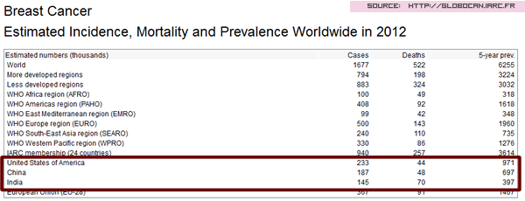

Slide 5
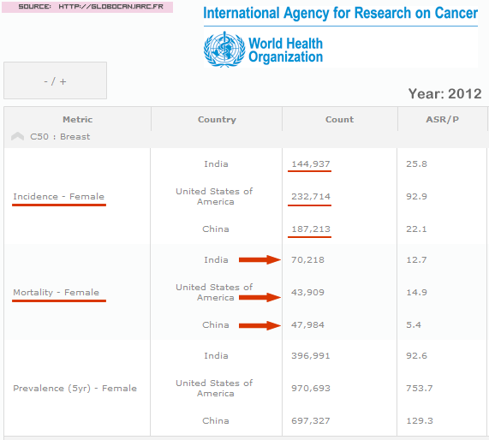

Slide 6
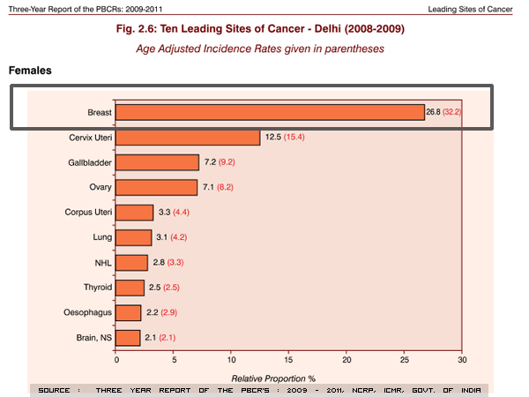

Slide 7
?
Why is the mortality so high?
more patients turn up in later stages.
What are the reasons for late presentations?
lack of awareness,
shyness on part of patients,
social stigma,
ignorance of doctors
So what do we learn today?

Slide 8
WHO prediction for breast cancer in India
For the years 2015, there will be an estimated 1,55,000 new cases of breast cancer and about 76000 women in India are expected to die of the disease. The gap only seems to be widening, which means, we need to work aggressively on early detection.

Slide 9
RISK FACTORS

Slide 10
Three main groups:
Major
Intermediate and
Minor

Slide 11
Major risk factors
Gender
100 times more common in women than in men.
Age
Very rare before the age of 20 and rare below 30 years.
The incidence of breast cancer doubles every 10 years until the menopause.
Previous breast cancer
Family history and genetic predisposition

Slide 12
Intermediate risk factors
Diet and alcohol intake
Endocrine factors
Increased duration of exposure to endogenous estrogens.
Early age of menarche (age< 12), late age of menopause (> 55), and late age at first pregnancy (> 30),nulliparity,HRT,OCPs.
Lifetime number of menstrual cycles.
Irradiation

Slide 13
Minor and controversial risk factors
Body size
Stress

Slide 14
Genetics of breast cancer
BRCA 1
BRCA 2

Slide 15
BRCA-1 is located on chromosome 17q.
BRCA-1–associated breast cancers are invasive ductal carcinomas, are poorly differentiated, and are hormone receptor–negative.
BRCA-2 is located on chromosome 13q .
BRCA-2–associated breast cancers are invasive ductal carcinomas, are well differentiated and express hormone receptors.

Slide 16
PATHOLOGY

Slide 17
Why?
Paramount importance in establishing the diagnosis of the tumour.
It also helps determine the patient's prognosis
There are many methods of pathologically classifying breast cancer; most are based on whether the tumour is invasive or non-invasive and whether it is derived from the duct system or the lobule.

Slide 18
Ductal carcinoma of the breast
Most common form of breast cancer accounting for 85 to 90 per cent of all cases.

Slide 19
Lobular carcinoma of the breast
subdivided into in situ and invasive forms

Slide 20
Clinical scenarios

Slide 21
A 38 years old lady (with a history of breast cancer in her sister) presented with a 4 cm lump in her right breast which turned out to be a cancer and had a few enlarged axillary nodes. She had noticed the lump only a few months back. However, on evaluating all past records, doctor found one mammogram done 2 years back (was advised by her gynecologist), just for screening; she did not have any lump or other symptom then. In that mammogram, there was a small area of stippled microcalcification, which was very suspicious (Stippled microcalcifications are pathognomonic for cancer) . The radiologist had also mentioned it in the report. But since there was no palpable lump, her gynecologist told her, not to worry. She didn't do anything for that for the next 2 years, and finally, was detected with cancer in the same site, in a minimum of clinical stage 2B. Finally after surgery, 5 (out of 27) nodes were positive for cancer and this placed her in stage 3A. So please understand here, the gynecologist advised the mammogram, but did not not know how to interpret or act, and the lady, who would have otherwise been detected with cancer of stage 1 and would have had more than 90% chance of 10 years survival, now ended up with stage 3A and will have about 60% chance of 5 year survival. So two years of wait have definitely decreased her life by 5 years.

Slide 22
A 32 years old lady presented with a history of heaviness in breast before the periods as well as pain in the breast for a few days before the periods. On clinical examination, breasts were normal, except for slightly engorged. Again here, her family doctor had advised her mammography (I wouldn't have advised her mammography, if at all needed, I would have gone for an ultrasound of the breast first). On the ultrasound which was done with the mammogram, there were multiple cysts of varying sizes in both the breasts, from few millimetres to 8 to 9 millimetres. She was overtly worried about cancer, and had already taken opinion from one surgeon and one gynecologist. One had advised surgery (!!) and the other had given some non specific medications. All the doctor did was to reassure her, that this was nothing to worry about (She was visibly more worried about the cancer than the symptoms of pain and heaviness she had). The doctor assured her that this was not cancer, this did not require surgery, this occurs in many women of her age - some have more symptoms while some have less symptoms, and that over a period of time, it will all settle. Gave her some symptomatic medications and some vitamin supplements and believe me, after three months, she was almost settled of symptoms and was very happy. Not that medications worked or something, but it was the re assurance that worked.

Slide 23
CLINICAL FEATURES

Slide 24
A lump
Changes in the skin may be the sole presenting symptom.
Puckering .
Peu d'orange .
Ulceration .
Nipple distortion and inversion .
A unifocal or bloodstained nipple discharge.

Slide 25
Diagnosis
Fine-needle aspiration cytology
Core biopsy
Mammography

Slide 26
TNM definitions
Primary Tumour
Tx – Primary tumour cannot be assessed
To – No evidence of primary tumor
Tis – Carcinoma in situ
T1 – Tumor 2 cm or less
T2 – 2 – 5 cm tumor
T3 – Tumor 5 cm and above
T4 – Extn. to chest wall / skin

Slide 27
Regional lymph node involvement - clinical
NX – Regional lymph nodes cannot be
assessed.
No – No regional lymph nodes.
N1 – Movable ipsilateral axillary nodes.
N2 – Fixed ipsilateral axillary nodes.s
N3 – Ipsilateral internal mammary nodes

Slide 28
Regional lymph node involvement - pathological
pNX – Regional lymph nodes cannot be assessed.
pNo – No regional lymph node metastasis.
pN1 – Movable ipsilateral axillary node metastasis.
  pN1a – Micrometastases (< 0.2 cm )
  pN1b – Metastases ( > 0.2 cm )
    i) 1 – 3 nodes
    ii) 4 or more nodes
    iii) extending beyond the capsule (< 2 cm)
    iv)Metastases to nodes ( > 2 cm )
pN2 - Fixed ipsilateral axillary nodes
pN3 – Ipsilateral internal mammary nodes

Slide 29
Distant Metastases
Mx – Distant metastases cannot be assessed.
Mo – No distant metastases.
M1 – Distant metastases ( ipsilateral
supraclavicular lymph nodes )

Slide 30
AJCC / UICC Stage grouping
St 0 - Tis No Mo
St 1 – T1 No Mo
St 2a
To N1 Mo
T1 N1 Mo
T2 No Mo
St 2b
T2 N1 Mo
T3 No Mo

Slide 31
AJCC / UICC Stage grouping
St 3a
To N2 Mo
T1 N2 Mo
T2 N2 Mo
T3 N1 Mo
T3 N2 Mo
St 3b
T4 any N Mo
any T N3 Mo
St 4
any T any N M1

Slide 32
STAGING
The Manchester system (1940)
Stage I. Tumour confined to breast. Any skin involvement covers an area less than the size of the tumour.
Stage II. Tumour confined to breast. Palpable, mobile axillary nodes.
Stage III. Tumour extends beyond the breast tissue because of skin fixation in an area greater than the size of the tumour or because of ulceration. Tumour fixity underlying fascia.
Stage IV. Fixed axillary nodes, supraclavicular nodal involvement, satellite nodules or distant metastases.

Slide 33
MANAGEMENT

Slide 34
Management of non-invasive breast cancer
Stage 0

Slide 35
LCIS
Because LCIS is considered a marker for increased risk rather than an inevitable precursor of invasive disease, the current treatment of LCIS is observation with or without tamoxifen.
The goal of treatment is to prevent or detect at an early stage the invasive cancer.
There is no benefit to excising LCIS, as the disease diffusely involves both breasts and the risk of invasive cancer is equal for both breasts. The use of tamoxifen as a risk-reduction strategy should be considered in women with a diagnosis of LCIS.

Slide 36
DCIS
Women with DCIS and evidence of widespread disease (two or more quadrants) require mastectomy.
For women with limited disease, lumpectomy and radiation therapy are recommended.
Low-grade DCIS of the solid, cribriform, or papillary subtype, which is less than 0.5 cm in diameter, may be managed by lumpectomy alone.
Adjuvant tamoxifen therapy is considered for all DCIS patients.

Slide 37
Simple mastectomy
95% cure rate
Rarely relapse, due to micro-invasive cancer
No need for axillary dissection
Wide excision alone—30% recurrence at 5 years
Wide excision + radiotherapy—15% recurrence at 5 years

Slide 38
Early Invasive Breast Cancer
Stage I, IIa, or IIb
T1–3, N0–1 tumors.

Slide 39
Treatment of the breast and axilla
Pathological staging to direct adjuvant therapy
Adjuvant therapy—endocrine, chemotherapy, radiotherapy
Follow-up

Slide 40
Breast surgery
Quadrantectomy removes the primary cancer with a margin of 2.0 cm of normal breast tissue.
Lumpectomy is the removal of the tumour mass with a limited portion of normal tissue (1 cm).
MRM

Slide 41
INDICATIONS OF BCS
T1,T2lesions, N0/N1,M0 disease.
Tumor>4cm in a large breast.
Single clinical and mammographic lesion.
Patient should be willing tomaccept the chances of recurrence.

Slide 42
CONTRA INDICATIONS OF BCS
T4,N2 Lesions
Patients choice
Multifocal/Multicentric disease
Tumor size high as compared to breast size.
Extensive calcification on mammography
Pregnancy
Persistent positive margins
Patient’s contraindication to radiotherapy.

Slide 43
Treatment of the axilla
Surgery
—sentinel node biopsy:
—removal of first node which contains secondary deposit
—use either blue dye or 99MTc colloid
—negative sentinel node avoids clearance

Slide 44
Loco-regional radiotherapy
Reduce the risk of local recurrence after BCS
Irradiation of axilla—not required if clearance performed
Radiation to axilla may cause lymphodema and brachial neuropathy

Slide 45
Adjuvant endocrine therapy
60% of breast cancers are oestrogen receptor positive
Ovarian ablation
Side-effects of tamoxifen—menopausal symptoms
—endometrial cancer, 4-fold increase in risk
LHRH agonists

Slide 46
Adjuvant chemotherapy
CMF (cyclophosphamide, methotrexate, 5FU)
Anthracycline regimes may be better
Taxanes based regimes

Slide 47
Management of locally advanced breast cancer
Stage IIIa or IIIb

Slide 48
The probability of metastatic disease is high (>70%).
A combination of neoadjuvant chemotherapy, surgery and radiotherapy is commonly used.

Slide 49
Management of metastatic breast cancer
Aim is palliation
If hormone-sensitive, bony disease—may survive years .
Visceral, ER-negative disease has bad prognosis
Usual sites—lung, liver, bone, brain
Rare sites—choroid, pituitary
Combination of endocrine therapy, chemotherapy, radiotherapy and symptomatic tt is given.

Slide 50
SENTINAL LYMPH NODE BIOPSY

Slide 51
SENTINEL NODE CONCEPT
Based on the hypothesis lymph flow is orderly, predictable & tumor cells spread sequentially
Sentinel node is the first node encountered by the tumour cells
The sentinel node is in the direct pathway of the primary tumour

Slide 52
Advantages of sentinel node biopsy
Minimally Invasive
Low Cost
low morbidity
Nodal metastasis outside axilla detected
obviates the need for ALND without compromising staging & local control

Slide 53
Disadvantages of Sentinel node Biopsy
Has a False negative rate of 6% (ALND3%)
Not useful in clinically involved axilla
Not useful in pregnancy & lactation
Cannot be done in multifocal / multicentric breast carcinomas
Cannot be done in patients with previous breast surgery on the same side

Slide 54
Technique
Blue dye isosulfan blue (or) technitium labelled colloidal albumin with gamma camera and probe can be used

Slide 55
Sub dermal injection
A single dose of 0.2 ml of the dye is injected at the tumour site sub-dermally one day prior to surgery
Peri tumour injection
Dye injected at four sites.
Larger volumes are given
Removal of dye or tracer is slower due to scanty lymph supply of breast parenchyma imaged 1 to 2 hrs after injection

Slide 56
SENTINEL LYMPH NODE DISSECTION
WITH DYE TECHNIQUE
Blue lymphatics leading to SLN are traced
Discolouration of breast and blue urine
ISOTOPE TECHNIQUE
Probe guided surgery is superior
Useful for intra-operative localisation
After removal of SLN probe is reapplied to site and radioactivity measured for confirmation

Slide 57
PIT FALLS IN SENTINEL NODE DISSECTION
6% FALSE NEGATIVE
SKIP PHENOMENON & CHANGED FLOW DIRECTION
INFILTRATION BY CARCINOMA
FATTY DEGENERATION
UPPER OUTER QUADRANT -CLOSE PROXIMITY TO SENTINEL NODE. SHINE THROUGH PHENOMENON-Breast to be retracted when probing

Slide 58
Special problems

Slide 59
SPECIAL PROBLEMS IN BREAST CANCER – PAGETS DISEASE
Rare before 30 years, peak between 50 & 60
Can occur in the male
Erythematous exudative or scaly lesion appears first on the nipple spreads to areola
Does not involve surrounding skin
Nipple retraction & nipple pigmentation & mass

Slide 60
D D for Pagets disease
Chronic Eczema
Malignant melanoma
Syphilitic chancre
Bowens disease
Mammary ductectasia

Slide 61
Mammography
Mass , sub areolar micro calcification
or only thickening of nipple areola
complex
Biopsy
Full thickness nipple biopsy or
exfoliative scrape cytology

Slide 62
PAGETS TREATMENT
1) with palpable mass- segmentectomy with 1.5 cm margin with ALND with PO-RT
2)if resection margins positive or muticentric or solid or comedo type or high grade with necrosis completion mastectomy is done

Slide 63
Pagets without palpable mass
Biopsy of nipple areola complex positive first step: On mammo no occult mass.no microcalcification—do segmentectomy of nipple areola complex +RT without axillary dissection
Mammography + ve
Stereotactic needle localisation of occult mass or microcalcification with frozen section biopsy and proceed
Tamoxifen

Slide 64
BREAST CANCER IN PREGNANCY&
LACTATION
DELAY IN DIAGNOSIS
1) firm ,nodular &hypertrophied breast
2) small tumours can be missed
3) present at advanced stage
4) high proportion of ER-ve
5) bad prognosis

Slide 65
BREAST CANCER IN PREGNANCY
Mammography
FALSE NEGATIVE rate is high due to high radiographic density of pregnant breast

Slide 66
BREAST CANCER IN PREGNANCY
Alkaline phosphatase is elevated in pregnancy
Chest X-ray is allowed with proper shielding
Bone scan
A) Stage 1 & 2-Bone mets uncommon scan not done
B)Stage 3 Especially with bone pain
Bone scan done in later stages of pregnancy or after pregnancy

Slide 67
BREAST CANCER IN PREGNANCY
Treatment
Modified Radical Mastectomy is the choice irrespective of the trimester
In the first & second trimester breast conservation with radiotherapy should not be done due to radiation induced anomalies in foetus

Slide 68
Study questions

Slide 69
A 57-year-old woman undergoes core-needle biopsy of a breast mass. The pathologic diagnosis is infiltrating ductal carcinoma of the breast.
How will you stage this cancer?
What are the important prognostic factors?

Slide 70
A 49-year-old woman presents with a breast mass. You are examining the affected breast.
◆ How would the following clinical findings affect the woman’s prognosis?
1. Red edematous breast with an underlying mass
Edema of the skin overlying the mass
Puckering of the skin overlying the mass
Retraction of the nipple
A 1.5-cm mass fi xed to the deeper tissues
A lymph node palpable in the supraclavicular area
A hard, fi xed lymph node in the ipsilateral axilla
Arm edema

Slide 71
A 60-year-old woman has breast cancer and undergoes preliminary staging. The lesion is 1.5 cm in diameter, and no axillary nodes are palpable. A metastatic workup is negative.
What stage is this woman’s cancer?
What are this woman’s surgical options, both for sampling the lymph nodes and treating the primary tumor?

Slide 72
A 38-year-old woman is scheduled for a mastectomy and sentinel node biopsy. She is concerned about her appearance and would like to know her options for breast reconstruction.
What options should you offer?

Slide 73
A 38-year-old woman presents with a 3-month history of a progressively enlarging breast mass. At the time she sees you, she has a 6- 7-cm fi xed mass, with erythema and edema on the upper, outer aspect of her right breast. Clinically, her axilla is positive with enlarged, firm lymph nodes.
What is the suspected diagnosis?
What histologic features are typical of this condition?
The surgeon confirms the physical findings and obtains a punch biopsy of the mass. Pathology reveals inflammatory carcinoma. Estrogen and progesterone receptors are negative.
What is the recommended treatment?

Slide 74
A 55-year-old woman has a modified radical mastectomy for a stage II carcinoma of the breast.
A small, 0.5-cm nodule in the suture line 5 years after surgery.
A mammographic abnormality in the opposite breast
Elevated liver function studies
A fracture of the femur

