Slide 1
BIOTERRORISM

Slide 2
Bioterrorism is the use or threatened use of a biological agent or the product of a biological agent in order to generate fear, morbidity or mortality in a population.

Slide 3
Definition
Biological warfare: Intentional use of microorganisms, and toxins, generally of microbial, plant or animal origin to produce disease and death in humans, livestock and crops.
Biological weapons/ bioweapons (BWs): Microorganisms that infect and grow in the target host producing a clinical disease that kills or incapacitates the targeted host.

Slide 4
Definition
Biological chemical weapon: produced by cultivating an organism and extracting from it the toxic material, e.g. botulinum toxin.
Strict chemical weapon: One that is produced in a chemical plant and does not involve growing a living organism, e.g. nerve gas, sarin.

Slide 5
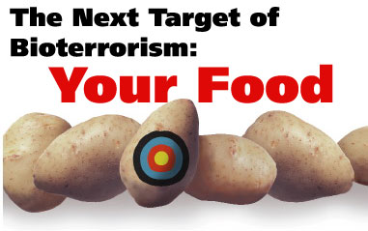
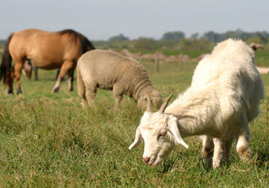
Targets
Humans (direct)
Economical (indirect)
livestock
crops
environment
viruses
bacteria
fungi

Slide 6
History of Biological Warfare
In ancient Greece, rotting animals were thrown into enemy wells.
British during the war with Indians (1763) - “as an act of good will” gave blankets used by small pox victims to the Indians.
In 1917, German govt. inoculated American horses and cattle bound for France from South America with Glanders disease.

Slide 7
History of Biological Warfare
In 1937, Japanese army experimented on prisoners with various diseases and also sprayed plague infested fleas over 11 Chinese cities.
1972- Two college youths charged for attempt to poison Chicago’s water supply with typhoid bacilli.
1981 - Origin of HIV/AIDS

Slide 8
History of Biological Warfare
Sep 1984, Rajneesh Cult, a microbiologist contaminated food with Salmonella Typhimurium in Dellas, Oregon.
After Sep. 11, 2001, mails contaminated with Anthrax spores received in New York, Washington DC and Florida

Slide 10
Evolution of chemical and biological weapons
4 phases
1st phase: gaseous chemicals were used
2nd phase: era of use of nerve agents
3rd phase: use of lethal chemical agents
4th phase: era of biotechnological revolution and use of genetic engineering

Slide 11
Characteristics of BW agent:
Low infective dose
High virulence
Short incubation period
Highly contagious
Robust and stable - rainfall, temp, humidity, atmospheric pollution, solar radiation etc.,
Consistently produce desired effect - lethal or incapacitation

Slide 12
Characteristics of BW agent:
Little immunity in target population
No prophylaxis with target population
Protection available with aggressor
Difficult to identify
Ease of production
Ease of delivery
Low persistence after delivery

Slide 13
Characteristic of a bio-terrorist attack
Victims unaware of exposure to infectious agents
Effect of the attack appears days, weeks or years after the exposure
Transmission of infectious agents from person to person through air or direct contact with body fluids
Establish an epidemic in which healthcare workers become infected themselves

Slide 14
Delivery Mechanisms
Aerosol route
Easiest to disperse
Highest number of people exposed
Most infectious
Undetectable to humans
Food / Waterborne less likely
Larger volumes required
More technically difficult
Notes:
Release of biological weapons could be accomplished in a number of ways. However, it is expected that an aerosol release is the most likely to be encountered in a large-scale bioterrorism event if the goal is to sicken or kill large numbers of people. This is because aerosols are odorless, colorless and relatively easy to disperse over vast areas, and for most of the diseases, it is the route that is most contagious and causes the most severe disease. Many of these agents could theoretically be used to target food or water supplies, however, the psychological impact would likely be more of a concern than the clinical effect because of water purification processes, dilution of infectious material into large volumes, stability of the organisms and the logistical difficulties of dispersion [2].

Slide 15
Delivery of BW
Delivered by rockets
Crop spraying by a light plane
Motor vehicle can cruise the streets of city emitting a fine spray of BW- aerosol through a fake tailpipe or other small vent.
Individual carrying a large suitcase or backpack can disperse by walking down the street.

Slide 16
Delivery of BW
Purse size perfume atomizer
Contaminated book or letter
Umbrella weapon; consists of a projectile weapon buried in the disguise of an umbrella.
Remote control devices
Robotic delivery

Slide 17
Advantages of BW agent
Easy transportation from one location to another.
Biological agents can mutate, reproduce, multiply and spread over a large geographic terrain by wind, water, insect, animal and human transmission.
Low production costs; BWs are ‘poor man’s weapons of mass destruction’ or ‘poor man’s atomic bomb’.
Little cost and space for a lab. for biological warfare

Slide 18
Advantages of BW agent
Large quantities produced in short period
Easy access to wide range of disease-producing biological agents
Non detection by routine security systems
Once released, capable of developing viable niches and maintaining themselves in environment indefinitely
Destroy an enemy while leaving his infrastructure intact as booty for the winter.

Slide 19
Disadvantages of BW agent
Difficulty in protecting workers at all stages of production, transportation, loading of delivery systems and final delivery.
Accidental release of BWs into the surrounding environment.
Many BWs are destroyed by exposure to UV light and drying. Rain may wash the agent out of the air before they reach the target.
Need special storage to maintain efficacy.
One’s own troops may be infected under the chaos of war.

Slide 20
Use of genetic engineering
Variety of potential biological weapons can be produced such as:
Organisms producing a toxin
Organisms with enhanced aerosol and environmental stability
Organisms resistant to antibiotics and vaccines
Organisms with altered antigenic structure

Slide 21
Perfect biological weapon
Highly infectious; require few organisms to cause desired effect.
Efficient dispersal, usually in the air.
Readily grown and produced in large quantities.
Stable in storage.
Resistant enough to environmental conditions so as to remain infectious long enough to affect the majority of the target.
Resistant to treatment e.g. antibiotics, antibodies, etc.

Slide 22
17 countries (CIA report, 1995) are involved in research and stockpiling germ warfare agents including Iran, Iraq, Libya, Syria, North Korea, South Korea, Taiwan, Israel, Egypt, Vietnam, Laos, Cuba, Bulgaria, India, South Africa, China and Russia.

Slide 23
BW agents
Bacteria
Viruses
Rickettsiae
Fungi
Biological toxins
Genetically altered organisms

Slide 24
Biological agents used in weaponization
Bacteria | Viruses | Fungi | Toxins
Bacillus anthracis* Yersinia pestis* Yersinia pseudotuberculosis Francisella tularensis* Clostridium botulinum* Clostridium perfringens Clostridium tetani Brucella abortus Brucella melitensis Brucella suis Rickettsia rickettsiae Coxiella burnetii Bartonella quintana Chlamydia psittaci Legionella pneumophila Burkholderia mallei Burkholderia pseudomallei Salmonella Typhi Shigella dysenteriae Escherichia coli Vibrio cholerae Campylobacter jejuni Listeria monocytogenes Staphylococcus aureus | Variola virus* Dengue virus Japanese encephalitis virus Tick-borne encephalitis virus Ebola virus Marburg virus Chikungunya virus Louping ill virus Murray valley encephalitis virus Omsk haemorrhagic fever virus Oropouche virus Powassan virus Rocio virus St. Louis encephalitis virus Rift valley encephalitis virus Crimean-Congo haemorrhagic fever virus Hantaan virus Eastern equine encephalitis virus | Coccidioides immitis | Botulinum toxin Clostridium perfringens toxin Tetanus toxin Cholera toxin Staphylococcal enterotoxin B Aflatoxin Ricin

Slide 25
Almost any pathogen can be used to intentionally spread the disease
Capable of causing mass casualties
Agents serving as potential biological weapons are not equally contagious
Differ greatly in rates of morbidity and mortality

Slide 26
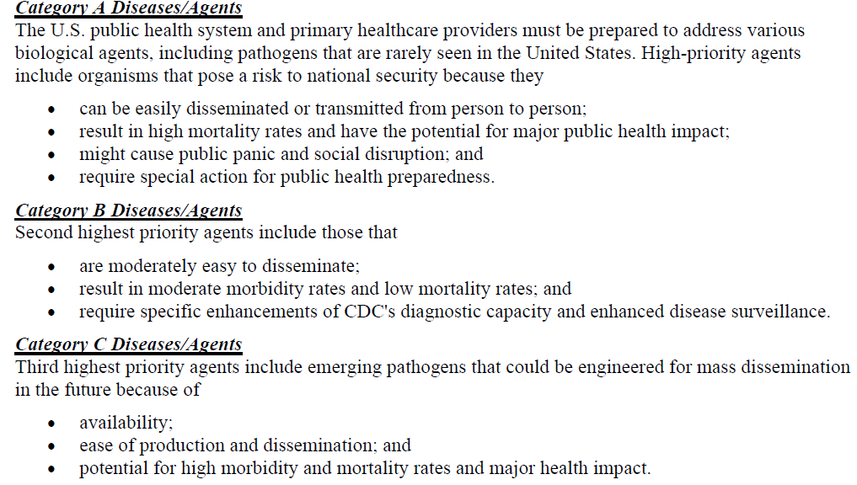

Slide 28
Smallpox virus as BW
DNA virus whose genetic code has been sequenced
Has long been used as biological warfare
WHO in 1980 declared the eradication of smallpox worldwide
Supposedly only two well guarded stocks of smallpox virus remain in world-Russian and American lab.
Korea and China also suspected of having stocks of smallpox virus.
Bulk of world’s population is susceptible to smallpox as vaccination is no longer carried out.

Slide 29
Small pox
But not buried!

Slide 30
Smallpox virus as BW
Candidate for BW because of following characteristics:
Easily cultivated and large quantity of virus could be produced in a relatively short time.
Highly infectious, spread via respiratory route. One gram affect about 100 cases and disease can become global in 6 weeks.
Mortality is 50%.
Easy to genetically engineer, making current vaccines ineffective and adding virulence factor genome to make smallpox 100% fatal.

Slide 31
Smallpox virus as BW
Extremely hardy, survive on fomites (days-weeks).
No routine vaccination, so most world’s population susceptible.
No known treatment.
Takes 2 weeks to develop immunity after vaccination.
Even vaccinated individuals not immune to genetically engineered virulent virus.
Diagnosis of smallpox can be delayed as some physicians have never seen a case of smallpox.

Slide 32
Plague
Caused by Yersinia pestis
Released as aerosols, rat fleas,
infected rats
Bubonic, pneumonic and
septicaemic
Pneumonic - man to man spread rapidly
Rat
Flea
- Vaccine - Antibiotics

Slide 33
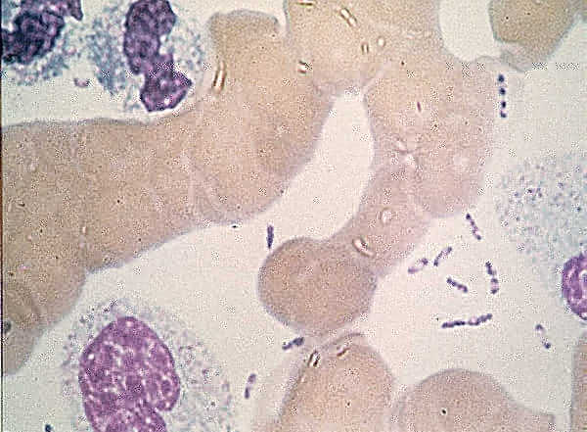
Plague
‘Safety pin appearance’
(Wayson stain)

Slide 34
Plague
Bubo of plague

Slide 35
Tularaemia
Caused by Francisella tularensis
Enzootic in many countries
10 - 50 orgs by aerial route and 100 orgs by oral route infective
Gram -ve coccobacilli,
Ulcers, lymphadenitis, septicaemia, pneumonia, 30 - 40 % fatality.
Incubation period 2 - 10 days

Slide 36
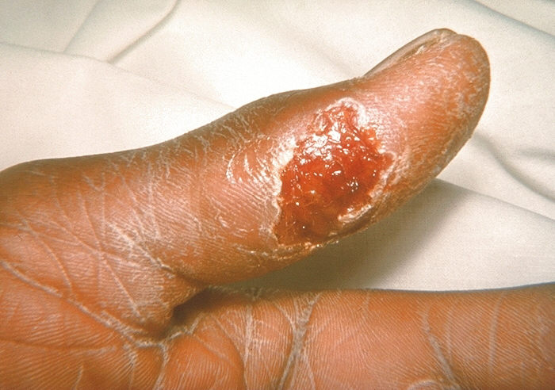
CDC/Emory University/Dr. Sellers. PHIL1344
Notes:
This photo shows the typical skin ulcer of ulceroglandular tularemia.

Slide 37
Bacillus anthracis
Naturally contracted through wounds and through inhalation of spores (high mortality rate).
Cutaneous, pulmonary and intestinal anthrax.
Rapidly fatal in 85% cases.

Slide 38
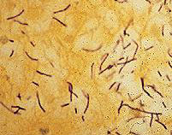
Bacillus anthracis
Lungs, meninges affected
Skin ulcers
Intestine - if meat of infected dead animals consumed
No person to person transmission
Vaccine (human) long procedure, short protection
Antibiotics

Slide 39
Anthrax
Widening of medistinum
Eschar on skin

Slide 40
Bacillus anthracis
Production of spores easy, cheap and no high technology required.
Spores have been called as ‘perfect germs’ for bioterrorism.
Extremely stable and stored indefinitely as dry powder.
Loaded in freeze dried condition and disseminated as aerosol with crude sprayers.

Slide 41
Bacillus anthracis
Lethal inhalation dose: one millionth of gram of anthrax spores.
Spores remain viable in soil for many years and renders the contaminated land unusable for non immune farm animals and man for years.
Strains of increased virulence and antibiotic resistance have been produced.

Slide 42
Bacillus anthracis
Prevention: vaccination
Treatment: antibiotics if diagnosed in time; Ciprofloxacin and Doxycycline.
Continue antibiotic treatment for 60 days as remain dormant in lung.

Slide 43
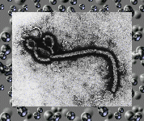
Viral Haemorrhagic Fever Group (VHF)
Ebola virus
First noticed in Sudan, Zaire in 1976
319 cases in Zimbabwe in 1995
Death in a week, connective tissue liquefies, patients ooze blood, tissue from orifices
Patients ‘twitch, shake and thrash to death’
Spread unclear

Slide 44
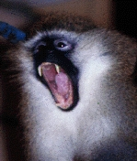
Viral Haemorrhagic Fever Group (VHF)
Marburg Virus
3 outbreaks in Africa,
1 in Germany
Spread ?Aerosol, direct contact, blood

Slide 45
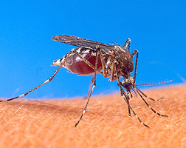
Viral Haemorrhagic Fever Group (VHF)
Hanta Virus - fever with renal complications, respiratory distress
Other viruses
Dengue, Yellow fever by bite of mosquito
Japanese Encephalitis
Argentine Haemorrhagic Fever (AHF)
Lassa fever
Crimean-Congo Haemorrhagic Fever (CCHF)

Slide 46
Botulinum toxin
Botulinum toxin (Botox)-most toxic
Minute quantities(in the dot of ‘i’) can kill 10 people.
Produced by Clostridium botulinum, obligate anaerobe.
Highly considered as biological weapon
Grow on ordinary media, tasteless and odorless.

Slide 47
Botulinum toxin
Can be absorbed through mucous membrane, so aerosol dispersal and through municipal water or food supplies.
Unstable in air, destroyed by brief boiling.
Symptoms are delayed (2-14 days), irreversible damage before victims realize what happened.
Treatment: polyvalent immune serum that prevents the toxin from binding to receptors in nervous system.
No effective vaccine

Slide 48
Clostridium perfringens
Enters through wounds
Gas gangrene
Most common agent causing food poisoning

Slide 49
Aflatoxin
Carcinogen; from molds
Induce liver cancer
Man and many animals susceptible
Can be loaded in missiles and bombs

Slide 50
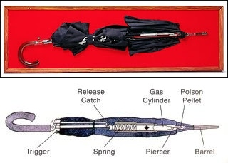
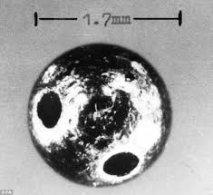
Ricin
Protein toxin extracted from castor bean plant
Used to target single individual for assassination.
BULGARIAN UMBRELLA

Slide 51
Disease | Causative agent | Clinical features | Diagnosis | Treatment | Prevention | Infection control
Anthrax | Bacillus anthracis | Flu like symptoms, eschar formation, GI symptoms | High index of suspicion, Blood and fluid culture, PCR, Special stain, Serology | Ciprofloxacin, doxycycline | Inactivated cell free vaccine | Standard precautions BSL-2: Clinical specimen and BSL3 for environmental samples
Smallpox | Variola virus | Scarring skin lesions, Papules, pustules | Clinical, Electron microscopy, PCR, RFLP | Antivirals not effective, Supportive care | Vaccine, VIG, Cidofovir | Isolation of cases
Tularemia | F. tularensis | Ulceroglandular, eye, respiratory, oropharynx involvement | High index of suspicion, culture, PCR, Serology | Supportive care, Aminoglycosides, Tetracyclines, Chloramphenicol, Ciprofloxacin | Live attenuated vaccine | Standard precautions, Pure culture handling hazardous, BSL-2 handling

Slide 52
Disease | Causative agent | Clinical features | Diagnosis | Treatment | Prevention | Infection control
Botulism | C. botulinum | Flaccid paralysis, cranial nerve palsies, GI symptoms | High index of suspicion, Clinical, Blood and stool culture, ELISA | Supportive care | Passive immunization with antitoxin, Botulinum toxoid | No person to person transmission, standard precautions
Plague | Y. pestis | Pneumonic, bubonic, septicemic | High index of suspicion, Culture, PCR, Serology | Aminoglycosides, Tetracycline, FQs, Chloramphenicol | No vaccine | Isolation of cases, Specimen processing in BSL3
Viral hemorrhagic fevers | Ebola, Marburg, Lassa, yellow fever, DHF etc. | Fever, myalgias, bleeding diathesis | High index of suspicion, Clinical, Culture for blood, PCR | Supportive treatment, Ribavirin useful in some. | Vaccine available for yellow fever | Strict isolation, Handle samples in BSL4

Slide 53
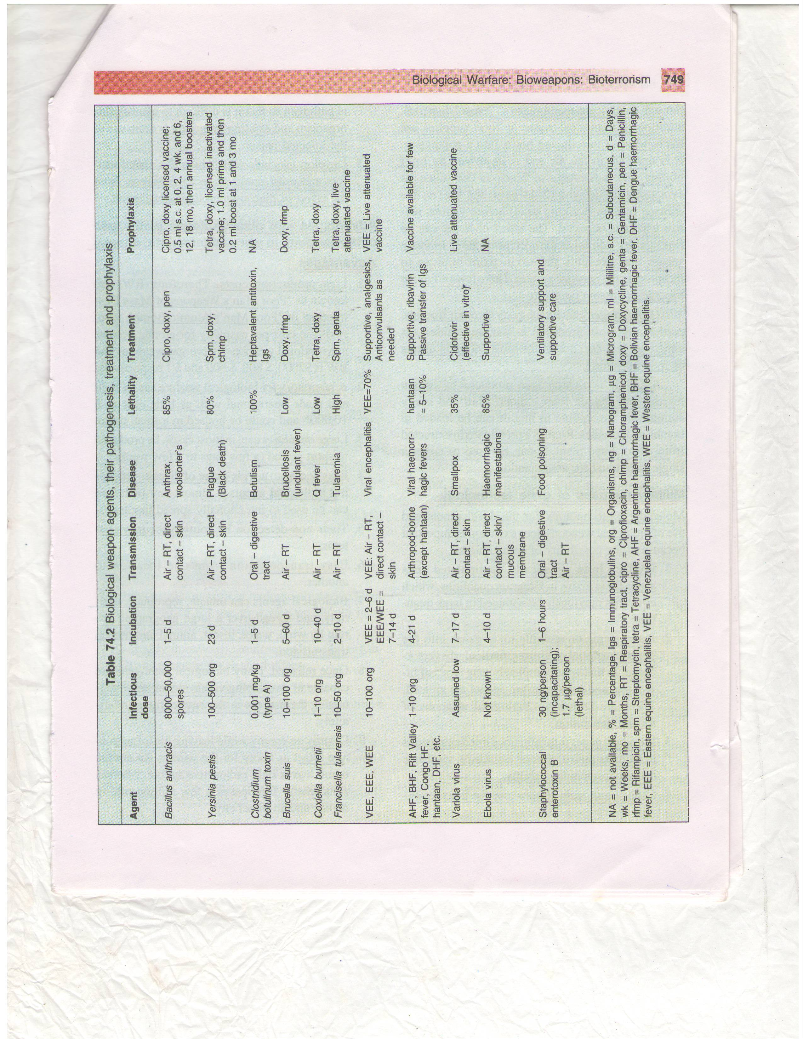

Slide 54
Epidemiological clues of BW attack
Presence of large epidemic with similar disease or syndrome, especially in discrete population
Many cases of unexplained death or disease
More severe disease than usually expected for a specific pathogen or failure to respond to standard therapy.
Unusual routes of exposure for a pathogen
Disease is unusual for a given geographical area or transmission season.
Disease normally transmitted by a vector that is not present in the local area.
Single case of disease by an uncommon agent(smallpox, viral hemorrhagic fevers)
Disease that is unusual for an age group.

Slide 55
Epidemiological clues of BW attack
Unusual strains or variants of organisms or antimicrobial resistance patterns different form those circulating.
Similar genetic type among agents isolated from distinct sources at different times or locations
Higher attack rates in those exposed in certain areas, such as inside a building.
Disease outbreaks of the same illness occurring in the non contiguous areas.
A disease outbreak with zoonotic impact
Intelligence of a potential attack, claims by a terrorist or aggressor of a release, discovery of munitions or tampering.

Slide 56
Response to a bioterrorist attack
Timely surveillance
Clinician awareness of syndromes of BW
Epidemiological investigation
Precise and early Laboratory diagnosis
Good communication

Slide 57
Early recognition & reporting
‘First responders’ are the public health and medical communities
General Practitioners and local health authorities
Syndromic approach
Establish good communication system and electronic networking

Slide 58
Establishment of Labs
Nuclear and CW require separate specialized centers
Specialized equipment, trained personnel for detection
For BW agents no separate establishment needed
Existing hospital labs require strengthening with equipment and minimum training

Slide 59
Laboratory Response Network(CDC)
Different level of laboratories
Level A
Level B
Level C
Level D

Slide 60
Specimen collection ...
General precautions
Personal protection measures
Safe handling of Blood as for HIV
Vaccination, if available (HBsAg)
Samples in leak proof screw cap containers
Autoclave / Incineration of waste

Slide 61
Specimen collection ...
Environmental samples (Bacteria)
Air
Centrifugal Air sampler for plates
Bacterial culture on Trypticase Soy agar
Water
Membrane filtration
Bacterial Culture of membrane

Slide 62
Specimen collection ...
Environmental samples (Bacteria)
Anthrax powders’ in periphery
Avoid opening of suspected letters in open
Gloves and masks (moistened)
Not under a fan or near window, closed room
None else in room, hold breath while opening
Scissors to gently cut open letters, ‘peep’ for suspicious powders. If present quickly seal and send to Ref lab.

Slide 63
Specimen collection ...
Patient samples
Syndromic approach
Two samples preferred - one of bacterial agents, one for viral agents
Respiratory Syndrome
Suspected organism
Samples
B. anthracis
Y. pestis
Fr.tularensis
C. burnetti
Adenoviruses
Sputum
Throat washings
Blood for culture (5 ml)

Slide 64
Specimen collection ...
Fever syndrome...
Fever with altered sensorium
Suspected Samples
organisms
JE Virus Blood / serum
Eastern /Western CSF
equine encephalitis
Yellow fever

Slide 65
Specimen collection ...
Fever syndrome...
Fever with hemorrhages
Suspected Samples
organisms
Yellow fever Blood / serum
Dengue Hemorrhagic fever CSF
Lassa fever Lung washing
Ebola, Marburg

Slide 66
Specimen collection ...
Fever syndrome...
Fever with rash
Suspected Samples
organisms
Small pox Blood / serum
Buffalo pox CSF
Rubella Vesicular fluid
Rickettsiae

Slide 67
Specimen collection ...
Jaundice
Suspected Samples
organisms
Hep A virus Blood / serum
Hep E virus Stool
Yellow fever

Slide 68
Specimen collection ...
Other specimen
Viscera from autopsy material
including
Brain
Liver
Kidney
Transported in Viral Transport medium

Slide 69
Transport of specimen
Packing
Leak proof container, sealed
Packed with absorbent cotton
Second leak proof container, sealed
‘Biohazard’ sign on outer pack
Cold chain enroute
Transport
Personal courier
Airlines / Courier companies likely to refuse

Slide 70
National Labs
DRDE
NICD
NIV
NICED
WHO
Other International Agencies

Slide 71
Roles of Clinicians
General Concepts
High level of suspicion
Unusual epidemiologic trends
Case clustering
Severe, fulminant disease in otherwise healthy
Unusual for the region
Similar disease in animals
Notes:
As the first responders in this new kind of terrorism, clinicians played a critical role during the 2001 outbreak of anthrax related to contaminated letters [3]. Because of this new threat, all physicians who might see patients at the first presentation of a bioterrorism-related illness should be able to recognize, manage and report such diseases. There are a couple of concepts that are important for the recognition of any bioterrorism event, regardless of the etiology. First, a reasonably high level of suspicion is needed to keep bioterrorism-related illnesses in the differential diagnosis because most of the likely agents are rare, or non-existent as naturally-occurring diseases. The old adage of “When you hear hoofbeats, think horses instead of zebras” needs to be amended to say “…think horses but don’t forget to consider the zebras”. Secondly, physicians should be conscious of any unusual epidemiologic trends that might suggest a biological weapons release or a naturally emerging infectious disease. For example, an unusual clustering of cases in a geographic area or among persons with common exposures should raise suspicion. Other red flags include a large number of otherwise healthy people presenting with severe disease, the identification of diseases that are typically not found in the geographic area, and a sudden increase in sick or dead animals, as many of the potential bioterrorism-associated diseases are zoonoses [4].

Slide 72
Roles of Clinicians
For specific Bioterrorism (BT) diseases
Recognize typical BT disease syndromes
Perform appropriate diagnostic testing
Initiate appropriate treatment/prophylaxis
Report suspected cases to proper authorities
1) Local health department
2) Hospital epidemiologist
3) Infectious Disease consultants
Notes:
Clinicians should be able to recognize the typical disease syndromes that would be encountered for the Category A diseases [2] and know how to make a preliminary diagnosis. Physicians should also know how to appropriately treat and provide post-exposure prophylaxis for each of the major pathogens. Finally, it is vital that all physicians know how to immediately report any suspected bioterrorism-related illnesses to the appropriate authorities. Generally this will be the local and/or state health departments, as well as the hospital epidemiologist, infectious disease consultants and infection control specialists. The local health departments will be able to provide information on specific samples needed for appropriate diagnostic tests [5].

Slide 73
BW and International Laws
Geneva Protocol (1928)
“ Protocol for the Prohibition of the Use in War of Asphyxiating, Poisonous or other Gases and of Bacteriological Methods of Warfare”
Signed on 17 Jun 1928, 108 State parties including India
Obsolete

Slide 74
BW and International Law
Biological Weapons Convention (1972)
‘Convention on the Prohibition of the Development, Production and Stockpiling of Bacteriological (Biological) and Toxin Weapons and on their destruction’
Signed 10 Apr 1972, in force from 26 Mar 75,
103 State parties

Slide 75
BW and International Law
US antiterrorism and Effective Death penalty Act, 1996
-Restricts interstate transfer of infectious material in USA

Slide 76
BW and International Law
Bioterrorism Act of 2002, US senate
- Essential element of national preparedness against bioterrorism and focus is on the safety of drugs, food and water from biological agents.

Slide 77
PREVENTION

Slide 79
Preventive measures
Full international cooperation
Educate likely target populations
Coordinate the monitoring of potential procedures and biological warfare
Use of gas masks
Decontamination foam, best first response to chemical and biological attack.
Stockpile biological warfare fighting supplies

Slide 80
Preparedness is always beneficial. The defenders have to be lucky at all the time, but the destroyers have to be lucky just once

