Slide 1
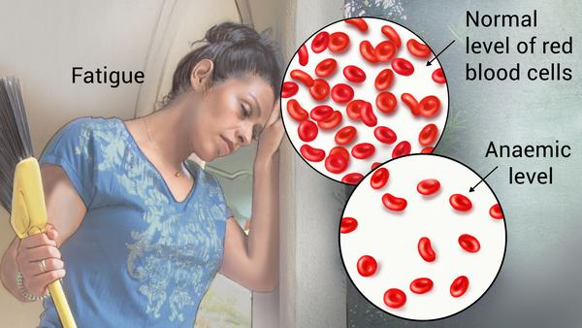
Anemia
By: Dr Sunita Mittal

Slide 2
Learning Objectives
What is anemia
What are symptoms and signs of anemia
What is classification and different types of anemia
What are causes of different types of anemia

Slide 3
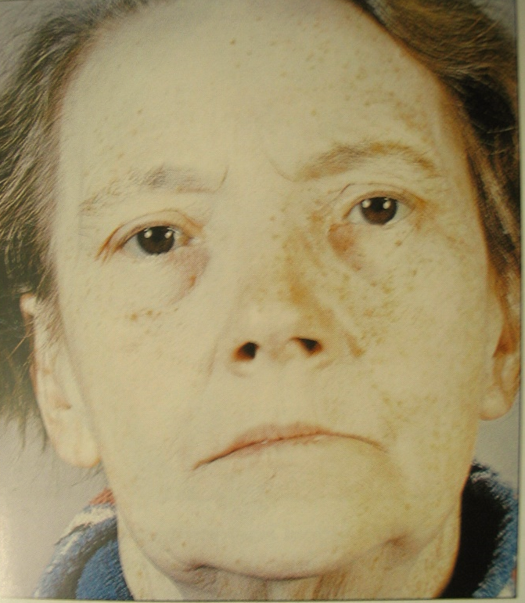
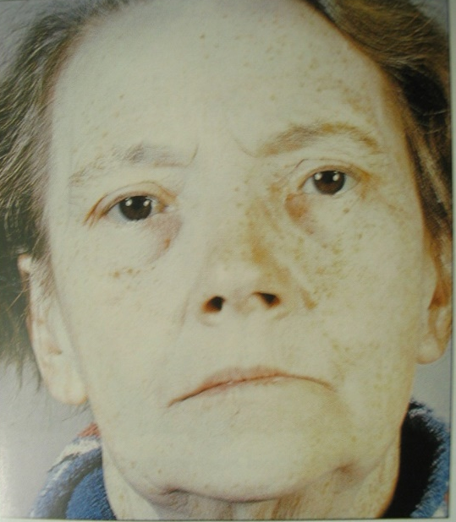
Anaemia
Significant reduction (at least 10 %) in circulating red cell mass or their hemoglobin content appropriate for the age and sex, leading to corresponding decrease in the Oxygen - carrying capacity of blood.
WHO criteria - Hb < 13 gm/dl in men & Hb < 12 gm/dl in women
Normal Appearance
Pallor due to Anemia

Slide 4
Grades of Anaemia

Slide 5
Approach to diagnosis for a case of anemia- Understanding Anemia
What are patients complaints- (Symptoms)
What are findings in patients on examination- (Signs)
Probable diagnosis of anemia
Investigations – RBCs count, Hb esti. and PCV –
Hematological Indices to reach to near the diagnosis
- Specific tests for final diagnosis

Slide 6
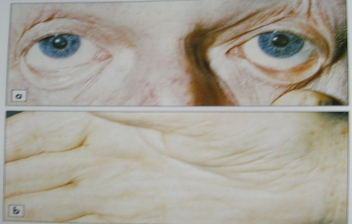
Presentation of Anemia
What are patients complaints- (Symptoms)
What are findings in patients on examination- (Signs)
In anemia, body lacks oxygen, so following signs & symptoms may be experienced:

Slide 7
Decreased Red Cell Production- Nutritional Deficiency- Iron Deficiency
Fe++ is required for Heme Synthesis (↓ Haemoglobin)
Causes of Iron deficiency anemia:

Slide 8
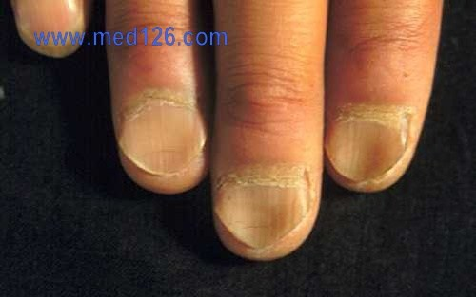
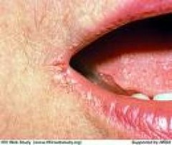
Decreased Red Cell Production- Nutritional Deficiency- Iron Deficiency
Clinical Features:
During Early Phase- General for anemia
Iron Therapy :

Slide 9
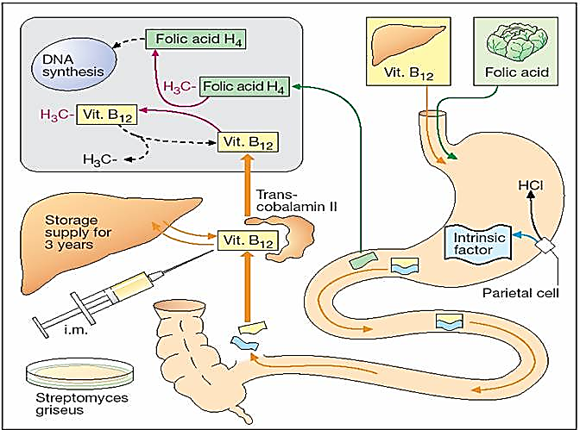
Decreased Red Cell Production- Nutritional Deficiency- Maturation factors Deficiency
(Megaloblastic Anaemia)
Pathophysiology

Slide 10
Causes:

Slide 11
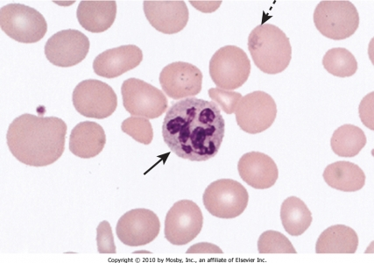
Megaloblastic anaemia
Clinical feature:
Management/Treatment:

Slide 12
Decreased Blood Cells Production - Dysplastic / Aplastic Anaemia
Bone marrow is the site of Blood cells production
Causes:
Primary
Secondary

Slide 13
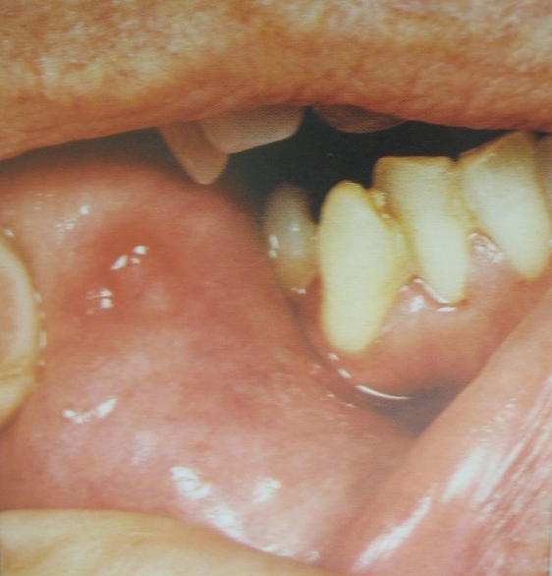
Dysplastic /Aplastic Anaemia
Presentation-
Management-

Slide 14
Decreased Red Cell Production - Anaemis of chronic disease
Pathophysiology
Causes

Slide 15
Decreased Red Cell Survival - Hemolytic anemia-Intracorpuscular Defect-Hereditary Disorders
Pathophysiology
Causes

Slide 16
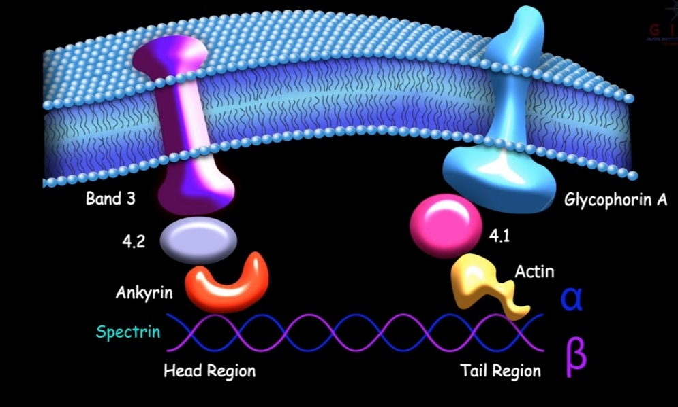
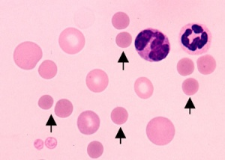
Decreased Red Cell Survival - Hemolytic anemia-
Hereditary Spherocytosis
Pathophysiology -

Slide 17
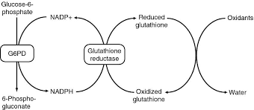
Decreased Red Cell Survival - Hemolytic anemia-
Glucose-6-PO4 – Dehydrogenase Deficiency
Pathophysiology

Slide 18
Decreased Red Cell Survival - Hemolytic anemia-
Globin chain Synthesis abnormality-
Most common of haemoglobinopathies- Sickle Cell Anaemia
Thalassemia

Slide 19
Decreased Red Cell Survival - Extra corpuscular Hemolytic Anemia
-Acquired disorder-Nonimmune hemolytic anemias
Chemicals and drugs -
Animal venoms –
Infectious agents –
Caused by physical injury to RBCs

Slide 20
Decreased Red Cell Survival - Extra corpuscular Hemolytic Anemia
-Acquired disorder-Immuno hemolytic anemias
Autoimmune hemolytic anaemia (AIHA) :
▪ Warm antibody hemolytic anemia -▪ Cold antibody hemolytic anemia

Slide 21
Decreased Red Cell Survival - Extra corpuscular Hemolytic Anemia
-Acquired disorder-Immuno hemolytic anemias

Slide 22
Decreased Red Cell Survival - Post hemorrhagic anemia
Acute blood loss anemia, also called hemorrhagic anemia, occurs due to acute hemorrhage (bleeding).

Slide 23
Self Assessment
Significant reduction (at least 10 %) in circulating …………or their ……………………appropriate for the age and sex, leading to corresponding decrease in the …………………………of blood.
WHO criteria - Hb < ……. gm/dl in men & Hb < ……. gm/dl in women.
……………………………….type of Anemia includes Iron deficiency, Thalassemia, lead poisoning
MCV-……………the causes include Vit B₁₂ and/or Folic acid Deficiency
Chronic blood loss leads to…………………………………………………………………
................................................. anemia is a type of megaloblastic anemia there is decreased availability of IF
Tuberculosis may cause anemia ……………………………………………………….

Slide 24
Thank you

