Slide 1
Cardiovascular system
Dr. Arun Goel
Associate professor
Department of Physiology

Slide 2
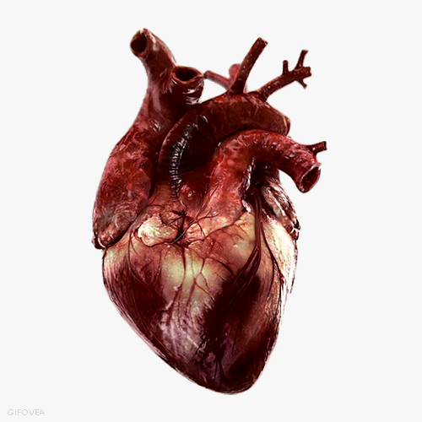
Cardiovascular system

Slide 3
Introduction
Need of circulatory system
Components of circulatory system
Type of pump
Primary & secondary roles

Slide 4
Cardiovascular system of mammals
Systemic circulation
General Plan
Pulmonary circulation
RV RA
LV LA
System of vessels that carry blood
The force for movement of blood is provided by heart
Two major loops of flow : systemic circulation and pulmonary circulation
Components
4 chambered heart
Arteries
Capillaries
Veins

Slide 5
Morphology of heart
The average adult human heart is about 12 cm from base to apex, 8 – 9 cm wide at its broadest transverse diameter and 6 cm anterioposteriorly.
The weight of the heart is about 300 g in males and 250 g in females
Double layered pericardial layer containing fluid allow contractile motion of the heart without friction
The atrium myocardium is electrically separate from the ventricular myocardium by fibrous tissue

Slide 6
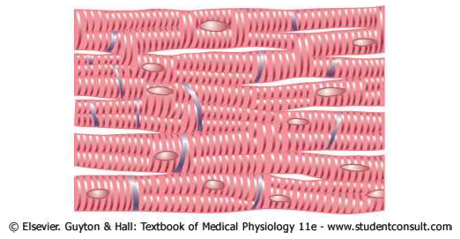
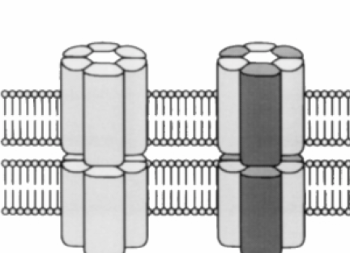

Slide 7
Functional features of the heart
Pump the blood
Maintain unidirectional flow
Generate high pressure
Separation of pulmonary circulation
Modify the function as per specific requirements of circulation

Slide 8
Functional Organization of the heart
Heart as a set of two functional pumps

Slide 9
Right pump
Components
Right atrium and Right ventricle
Input : vena cava
Output : pulmonary artery
Valves :
  Vena cava and Right atrium
  Right atrium and Right ventricle
  Right ventricle and pulmonary artery
Thickness of right ventricle wall : 3 -5 mm
Pressure generated : 25 mmHg during systole

Slide 10
Left pump
Components
left atrium and left ventricle
Input : Pulmonary vein
Output : Aorta
Valves :
  Pulmonary vein and Left atrium
  Left atrium and Left ventricle
  Left ventricle and Aorta
Thickness of ventricle wall : 9 mm
Pressure generated : 120 mmHg during systole

Slide 11
Relative position of different chambers and valves

Slide 12
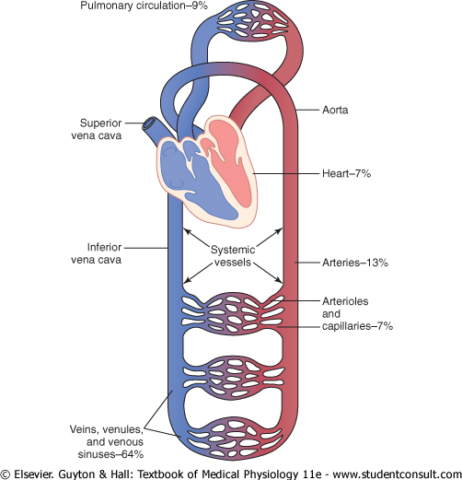
Distribution of blood in circulation

Slide 13
Functional aspects of cardiovascular system
Changing metabolic needs
Integration with other systems
Safety margin or physiologic reserve
Pathology resulting in diseases

Slide 14
Functional aspects of cardiovascular system
Intermittent cardiac output but continuous flow to tissues
Dampening of pulsatile arterial flow at capillary level
Inverse Relation of cross-sectional area with velocity of blood flow

Slide 15
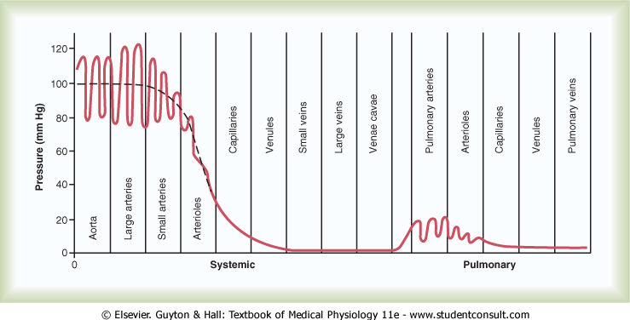
Pressures in circulatory system

Slide 16
Thank You

